Slide 1
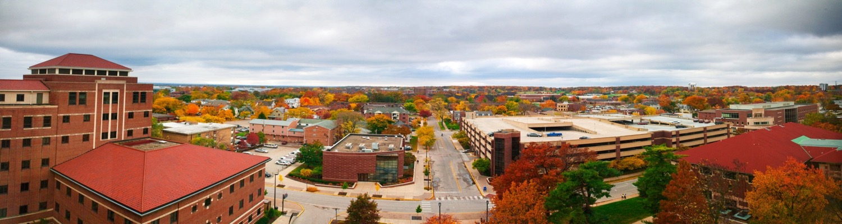

4th workshop: promoting open science
Research Data Management Funder Policies in the United States and a University's Call to Action – February 28, 2017 – Kyoto University
Michael Witt
Head, Distributed Data Curation Center
Associate Professor of Library Science
http://www.lib.purdue.edu/research/witt
E-mail: mwitt@purdue.edu

Slide 2
Purdue University
Research extensive (R1) public, land grant university in Indiana, USA
Founded 1869
~40,000 students
~10,000 graduate students
~9,000 international students
~2,000 tenure-track faculty
Colleges of Agriculture, Education, Engineering, Health & Human Sciences, Liberal Arts, Management, Pharmacy, Technology, Science, and Veterinary Medicine
US News & World Report Top 20 public university in the United States
$393,507, 563.88 (¥44 billion) in research and sponsored programs (FY 2015-2016)

Slide 3
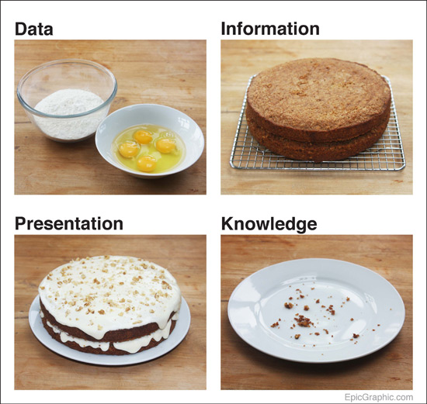
Data = Evidence
http://epicgraphic.com/data-cake

Slide 4
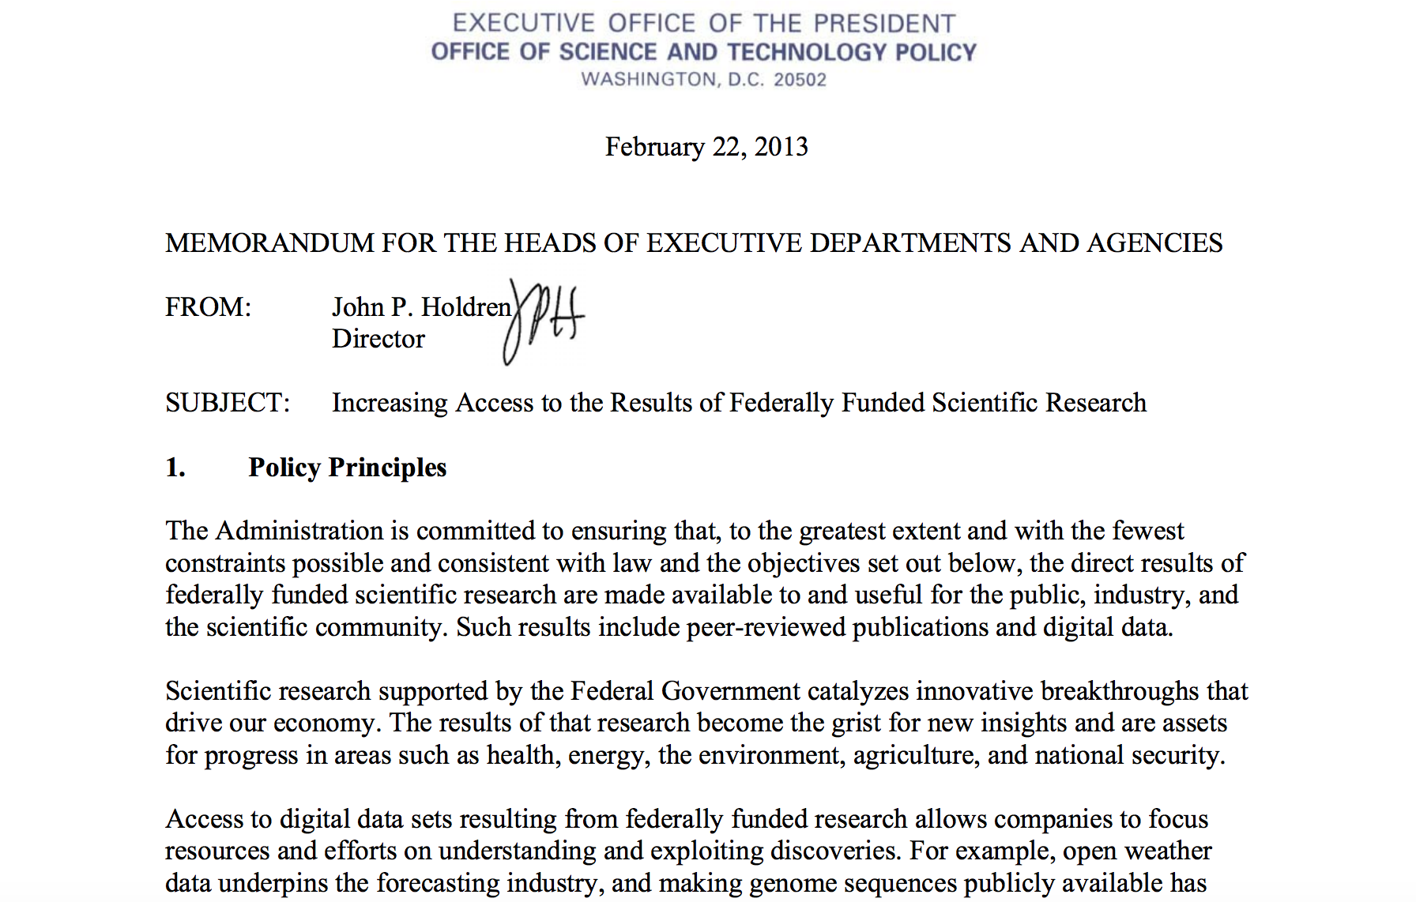

Slide 5
OSTP: Objectives for data
Maximize open access to data (with protections) balancing value and cost
Require data management plans with proposals
Permit data management costs in grant budgets
Ensure review of data management plans
Include mechanisms for compliance
Promote deposit of data in public data repositories
Encourage cooperation with private sector to improve data access and compatibility
Facilitate identifiers and attribution for data
Support training and workforce development for data management
Assess long-term preservation needs and options for development and sustainability of repositories
Increasing Access to the Results of Federally Funded Scientific Research, https://obamawhitehouse.archives.gov/sites/default/files/microsites/ostp/ostp_public_access_memo_2013.pdf

Slide 6
Navigating Agency requirements
open government
public access plan
implementation:
publications / data
intramural
extramural
data management plans

Slide 7
U.S. federal agencies
Public Access Plans
Department of Commerce
National Institute for Standards and Technology (NIST)
National Oceanic and Atmospheric Administration (NOAA)
Department of Defense (DOD)*
Department of Education (ED)*
Department of Energy (DOE)
Department of Health and Human Services
Administration for Community Living (ACL)*
Agency for Healthcare Research and Quality (AHRQ)*
Assistant Secretary for Preparedness and Response+ (ASPR)
Centers for Disease Control and Prevention (CDC)
Food and Drug Administration
National Institutes for Health (NIH)
Department of Homeland Security*
Department of Transportation (DOT)
Department of Veteran’s Affairs (VA)
Environmental Protection Agency (EPA)*
Institute of Museum and Library Services+
National Aeronautics and Space Administration (NASA)
National Endowment for the Humanities+
National Science Foundation (NSF)
Office of the Director of National Intelligence (ODNI)*
Smithsonian Institution
United States Agency for International Development (USAID)
U.S. Department of Agriculture (USDA)*
U.S. Geological Survey (USGS, Department of Interior)
+ Not mandated
* Not fully implemented yet
CENDI, Implementation of Public Access Programs in Federal Agencies, https://www.cendi.gov/projects/Public_Access_Plans_US_Fed_Agencies.html

Slide 8
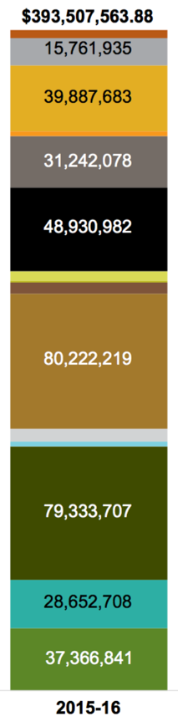
Purdue research awards 2015-16
$80.2M = National Science Foundation (NSF)
$79.3M = Non-federal industry or foundations
$48.9M = Health and Human Services (NIH)
$39.8M = Department of Defense (DOD)
$37.3M = State or local sponsors
$31.2M = Department of Energy (DOE)
$28.6M = Purdue Research Foundation
$15.7M = U.S. Department of Agriculture (USDA)
$32.5M = Other
Purdue Data Digest, https://www.purdue.edu/datadigest

Slide 9
Purdue research awards 2015-16
$80.2M = National Science Foundation (NSF)
$79.3M = Non-federal industry or foundations
$48.9M = Health and Human Services (NIH)
$39.8M = Department of Defense (DOD)
$37.3M = State or local sponsors
$31.2M = Department of Energy (DOE)
$28.6M = Purdue Research Foundation
$15.7M = U.S. Department of Agriculture (USDA)
$32.5M = Other
Purdue Data Digest, https://www.purdue.edu/datadigest

Slide 10
1. Data management plans: NSF
2-page data management plan (DMP) required with all proposals since January 2011
Funded researchers are “expected to share … primary data” per AAG Chapter VI.D.4
Per GPG Chapter II.C.2.j, DMP should address:
What data will be generated
Standard formats and content of data and metadata
Access and sharing (including protections for privacy, confidentiality, security, IP, etc.)
Policies for reuse
Archiving plan
Directorates, divisions, and individual programs may have additional requirements or guidance
Deposit data in “an appropriate repository”

Slide 11
2. Data management plans: NIH
Data sharing plans have been required since October 2003 for grant awards over $500,000/year in direct costs
Not reviewed as part scientific merit
To be expanded into data management at all funding levels in the future
“Protecting confidentiality and personal privacy are paramount” and “NIH expects that the data will be shared at the time of acceptance for publication” per Plan for Increasing Access to Scientific Publications and Digital Scientific Data from NIH Funded Scientific Research
Specific policies exist for genomic data and human subjects data, policy for sharing summary-level data for clinical trials expected
No repositories specified at the agency level; however, many specific funding programs designate repositories, NIH Data Sharing Policies

Slide 12
3. Data management plans: DOD
Not yet implemented – public access plan issued February 2015,
Two-year “rule-making” process including public comment
Proposes data be made available at time of article publication
Data that are not approved for public use will not be included
Proposes voluntary pilot for intramural research in 2016
Proposes mandatory DMP for intramural and extramural research later in 2017…?
Proposes using decentralized, public repositories with central data catalog (metadata) to be maintained by Defense Technical Information Center (DTIC)

Slide 13
4. Data management plans: DOE
“All research activities funded by DOE sponsoring offices must include a DMP” since October 2015, DOE Policy for Research Data Management
Share and preserve data “to the greatest extent, with the fewest constraints” weighing the costs and benefits
DMPs must address:
Whether and how data will be shared and preserved as well as how data can be used to validate results
Make data available and cited at time of publication of article
Consult and reference resources to be used (e.g., facility)
Protections for confidentiality, IP, security, etc.
Suggested elements of DMP are: Data Types and Sources, Content and Format, Data Sharing and Preservation, Protection, and Rationale
Additional requirements can be made by sponsoring office, program, and solicitation
Some centralized DOE user facilities, otherwise decentralized

Slide 14
5. Data management plans: USDA
Partially implemented, e.g., National Institute of Food and Agriculture 2-page DMP requires:
Expected data type
Format
Storage and preservation
Data sharing and public access
Roles and responsibilities
Monitoring and reporting
Overall agency to require DMPs by the end of 2017 per Implementation Plan to Increase Public Access to Results of USDA-funded Scientific Research
Will maintain a data catalog of metadata and pointers to datasets
Options being evaluated including a central department data repository, a federation of federal agency repositories, and/or distributed public/academic/disciplinary repositories
Ag Data Commons in beta testing
Implementation anticipated later this year…?

Slide 15
Where to keep research data?
Is a reputable repository available?
Recognized by your community, endorsement, certified, listed in re3data.org
Will the repository take the data you want to deposit?
Collection policy, format
Will the data be safe in legal terms?
Human subjects, health information, student data, government controlled,
Terms of deposit – intellectual property, transfer of rights
Will the repository sustain the data value?
Publishes metadata, persistent identifiers, metadata harvest and discovery
Preservation plan, format validation, fixity, antivirus, context information, continuity, versioning
Will the repository support analysis and track data usage?
Tracks citations and reports usage, Digital Object Identifiers (DOIs)
Whyte, A. (2015). ‘Where to keep research data: DCC checklist for evaluating data repositories’ v.1.1 Edinburgh: Digital Curation Centre. Available online: www.dcc.ac.uk/resources/how-guides

Slide 16
Campus Collaboration
Purdue University Research Repository (PURR)
The PURR service is a collaborative effort of the Purdue University Libraries, Executive Vice President for Research and Partnerships, and Information Technology at Purdue. PURR is a designated university core research facility.
Designated community:
Purdue University faculty, staff, and graduate student researchers; their collaborators; and the current and future consumers of their research data.
Based on the HUBzero Platform for Scientific Collaboration software

Slide 17
http://purr.purdue.edu

Slide 18
Motivations for purr
Research office = more competitive proposals and compliance with funder requirements
Information technology = research computing expertise, e.g., storage engineering, HPC
Libraries = long-term stewardship and access to data as a part of the scholarly record, library and information science expertise

Slide 19
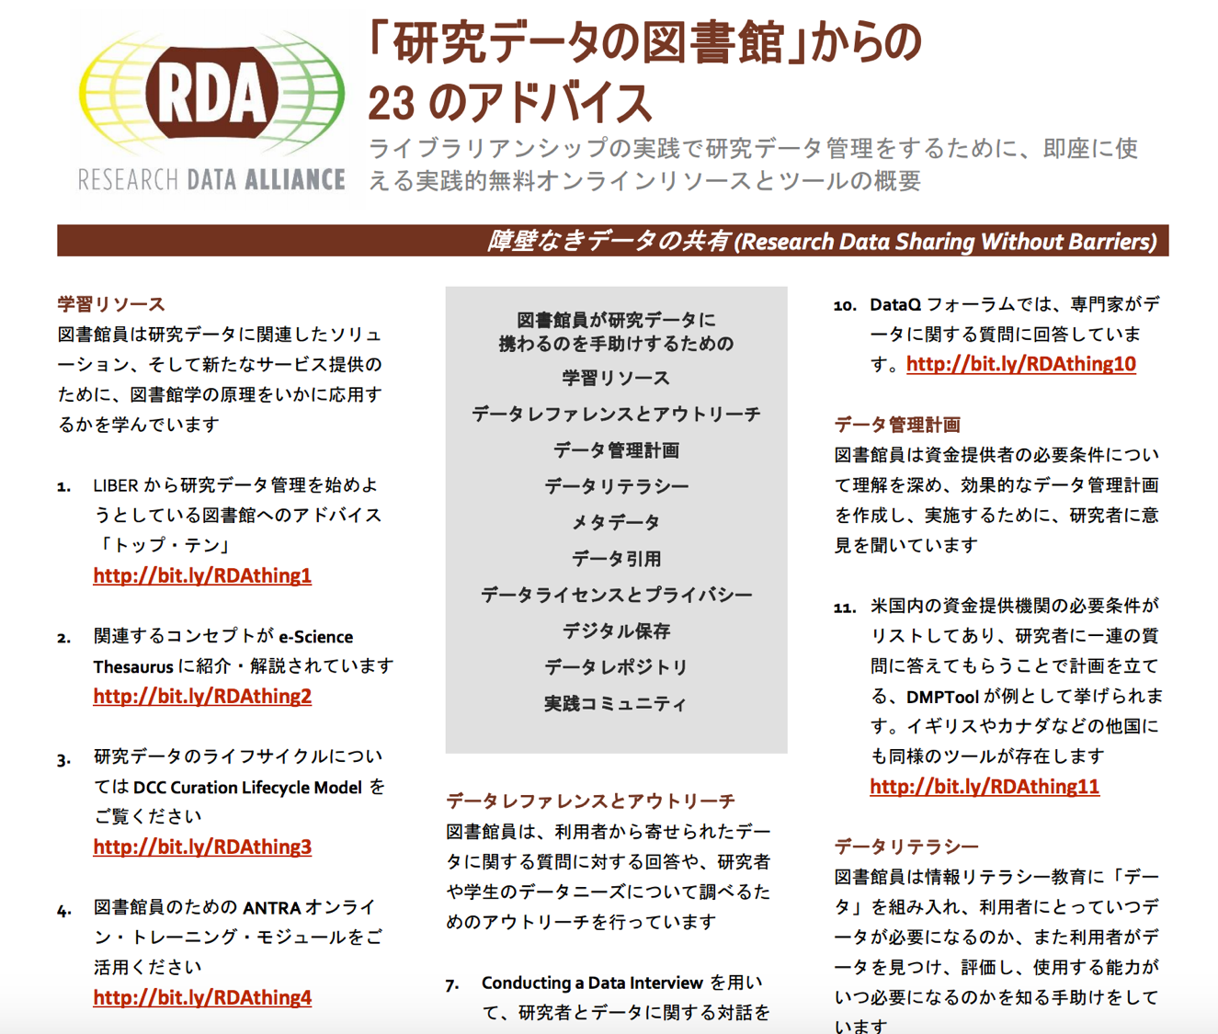
http://dx.doi.org/10.15497/RDA00010

Slide 20
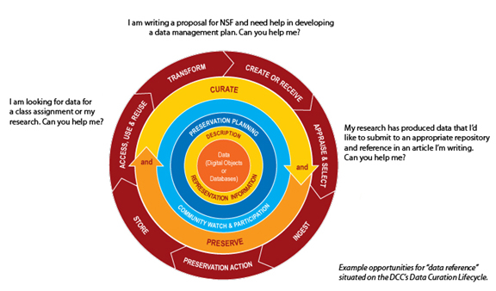
Curation lifecycle service model
Witt, M. (2012). Co-designing, Co-developing, and Co-implementing an Institutional Data Repository Service. Journal of Library Administration, 52(2). DOI:10.1080/01930826.2012.655607. http://docs.lib.purdue.edu/lib_fsdocs/6/
Digital Curation Centre’s Curation Lifecycle Model: http://www.dcc.ac.uk/resources/curation-lifecycle-model

Slide 21
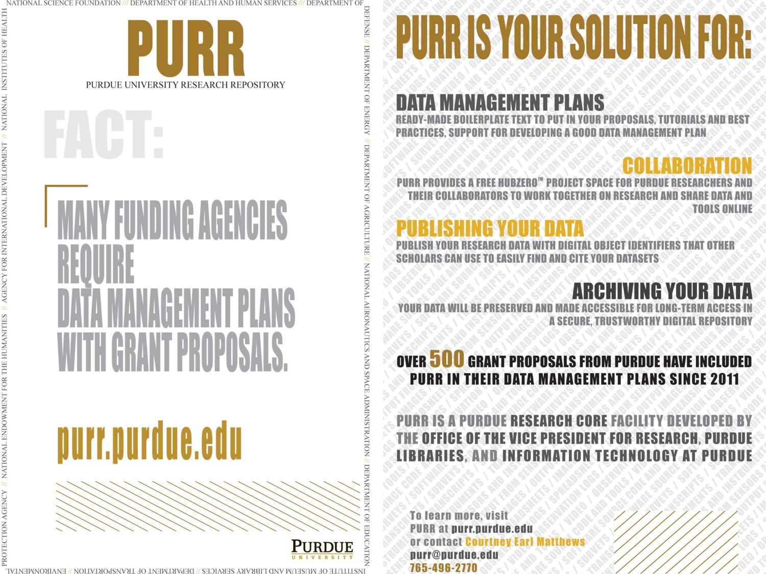
purr postcard and poster
21

Slide 22
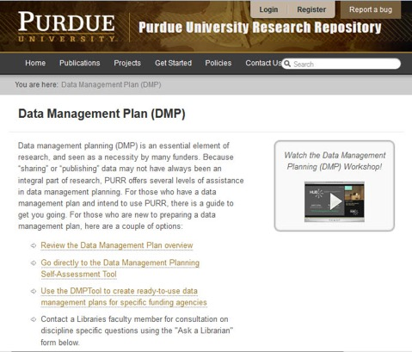
Data Management Plans
Boilerplate text
Example DMPs
Up-to-date funder requirements
DMPTool
Workshops
Tutorials
Reference and consultation with subject-specialist librarian and/or data services specialist
https://purr.purdue.edu/dmp

Slide 23
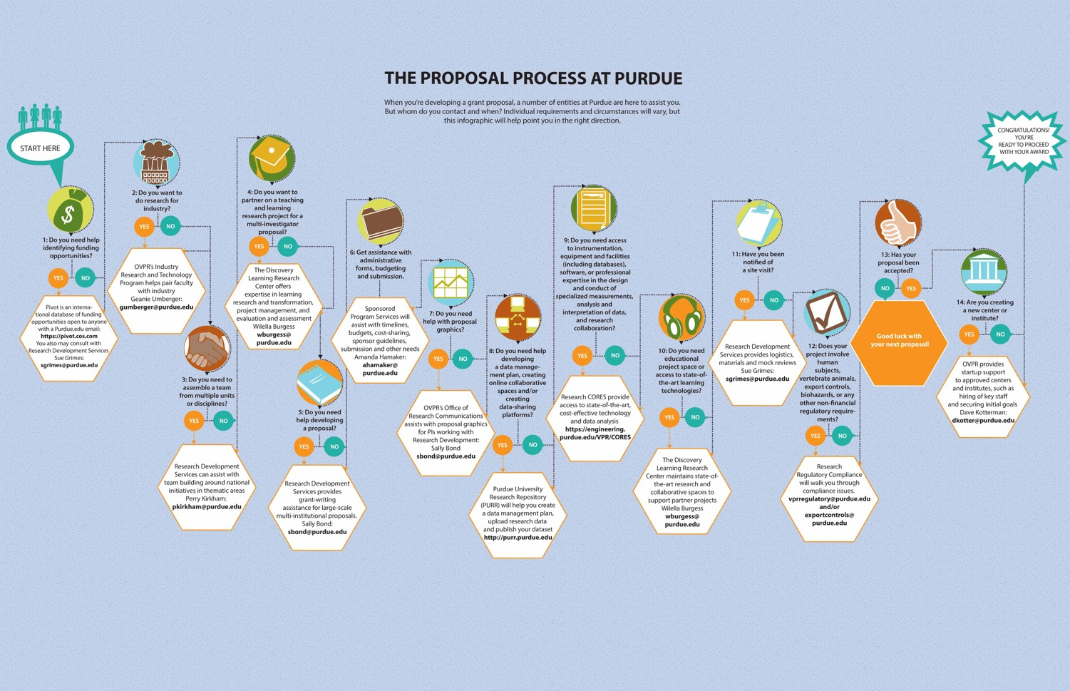
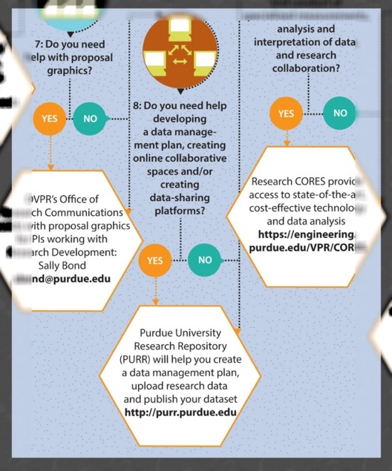
Dimensions of Discovery (Winter 2013). Office of the Vice President for Research, Purdue University,
http://www.purdue.edu/research/vpr/publications/docs/dimensions/Winter2013.pdf

Slide 24
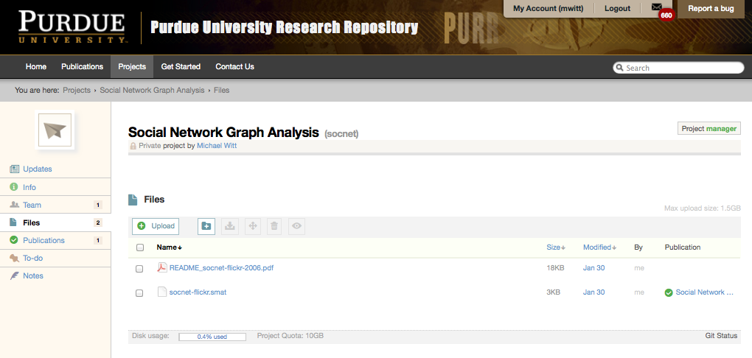
Create a Project
PURR project tutorial video: http://www.youtube.com/watch?v=q5xGO_oF9uQ

Slide 25
Use project to collaborate
Create:
any Purdue faculty, staff, or graduate student researcher can create private projects
describe the project
disclaim use of sensitive or restricted data
receive a default allocation of storage
register a grant award to increase allocation
invite collaborators from other institutions to join project
Collaborate:
git repository to share and version files (sftp & Google Drive integration)
virtual machine/s
wiki
blog
to-do list management and project notes
newsfeed
stage data publications

Slide 26
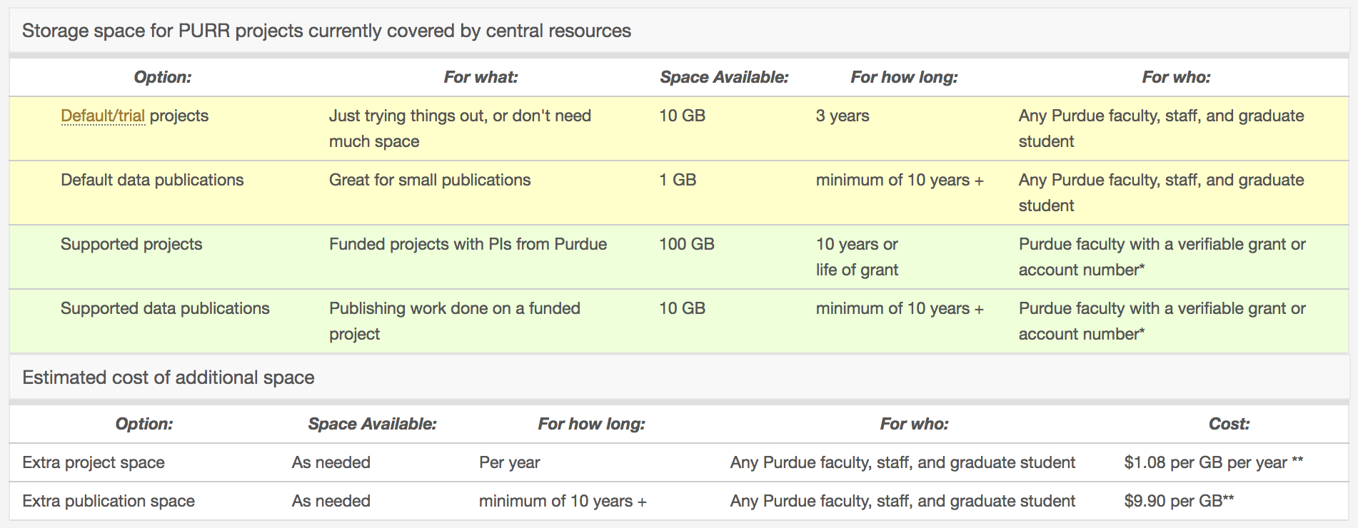
Storage Allocation
https://purr.purdue.edu/about/pricing

Slide 27
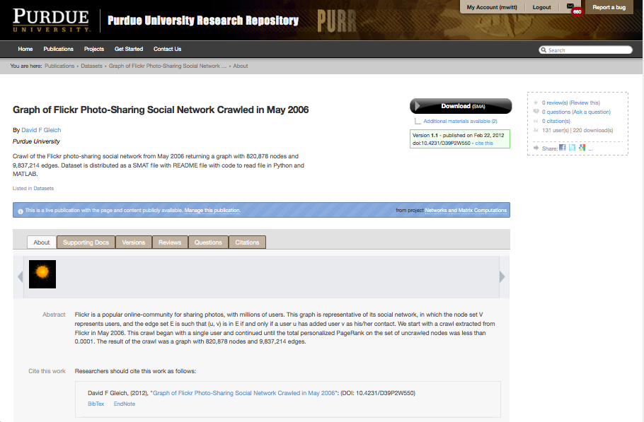
Data Publication & Archiving
PURR publication tutorial video: http://www.youtube.com/watch?v=jYBcsfiRhio

Slide 28
PURR governance & Staffing
Executive Committee: Dean of Libraries, Vice President for Research, Chief Information Officer
Steering Committee: 2 from libraries, 2 from IT, 2 from research office and sponsored programs, 3 domain faculty researchers
Personnel: Project Director (.50), Technologists (3.85), HUBzero Liaison (.35), Metadata Specialist (.20), Digital Archivist (.25), Repository Outreach Specialist (1.0), Data Curator (1.0)
Key players: Subject-specialist librarians & data services specialists

Slide 29
PURR by the numbers
2,312 data management plans (grant proposals)
318 grant awards
3,503 registered researchers
899 research projects
588 published datasets
277 data citations

Slide 30

ありがとうございます
Michael Witt
Head, Distributed Data Curation Center
Associate Professor of Library Science
http://www.lib.purdue.edu/research/witt
E-mail: mwitt@purdue.edu

