Slide 1
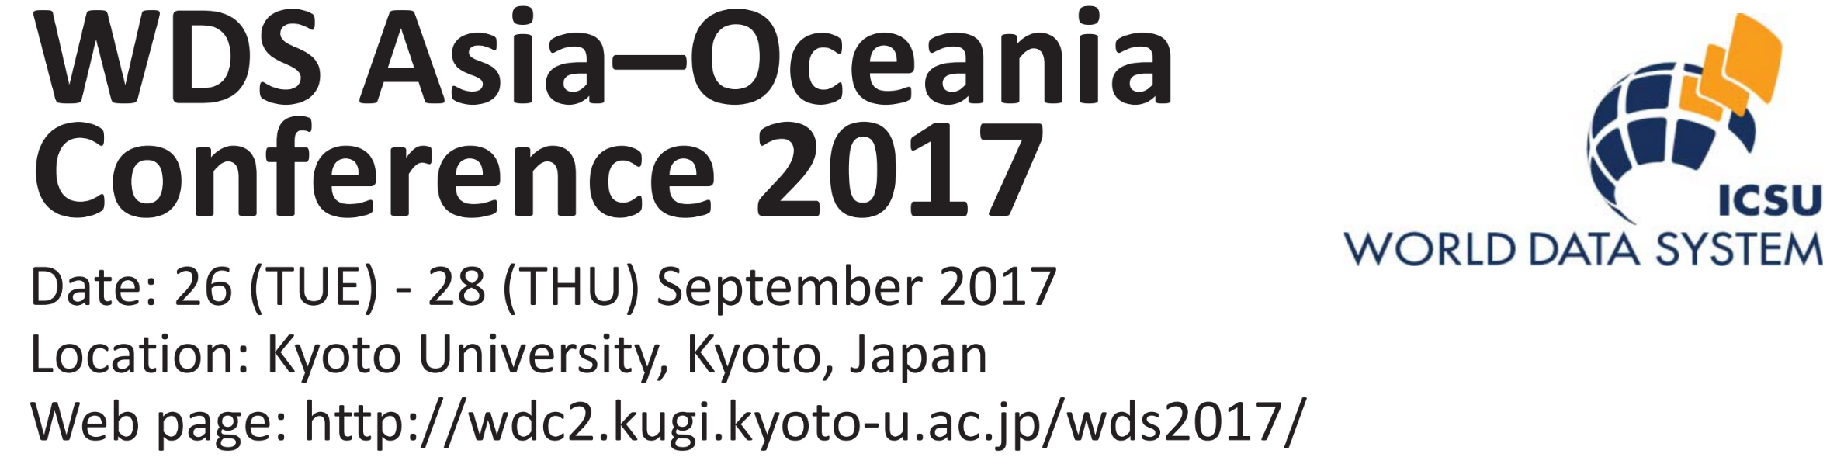
Takashi Watanabe (ICSU WDS International Programme Office)
Iyemori Toshihiko (WDC for Geomagnetism, Kyoto, Kyoto University)
Yasuhiro Murayama (National Institute of Information and Communications Technology, NICT)
Guoquing Li (Institute of Remote Sensing and Digital Earth, CAS)

Slide 33
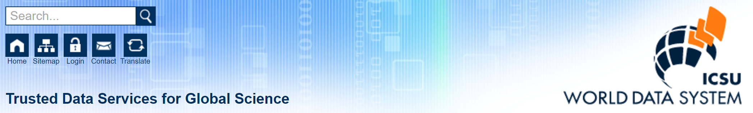
ICSU-WDS (https://www.icsu-wds.org/)
The World Data System (WDS) is an Interdisciplinary Body of the International Council for Science (ICSU) with a mission to promote international collaboration on long-term preservation and provision of quality-assessed research data and data services. ICSU-WDS is a membership organization that federates trustworthy scientific data services and networks across a range of disciplines in the Natural and Social Sciences, as well as the Humanities.

Slide 34
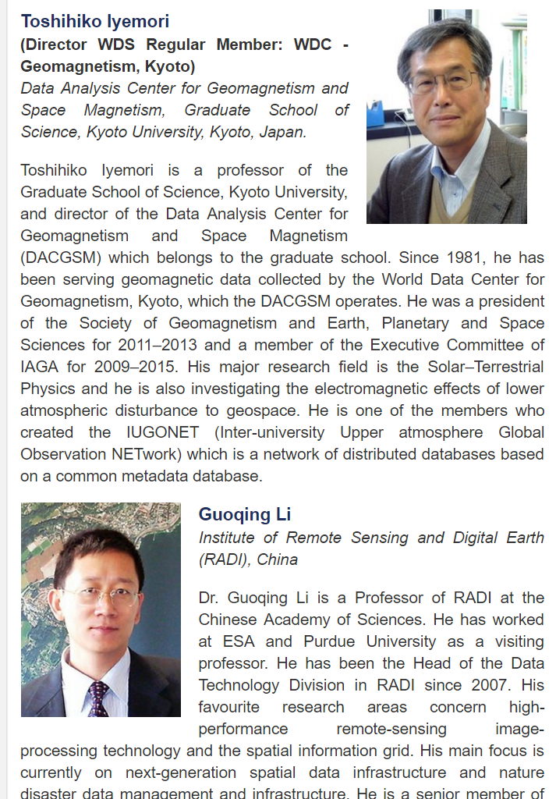
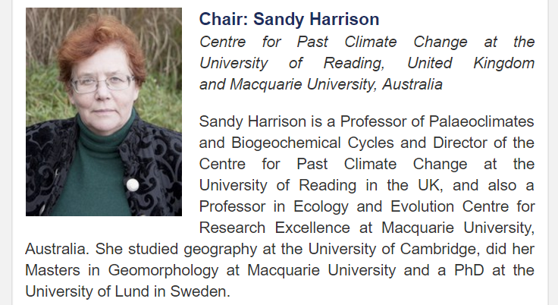
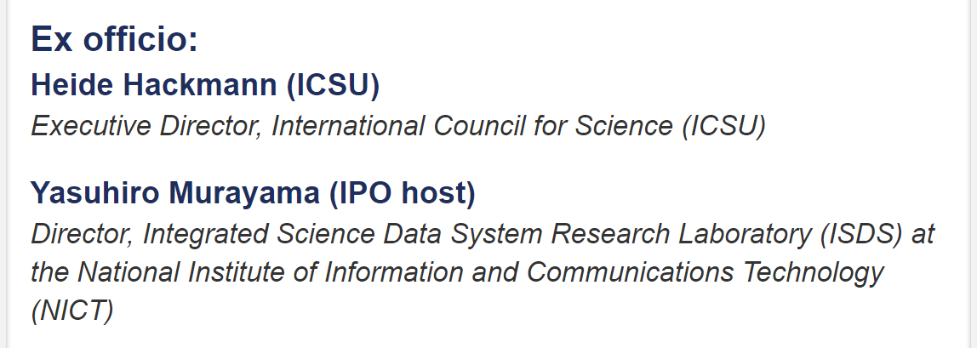
WDS is organized by the Scientific Committee

Slide 35
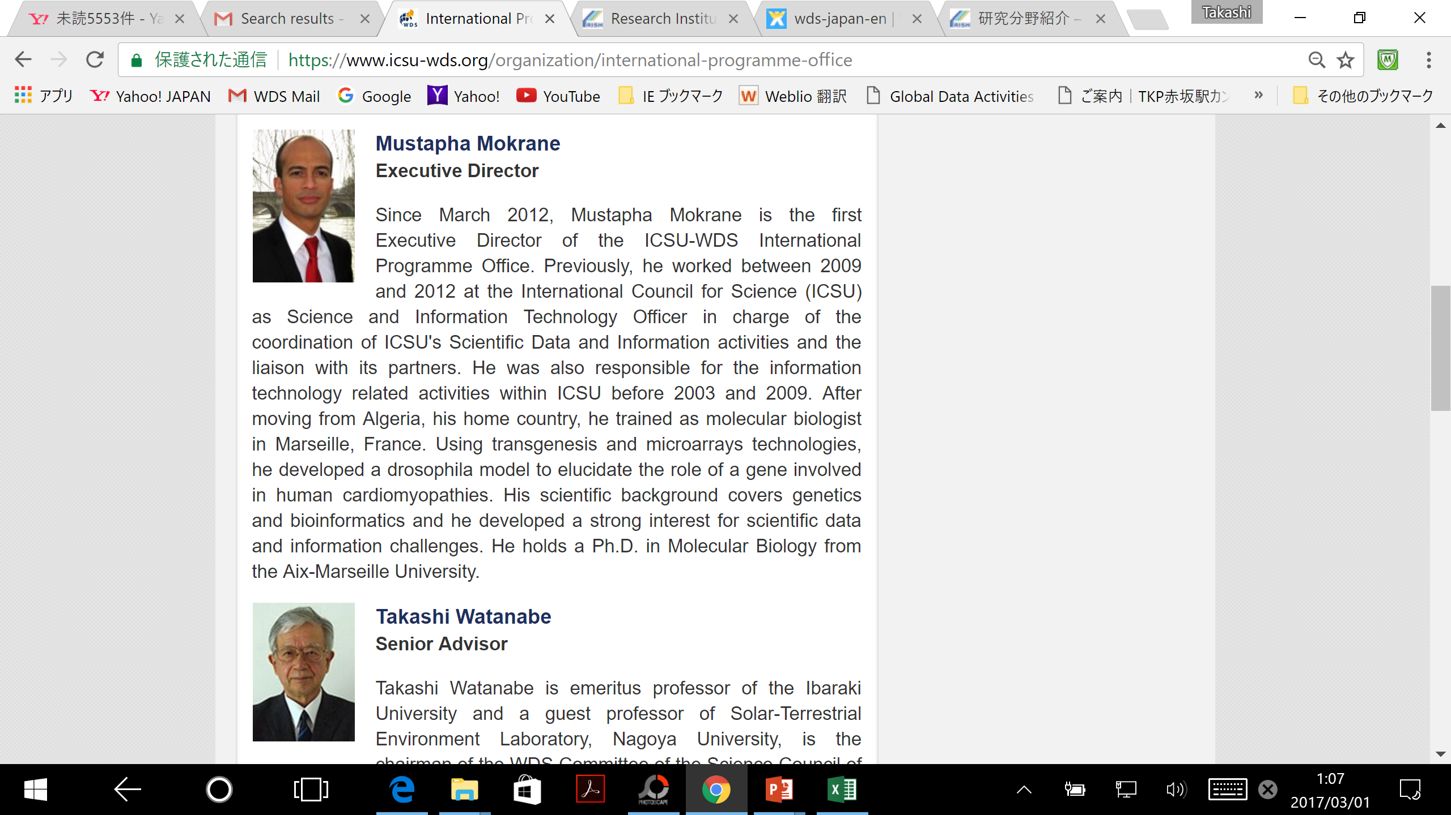
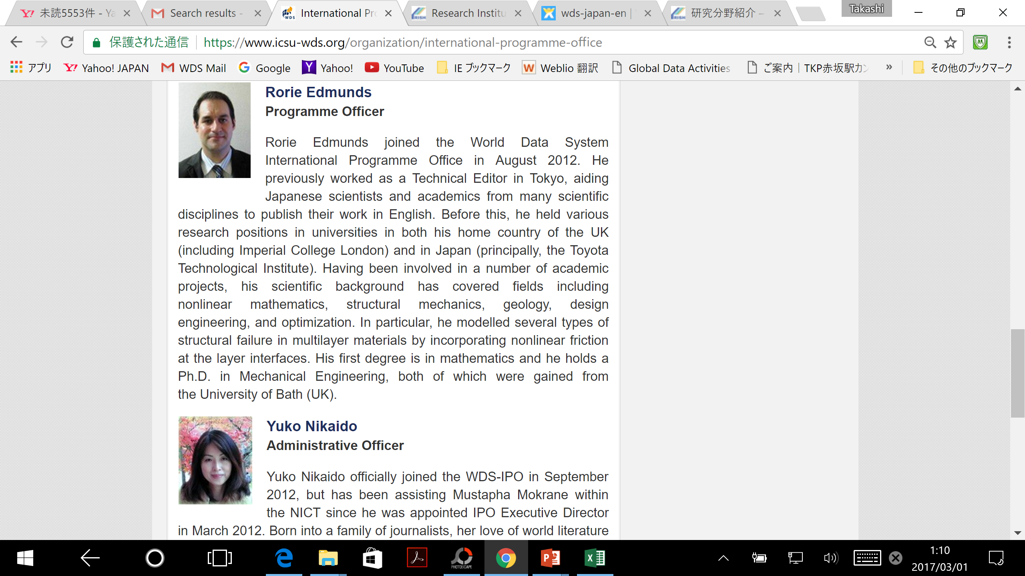
WDS International Programme Office (WDS-IPO) at NICT, Tokyo

Slide 36
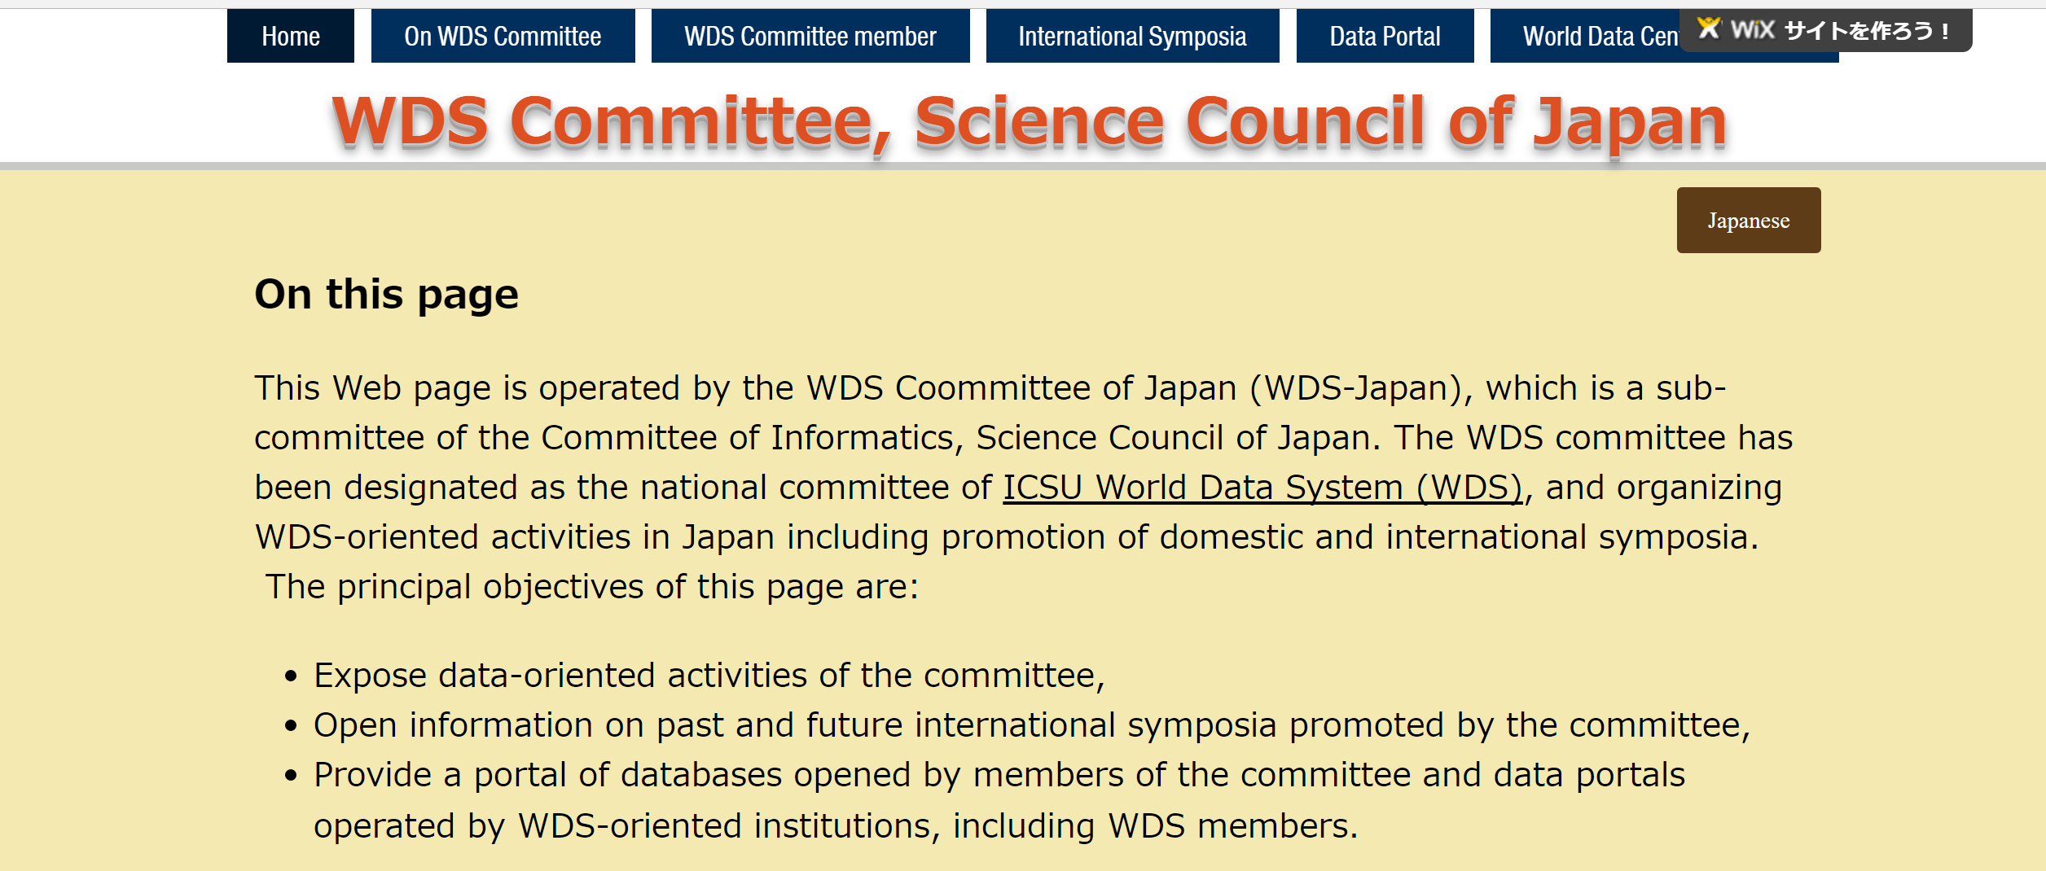
WDS Committee, Japan
“WDS-Japan”
http://takashiwatanabe.wixsite.com/wds-japan-en

Slide 37
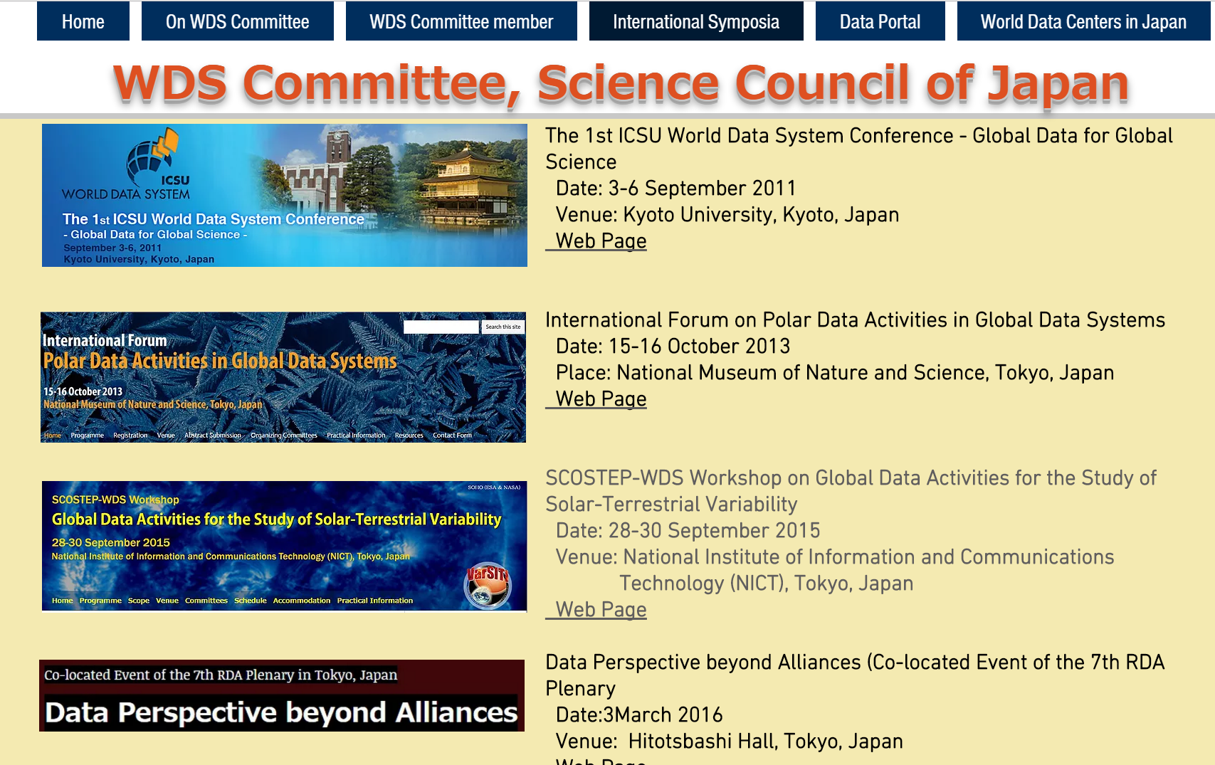
WDS National Committee is organizing a series of international conferences.

Slide 38
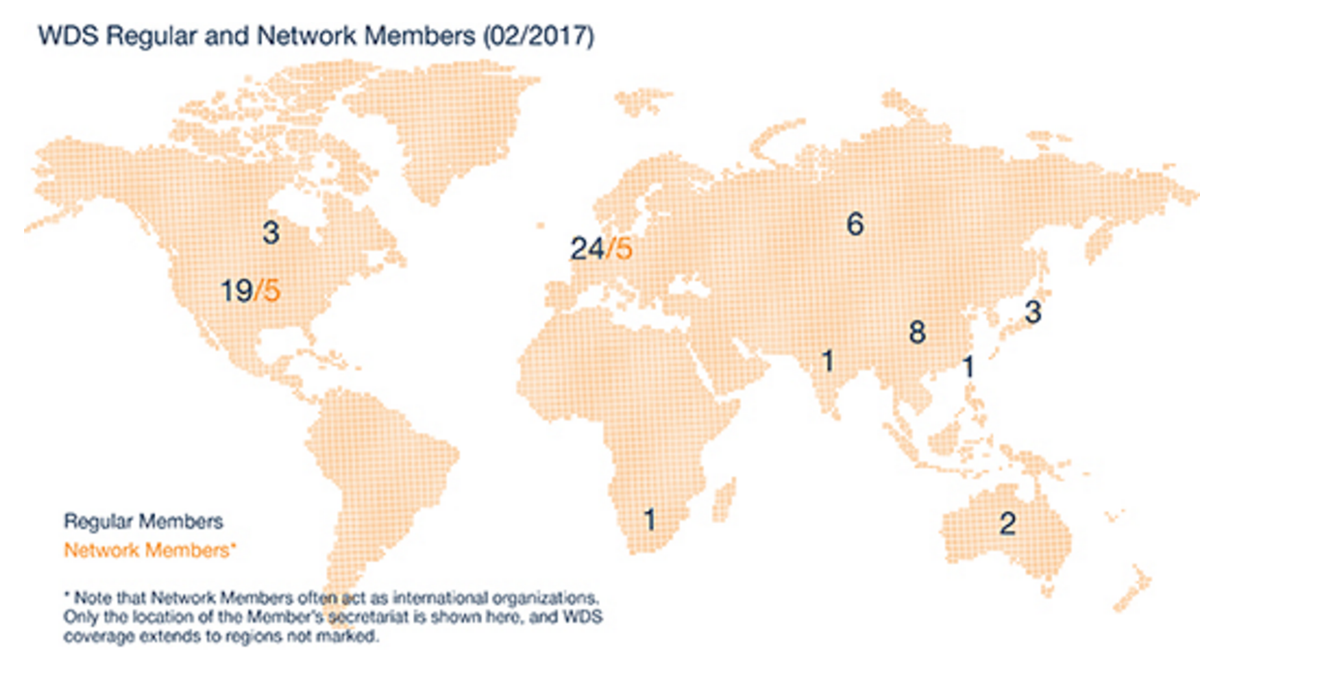
As of 09 Feb 2017, the World Data System has 104 Member Organizations in four different categories.
68 Regular Members
10 Network Members
8 Partner Members
18 Associate Members

Slide 39
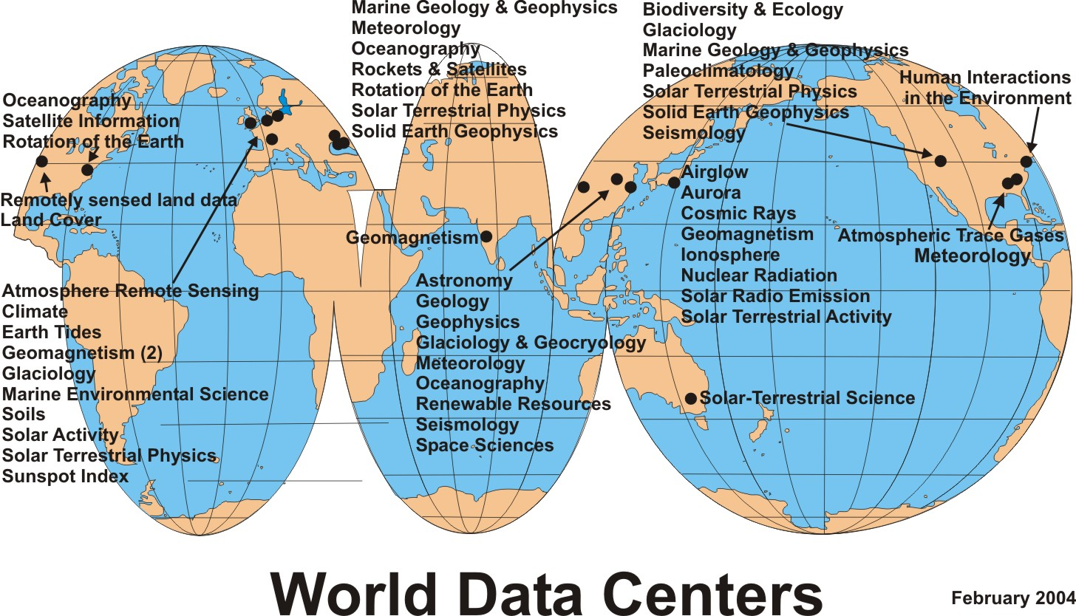
Former ICSU World Data Center (WDC) System (1957 - 2008)
WDCs moved to WDS (Jan. 2015)

Slide 40
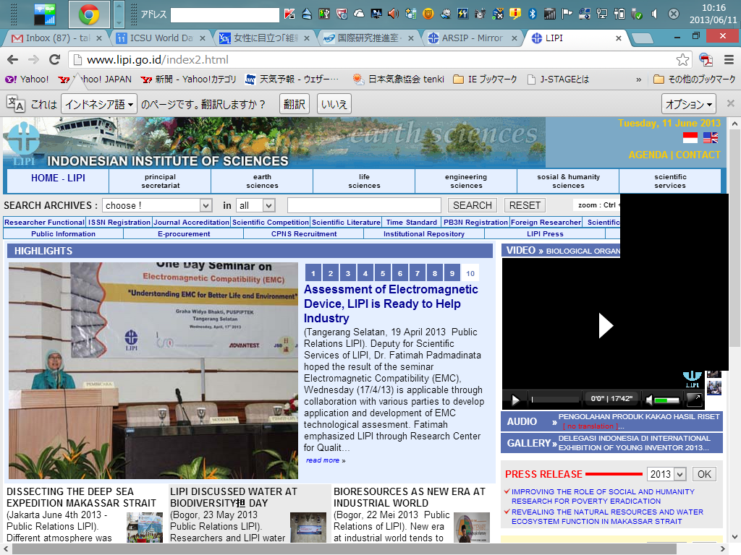
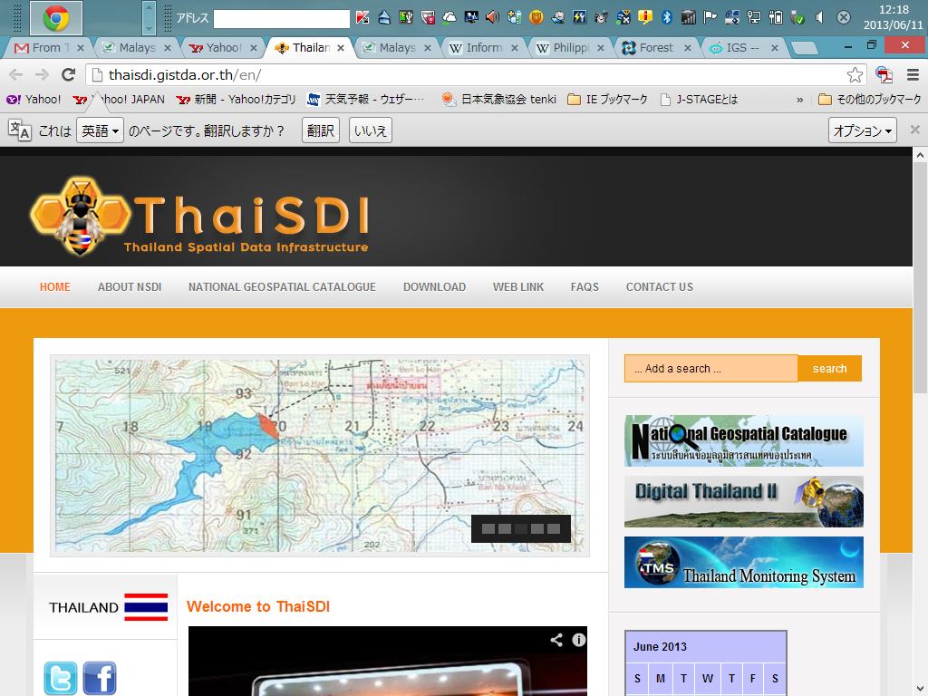
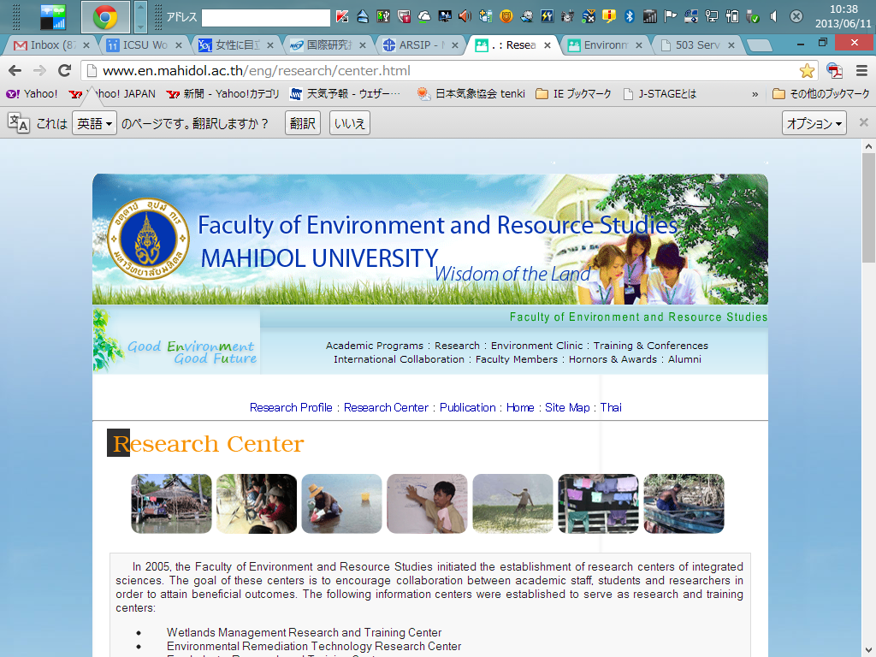
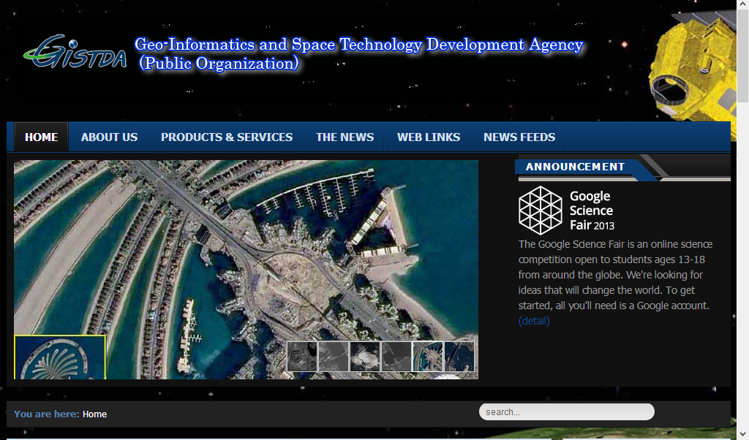
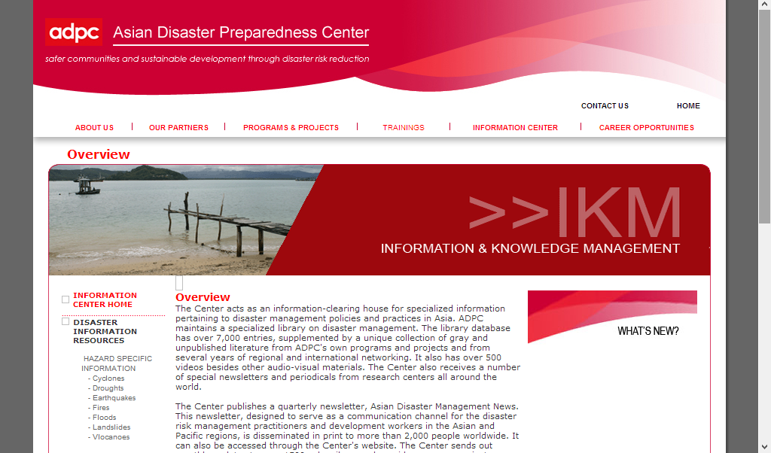
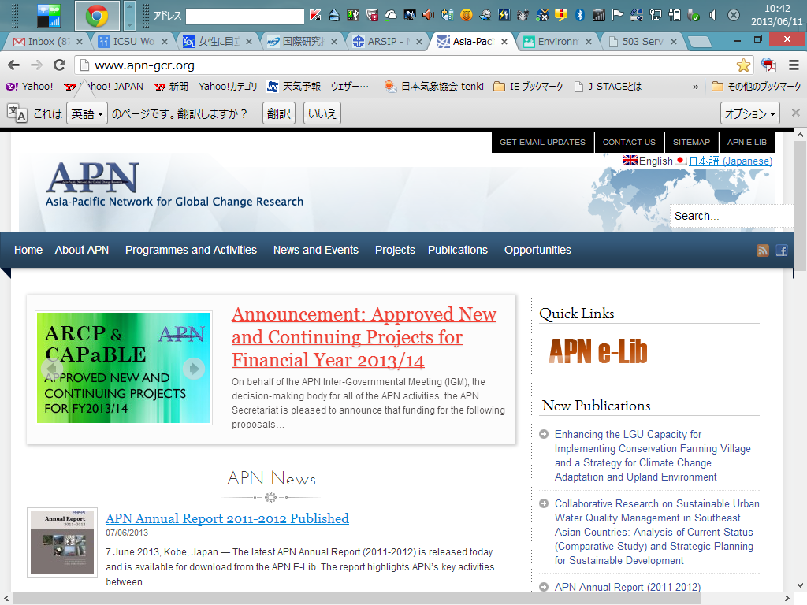
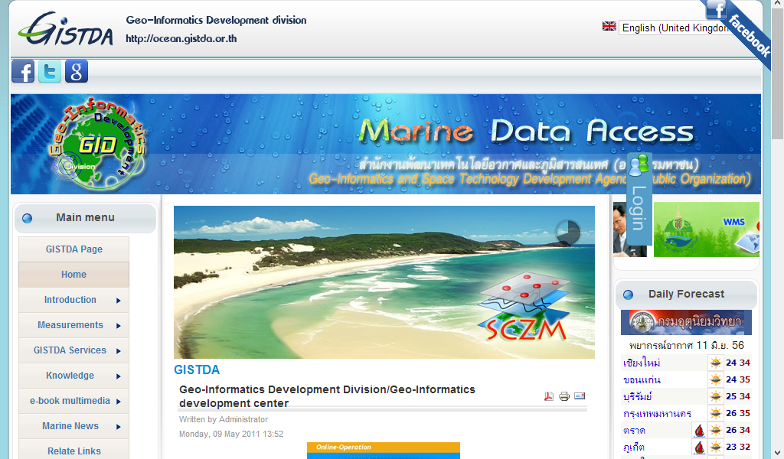
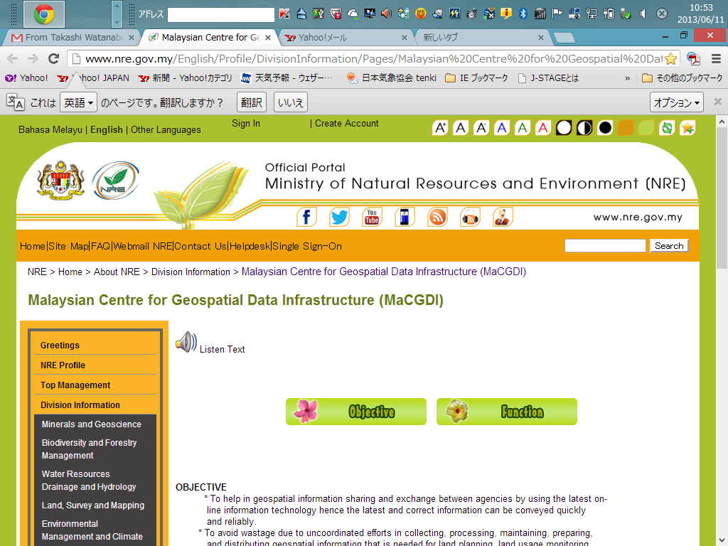
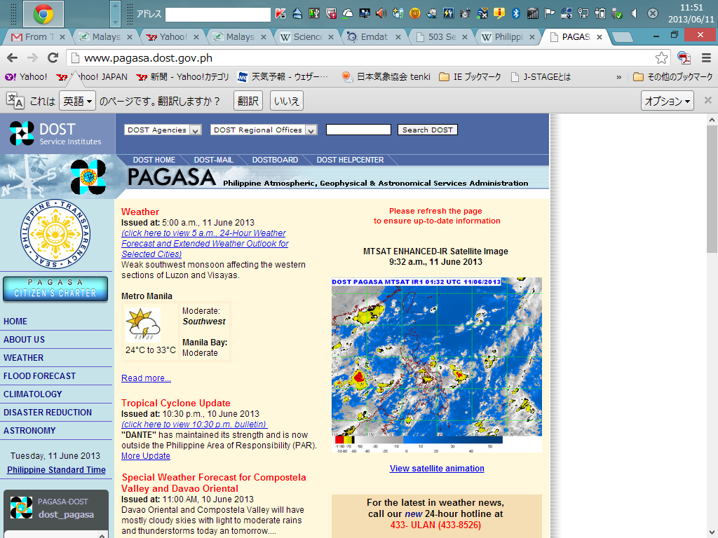
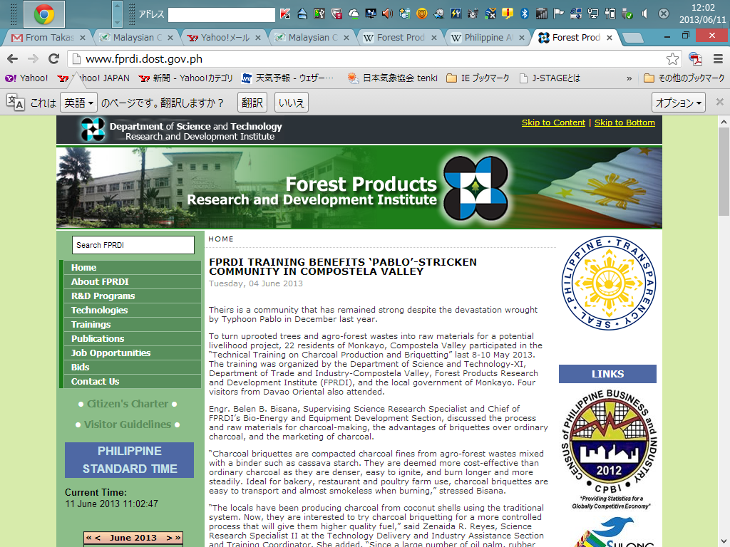
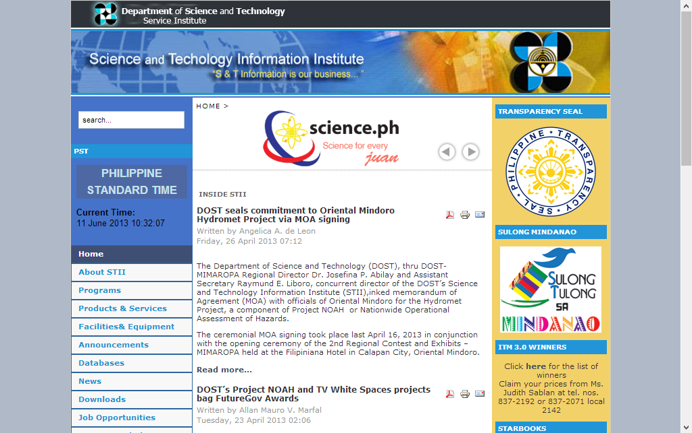
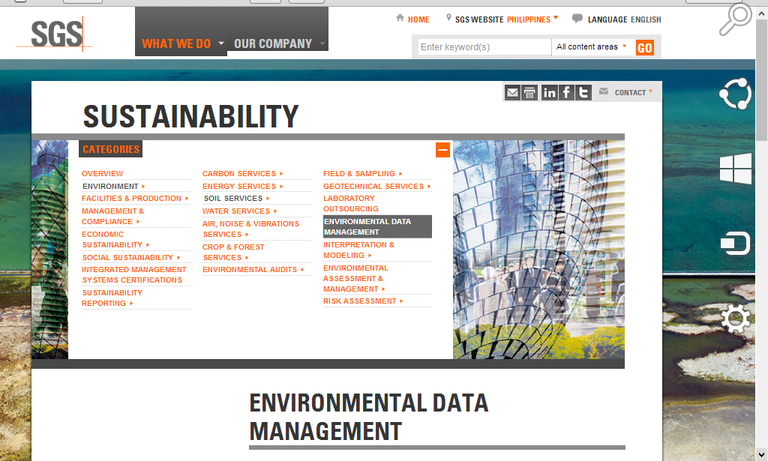
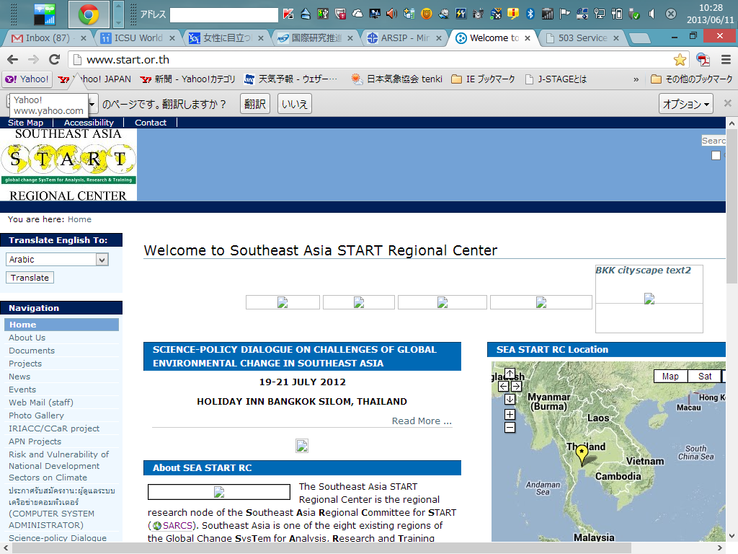
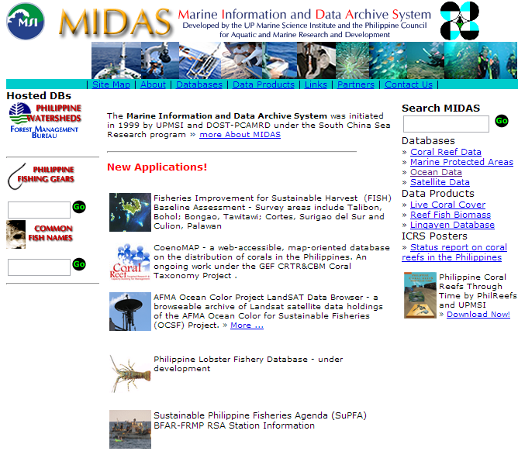

Slide 41
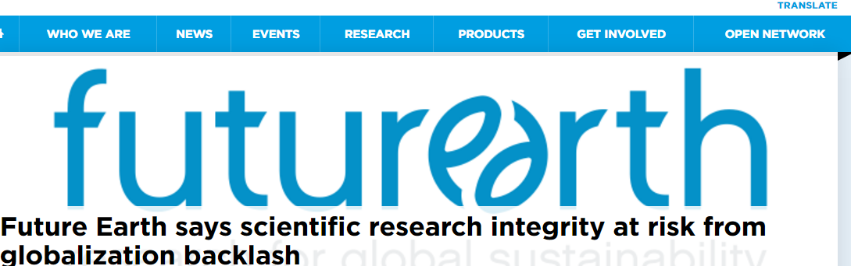
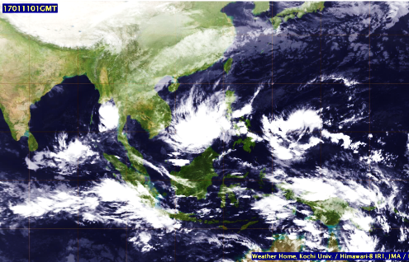
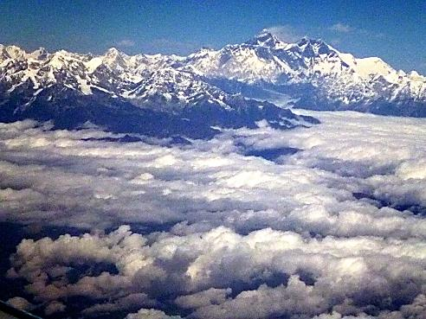
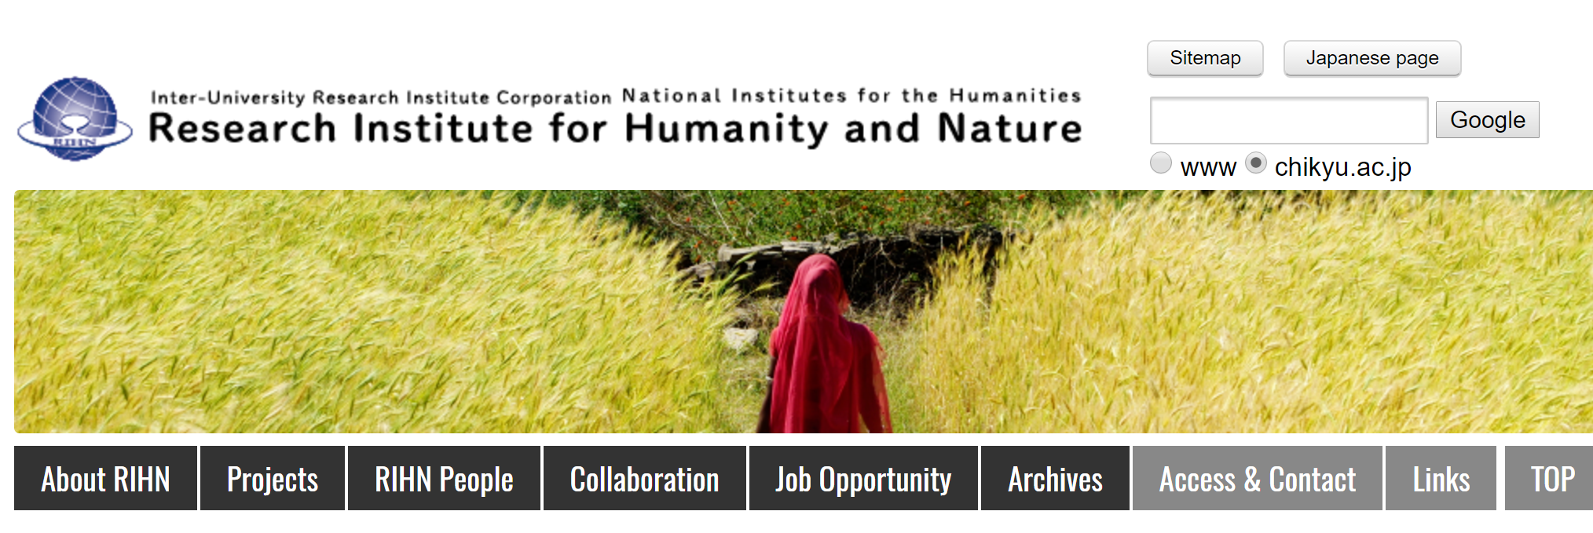
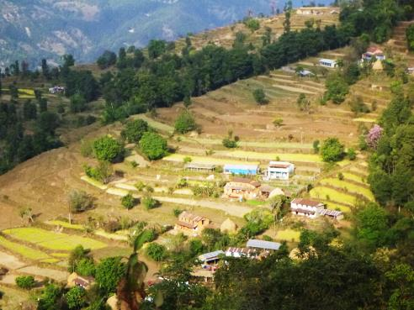
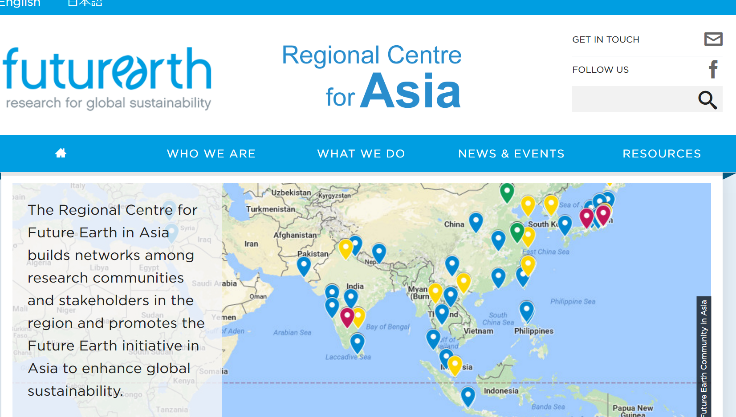
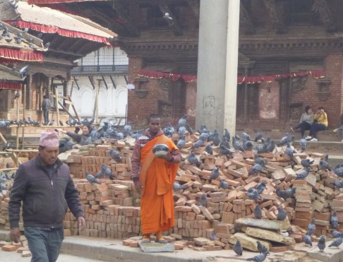
Future Earth is a major international research platform providing the knowledge and support to accelerate transformations to a sustainable world
http://weather.is.kochi-u.ac.jp/

Slide 42
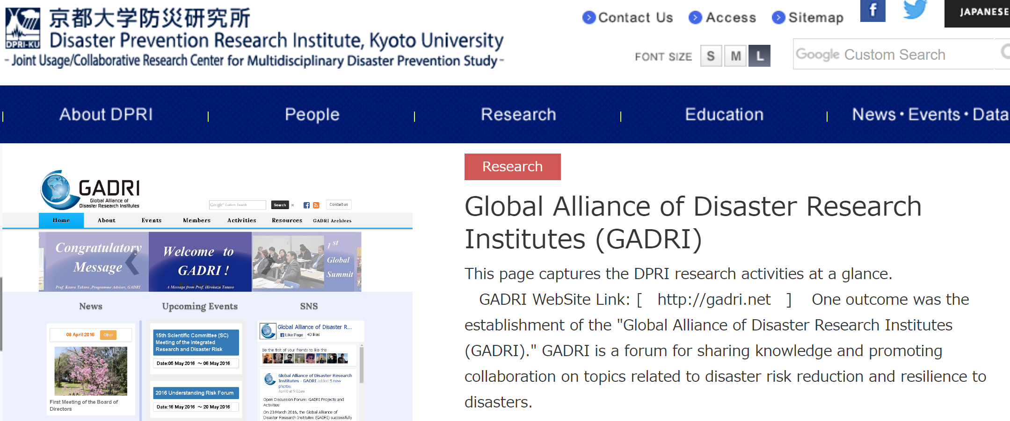
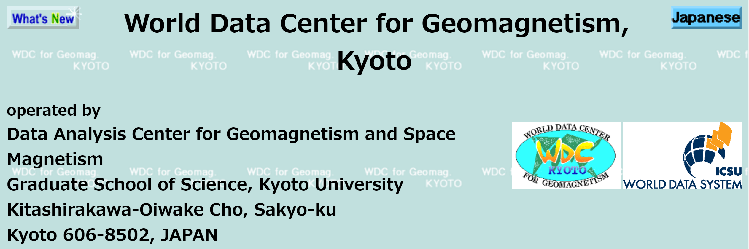
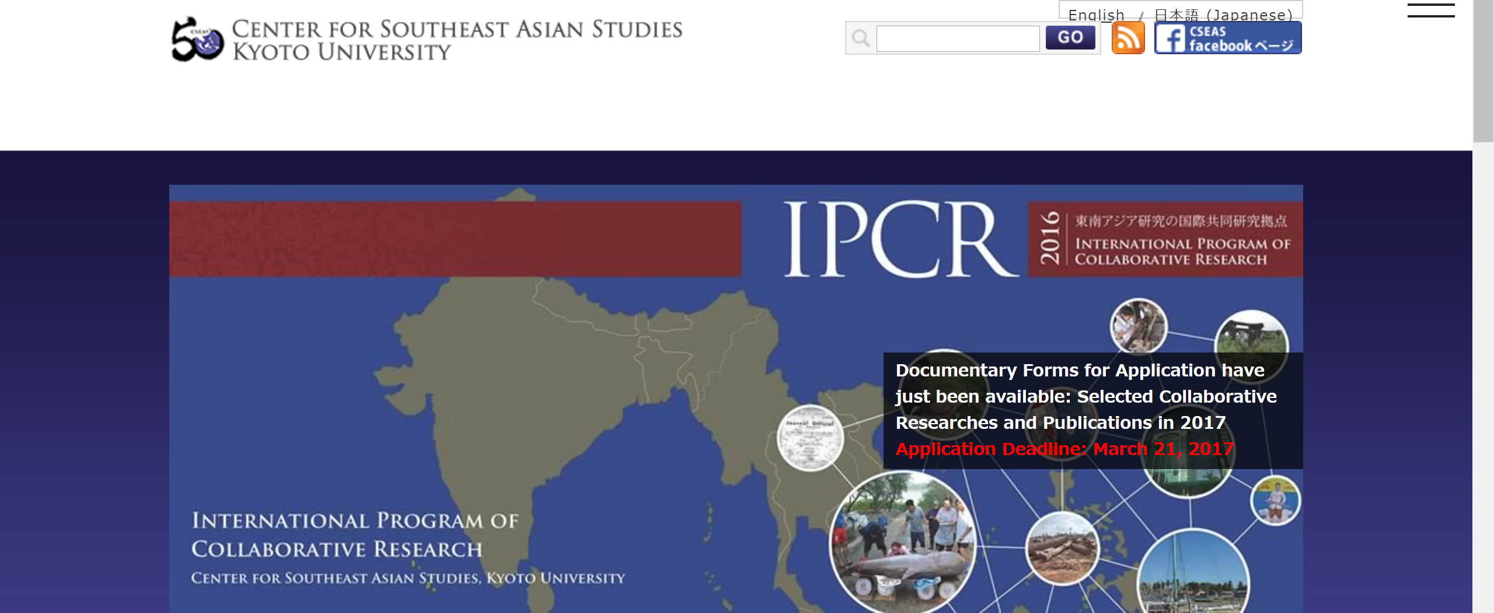
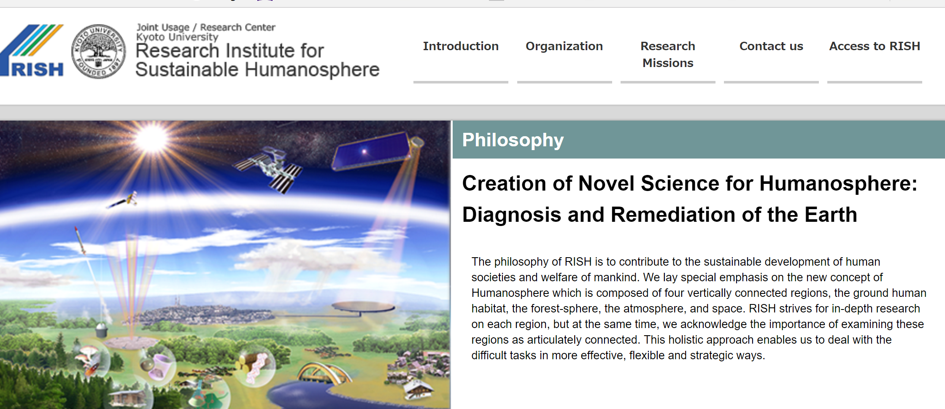
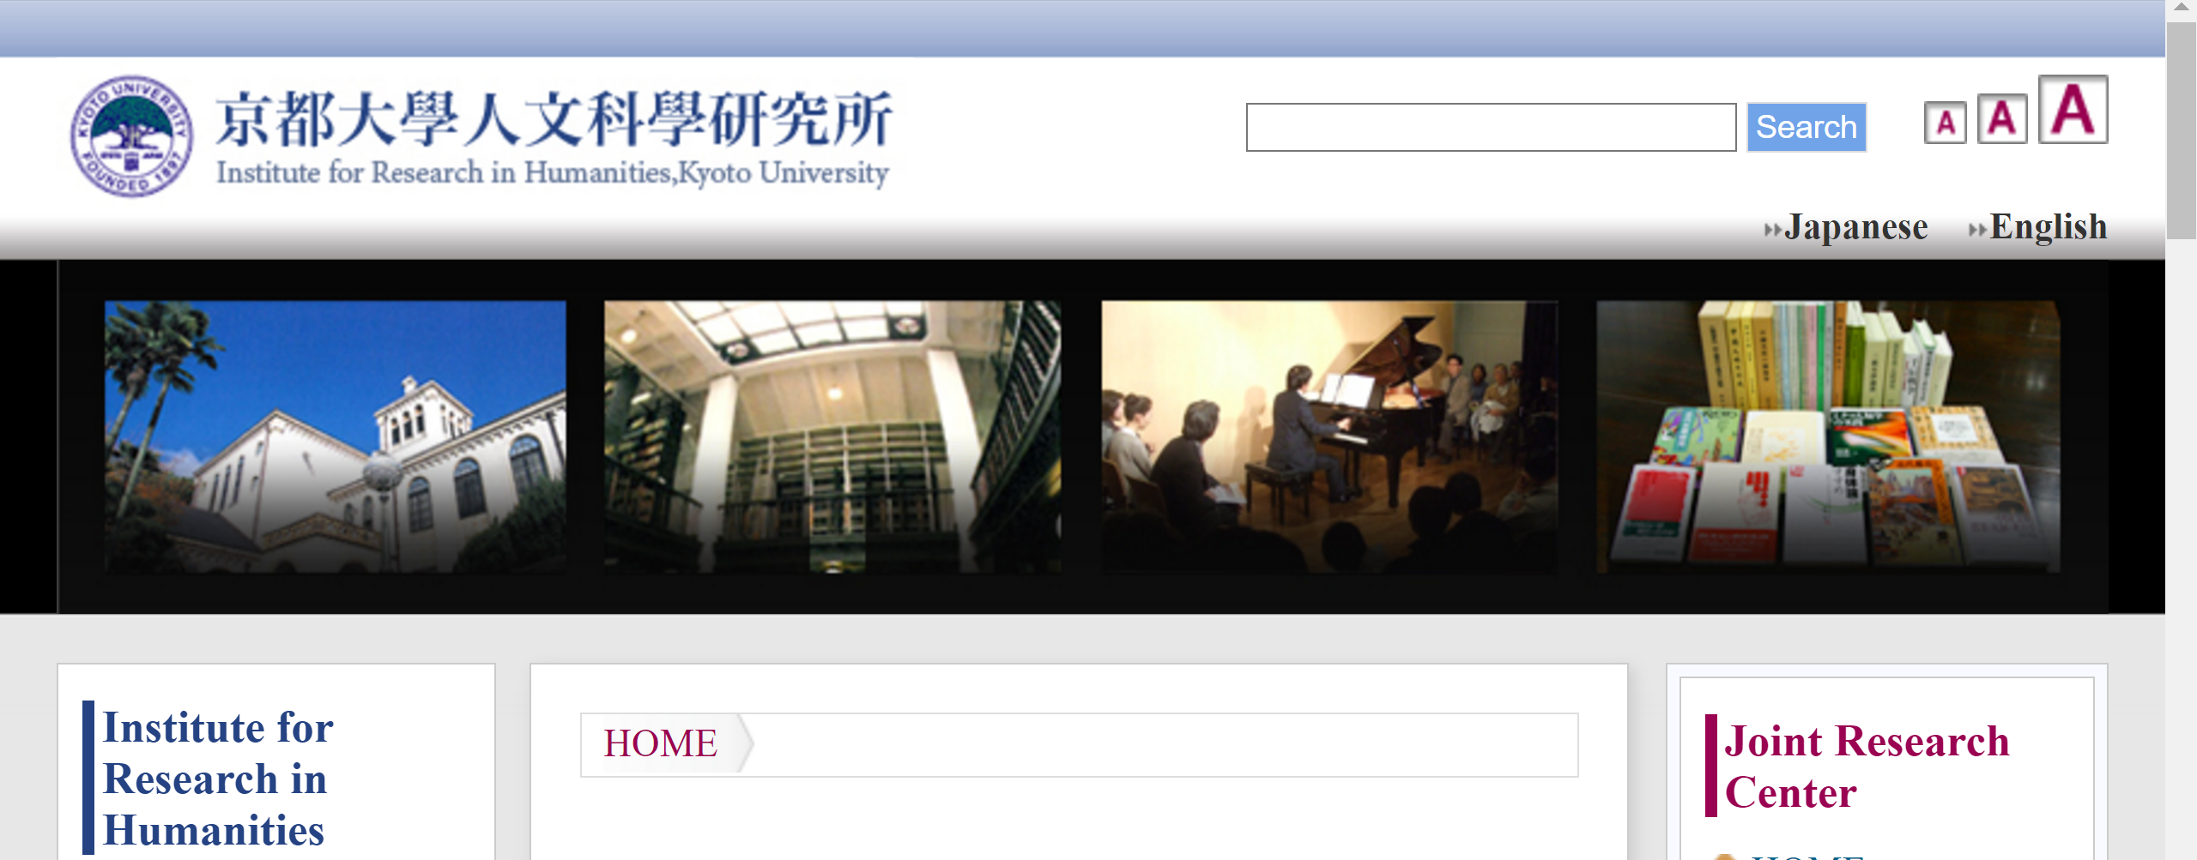
Kyoto University has a close connection to Asian countries

Slide 43
The WDS Asia–Oceania Conference 2017 will reinforce the WDS community in this region, and help establish a collaborative system for access to and dissemination of research data. The principal objectives of the conference are:
Strengthen collaboration among China, Japan, and countries in the Asia–Oceania region for WDS activities
Build and expand the WDS community in the Asia–Oceania region
Exchange experience on successful applications for WDS membership
Encourage former World Data Centres to join ICSU-WDS
Introduce advanced technologies connected with WDS-oriented activities
Promote WDS activities in support of Future Earth in the Asia–Oceania region

Slide 44
SOC Members of the WDS Asia-Oceania Conference, 2017
T. Iyemori (Co-Chair) | WDC for Geomagnetism, Kyoto, Kyoto University)
Li Guoqing (Co-Chair) | Institute of Remote Sensing and Digital Earth, CAS
T.Watanabe (Secretary) | ICSU WDS International Programme Office
S. Harrison | WDS-Chair, University of Reading
S. Iwata | The Graduate School of Project Design
Li Jianhui | Computer Network Information Center, CAS
M. Mokrane | ICSU WDS International Programme Office
Y. Murayama | National Institute of Information and Communications Technology
R. Shaw | IRDR International Programme Office
Shi Lei | National Science and Technology Infrastructure Center, MOST, China
M. Taniguchi | Research Institute for Humanity and Nature
K. Takara | Disaster Prevention Research Institute of Kyoto University
Wang Juanle | Institute of Geographic Sciences and Natural Resources Research, CAS
Seo-Young Noh | Korea Institute of Science and Technology
J. Hunter | University of Queensland
B. Veenadhari | Indian Institute of Geomagnetism
Lourdes J. Cruz | Chair of Regional Committee for Asia and the Pacific, ROAP, University of the Philippines Diliman
Wenbo Chu | GEO Secretariat

Slide 45
Tentative Program
Date (2017) | AM | PM
25 SEP (MON) | Cooperative -Event (Data-Analysis Workshop on Solar-terrestrial Environment) | Cooperative Event (Data-Analysis Workshop on Solar-terrestrial Environment)
26 SEP (TUE) | Registration, Opening talks | Key-note talks
27 SEP (WED) | Reports of data-oriented activities | International and Interdisciplinary collaborations on data
28 SEP (THU) | Discussion on action plan | Workshop on WDS membership accreditation

Slide 46
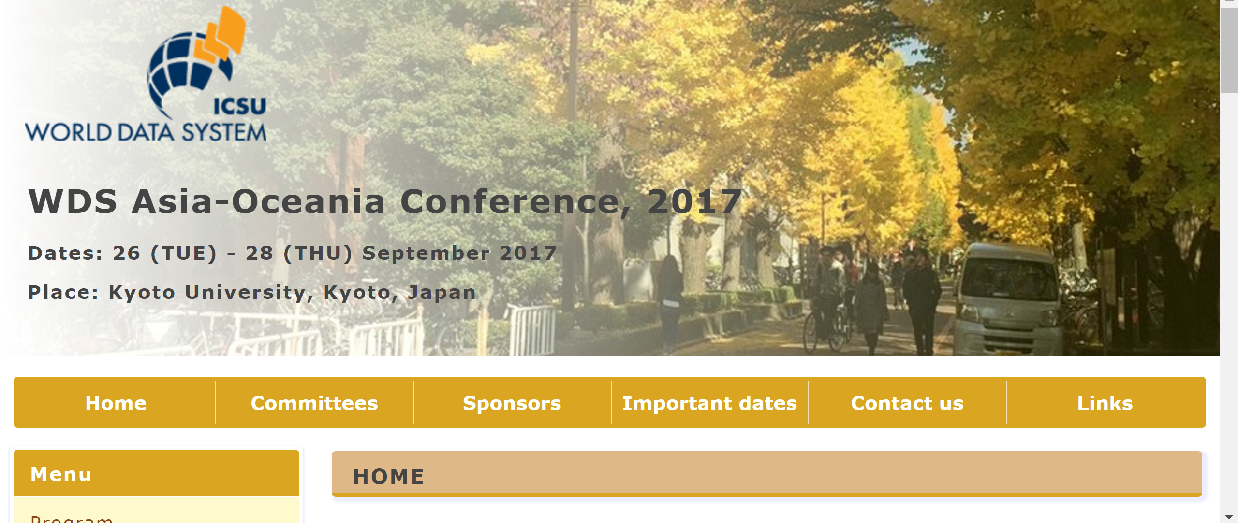
We welcome your participation!
http://wdc2.kugi.kyoto-u.ac.jp/wds2017/

Slide 47
2016年度名古屋大学宇宙地球環境研究所研究集会
科学データ研究会・WDS国内シンポジウム
Science Data Symposium + WDS Japan Symposium 共同開催：名古屋大学宇宙地球環境研究所、情報通信研究機構、研究データ利活用協議会、WDS小委員会
開催期間：2017年3月9日（木）－10日（金）
9 – 10 March 2017
会場：ベルサール「神保町」（東京都千代田区神田神保町）
Bellesalle Jinbocho, Kanda, Tokyo http://www.bellesalle.co.jp/room/bs_jimbocho/access.html
Conference Web page (in Japanese)：http://takashiwatanabe.wixsite.com/science-data

Slide 48
No Conclusion No Question?

Slide 49
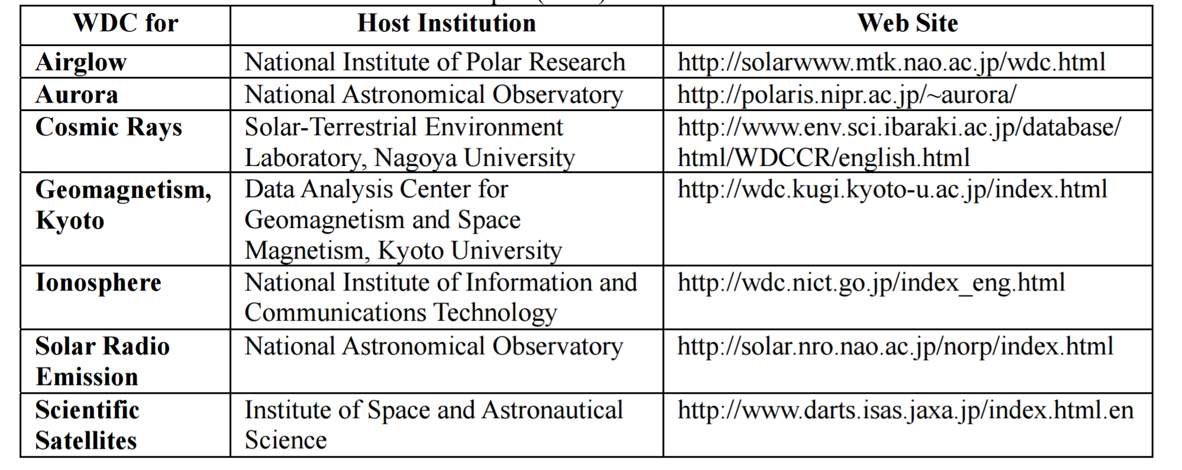
Former World Data Centers in Japan (1957-2008)

Slide 50
WDS Members from Japan as of 2016
Member | Host Organization
WDC for Geomagnetism, Kyoto | Kyoto University
WDC for Ionosphere and Space Weather | National Institute of Information and Communications Technology
Research Institute for Sustainable Humanosphere | Kyoto University

Slide 51
