Slide 1
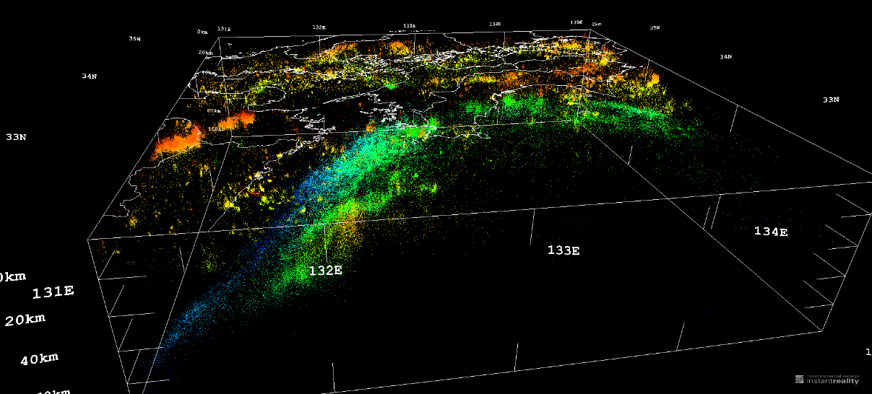
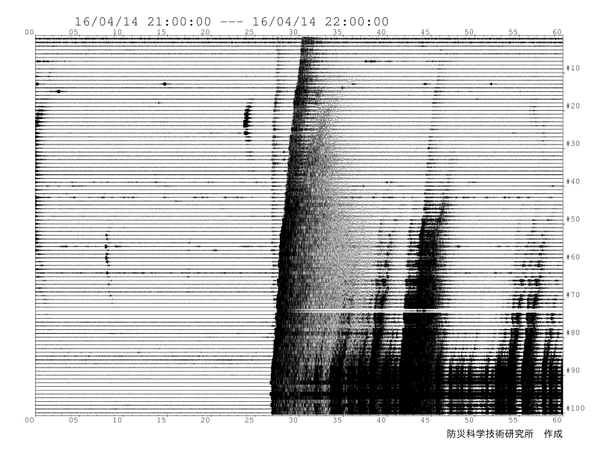
防災科研基盤的地震観測網と観測データの公開・利用
Introduction of NIED Seismograph Networks
Hypocenter Distribution in SW Japan
2016 Kumamoto Earthquakes
NIED Hi-net 2003/01-2016/08 (M≥0.5）
汐見 勝彦 / 国立研究開発法人防災科学技術研究所 地震津波火山ネットワークセンター
K. SHIOMI / National Research Institute for Earth Science and Disaster Resilience (NIED)
2017/03/01 Wed. 4th Workshop for Promoting Open Science Data @Kyoto Univ.

Slide 2
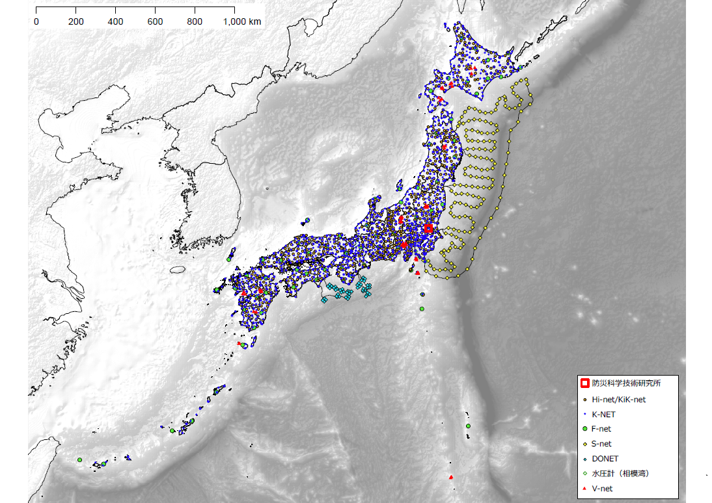
Outline
NIED operates the nationwide seismograph networks, and the observed data (e.g., waveform, earthquake catalog) are open to the public via the NIED websites.
Waveform data are exchanged and shared with Japan Meteorological Agency (JMA), Universities, and other related institutes in real-time.
To maintain and upgrade our networks, we have to track the user activities.
NIED Earthquake-Tsunami-Volcano Observation Networks

Slide 3
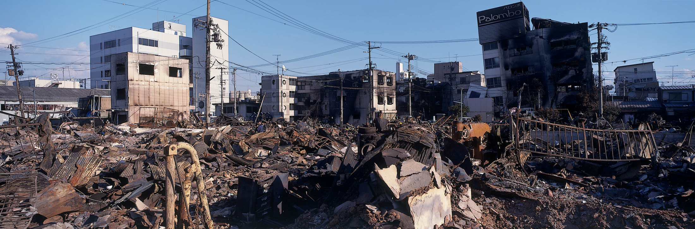



Impact of 1995 Kobe Earthquake
Research for Earthquake Prediction (1960’s~)
Hyogoken-Nanbu (Kobe) Earthquake (Mj7.3) attacked the metropolitan area of western Japan on January 17, 1995.
More than 6,000 people were killed, and about 250,000 buildings were collapsed by this earthquake.
©NIED
Fundamental survey and observation
for earthquake research
Seismograph
Networks
GNSS Continuous
Observation Facilities
Surveys of
Inland Active Faults
Notes:
In Japan, the old seismograph network construction started since the late 60’s to predict large earthquakes. The turning point occurred on January 1995. The large earthquake, Hyogoken-Nanbu earthquake, well known as Kobe earthquake, attacked the metropolitan area of western Japan. By this earthquake, a lot of people were killed and many buildings were damaged. After this earthquake disaster, Japanese government had started “Fundamental survey and observation for earthquake research”. Our seismograph networks were constructed as a part of this project.

Slide 4
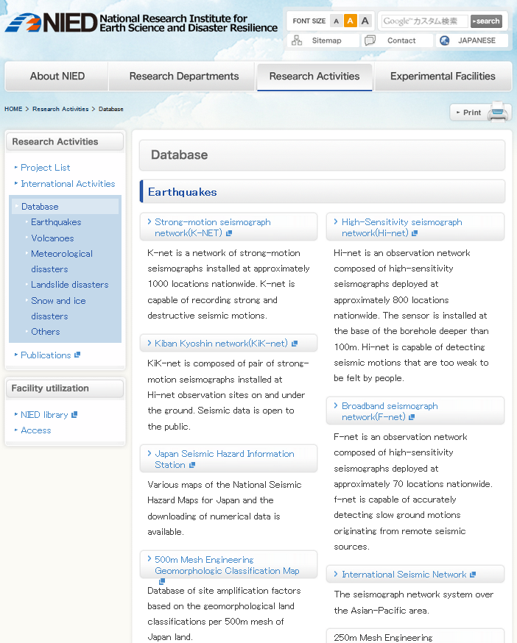
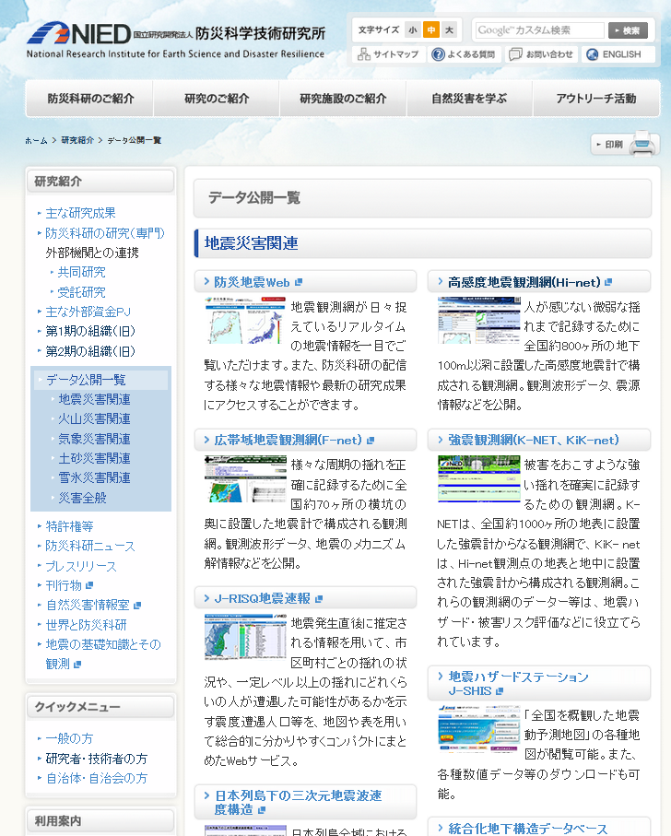
Database On the NIED Website
NIED English Website
NIED Japanese Website
Databases Related to the Real-Time Earthquake Observations
http://www.bosai.go.jp/e/activities/database/
http://www.bosai.go.jp/activity_special/data/

Slide 5







Three-kind Seismograph Networks
Strong
K-NET/KiK-net
Strong motion seismographs
Seismic Intensity
Seismic Design
F-net
Broadband
Seismograph
Hi-net
High-sensitivity seismograph
Earthquake
Mechanism
Earth Model
Hypocenter Location
Earth Model
Weak
Slow
Fast
Notes:
NIED is operating three kinds of seismograph networks to observe the ground motion with various frequencies and amplitude range.
First, we introduce the high sensitivity seismograph network, called Hi-net.

Slide 6
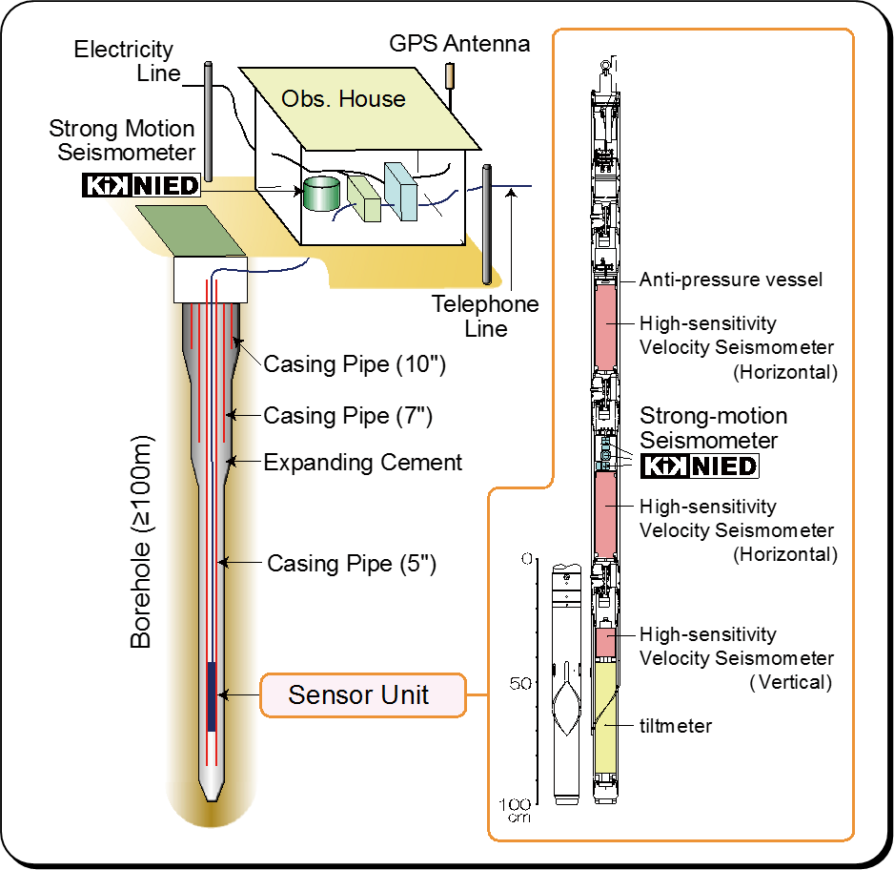
Outline of the NIED Hi-net
Hi-net: High-sensitivity seismograph network in Japan
Since Oct. 2000
Continuous data recording with 100 Hz
WIN32 format
780 stations (Feb, 2017)
NIED
(No Stations in Ryukyu Islands)
Notes:
These are short summary of the NIED Hi-net

Slide 7
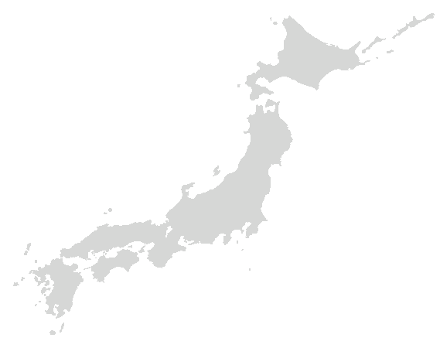





Real-time Exchange of Seismograph Data
Hi-net/F-net
Stations
Internet
IP-VPN
Network*
Research
Data Storage &
Distribution
Data
Exchange
System
JMA
Universities
Public Services
Earthquake Early Warning
Earthquake Catalog
ERI, Univ. of Tokyo
JAMSTEC, AIST
Local Government
etc...
Education/Research
*V-net (Volcano observation network) and S-net / DONET (Sea floor observation network) share the same network service.
Other Universities
Notes:
In Japan, not only NIED but JMA, National Universities and other institutes operate their own high-sensitivity and broadband seismograph networks. Since 2002, we started to exchange the seismological data to share the fundamental information about seismic activity in Japan Islands. JMA determines hypocentral locations of micro-earthquakes by using all these waveform data and opens the catalog to the public. NIED collects and archives these all waveform data, and provides them to the public by using Internet.

Slide 8
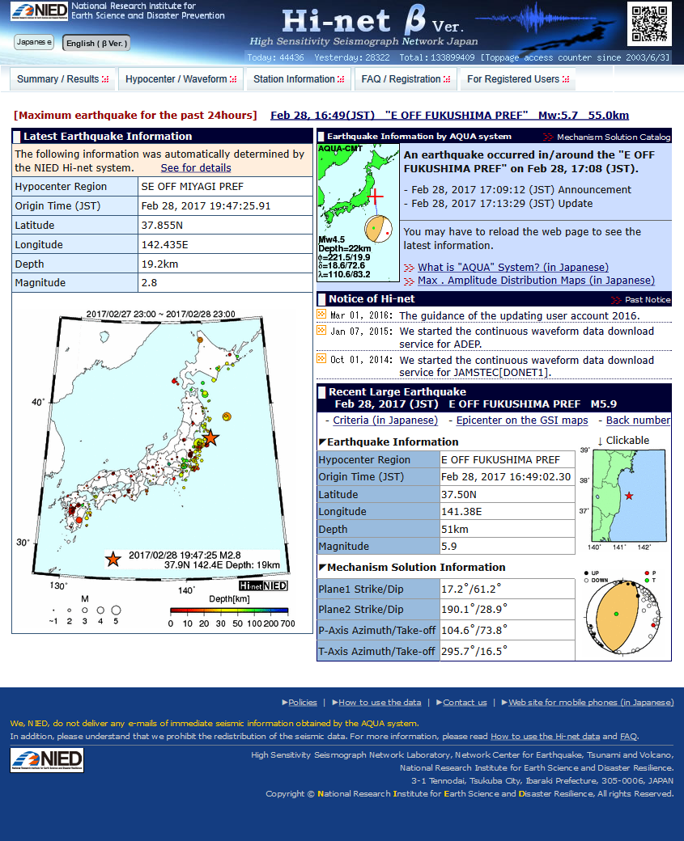
NIED Hi-net Website
Latest Earthquake Info.(M≥2.5)
Quick Announcement
Large Earthquake Info.
(M≥5)
Hypocenter Distribution of
the Last 24 Hours
http://www.hinet.bosai.go.jp/?LANG=en

Slide 9
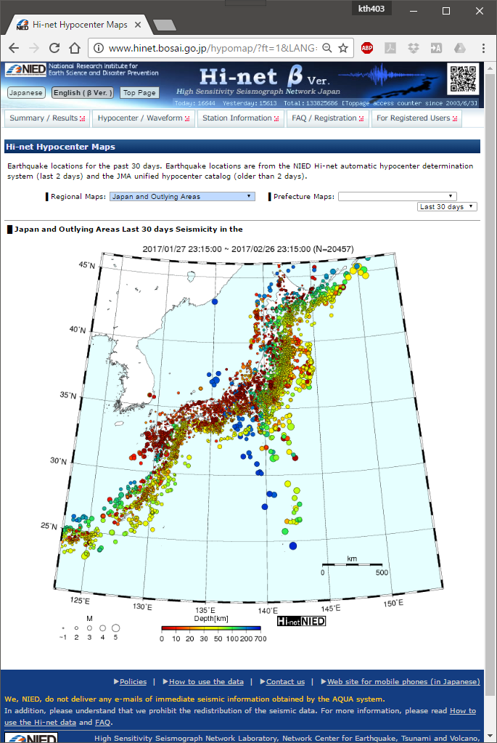
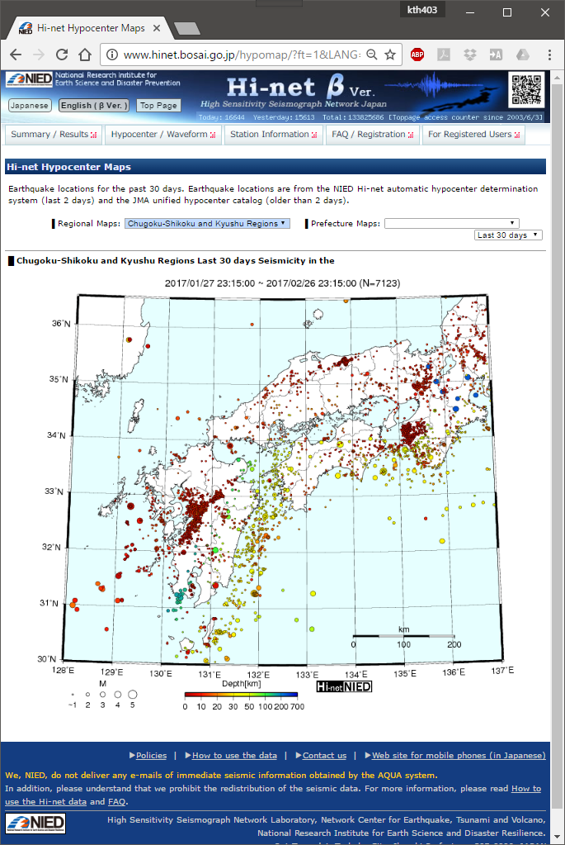
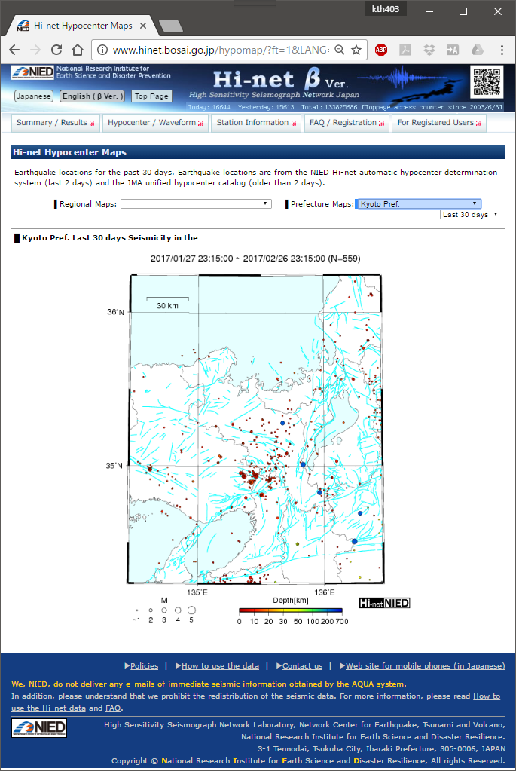
Earthquake Information
Nation-wide
Regional Scale
Prefecture Scale
30 Days / 7 Days / 24 Hours

Slide 10
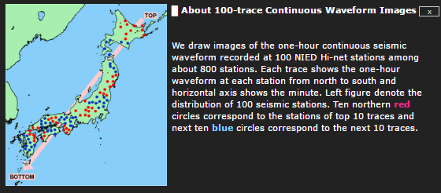
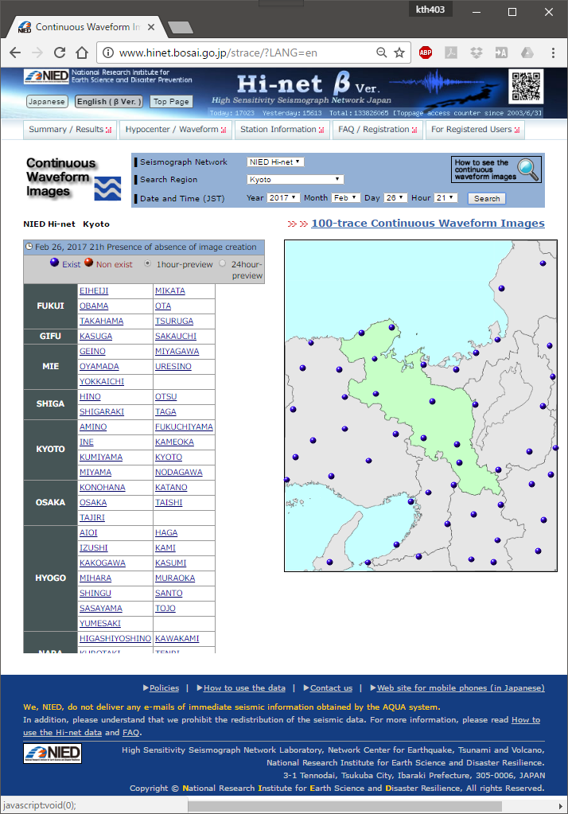
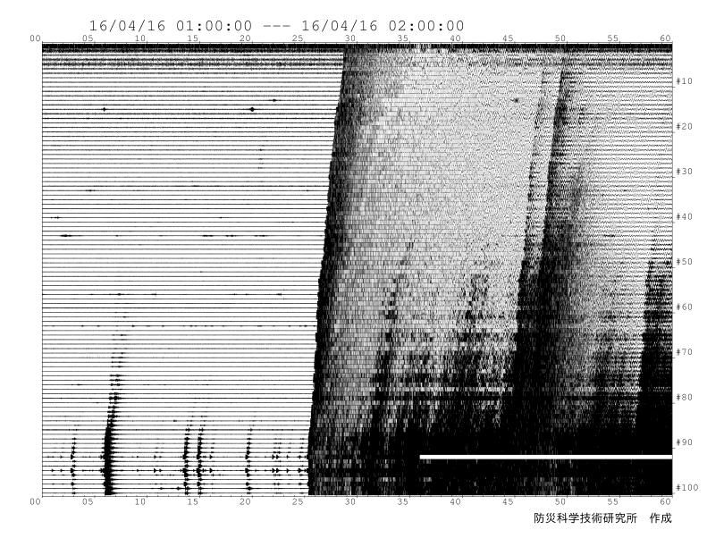
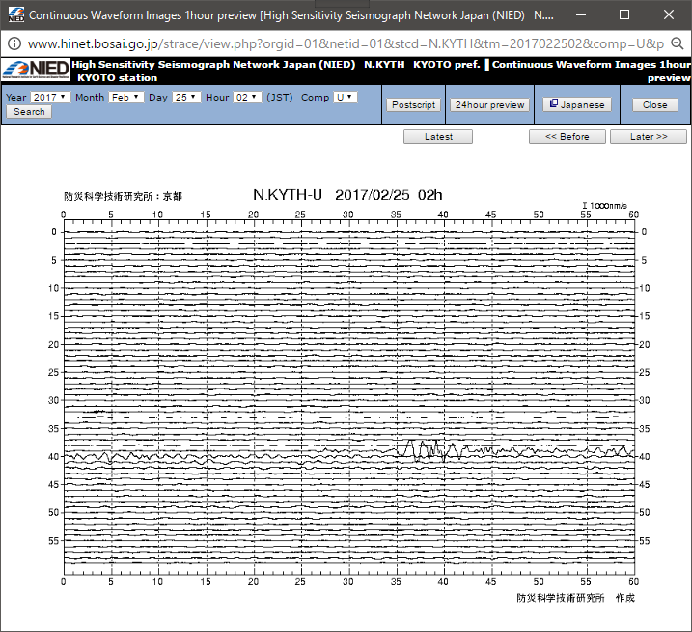
Waveforms
N
Aftershocks
M 6.9 - 287km S of Ndoi Island, Fiji
(USGS/NEIC)
S
2016/04/14 21:26:34 M6.5 at Kumamoto
2016/04/16 01:25:05 M7.3 at Kumamoto

Slide 11
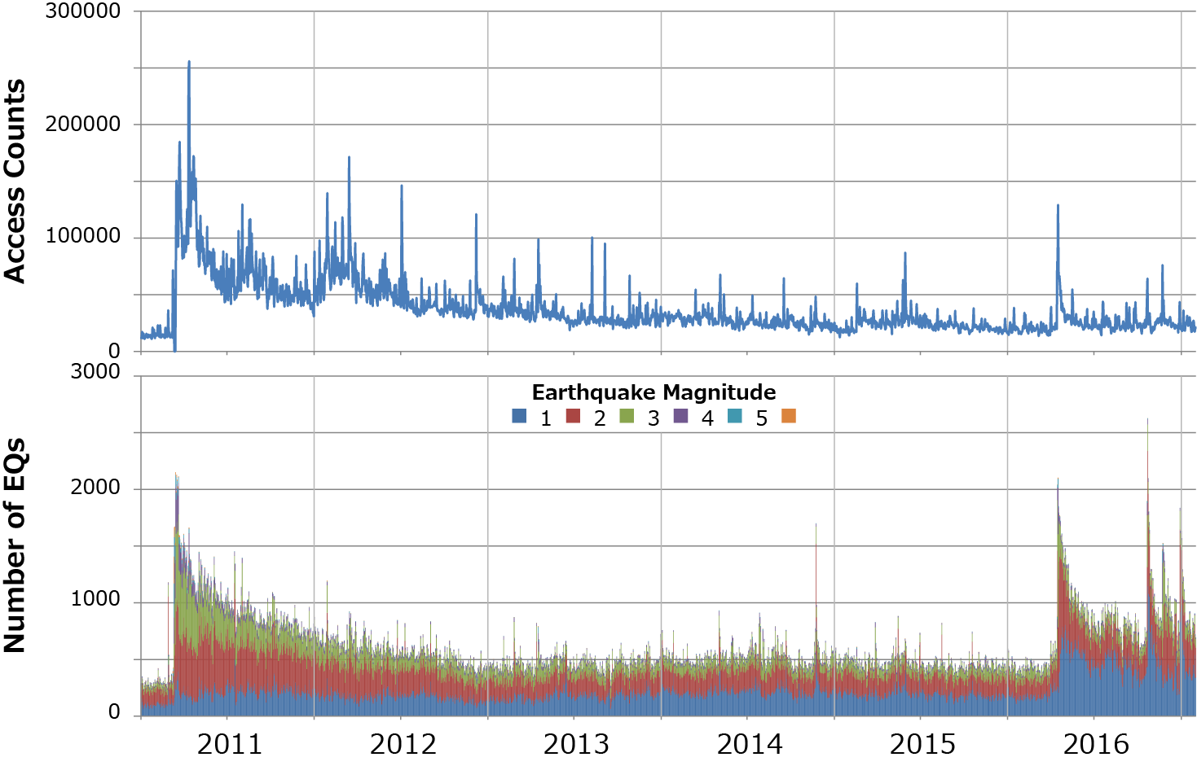
Access Counts of the Hi-net Website
C. Fukushima (M6.4)
Daily
Off Sanriku (M6.9)
Off Chiba (M6.1)
Kumamoto (M7.3)
C. Tottori (M6.6)
Tohoku-Oki Earthquake (M9.0)
N. Nagano (M6.7)
Notes:
2011/2/27 岐阜県飛騨地方 M5.5

Slide 12
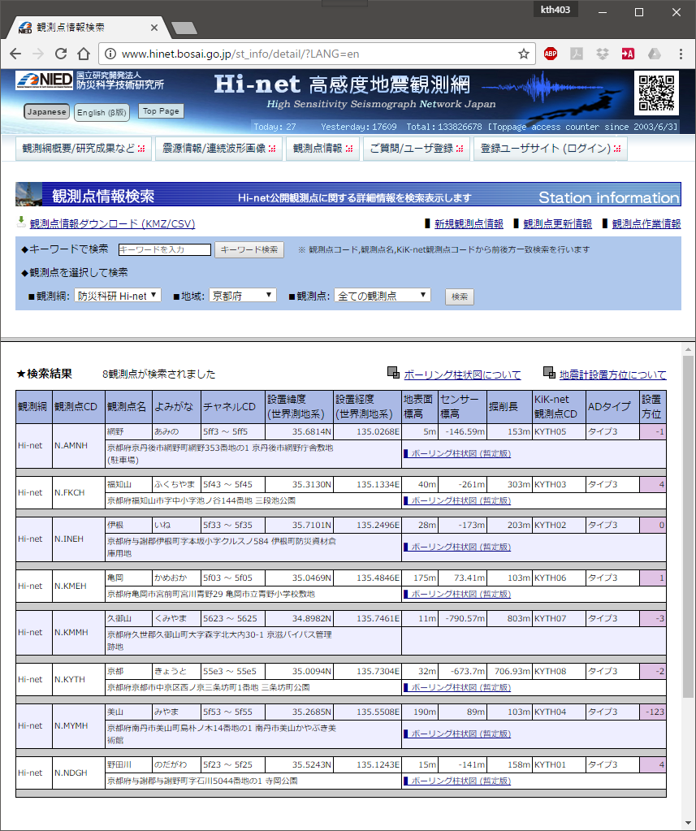
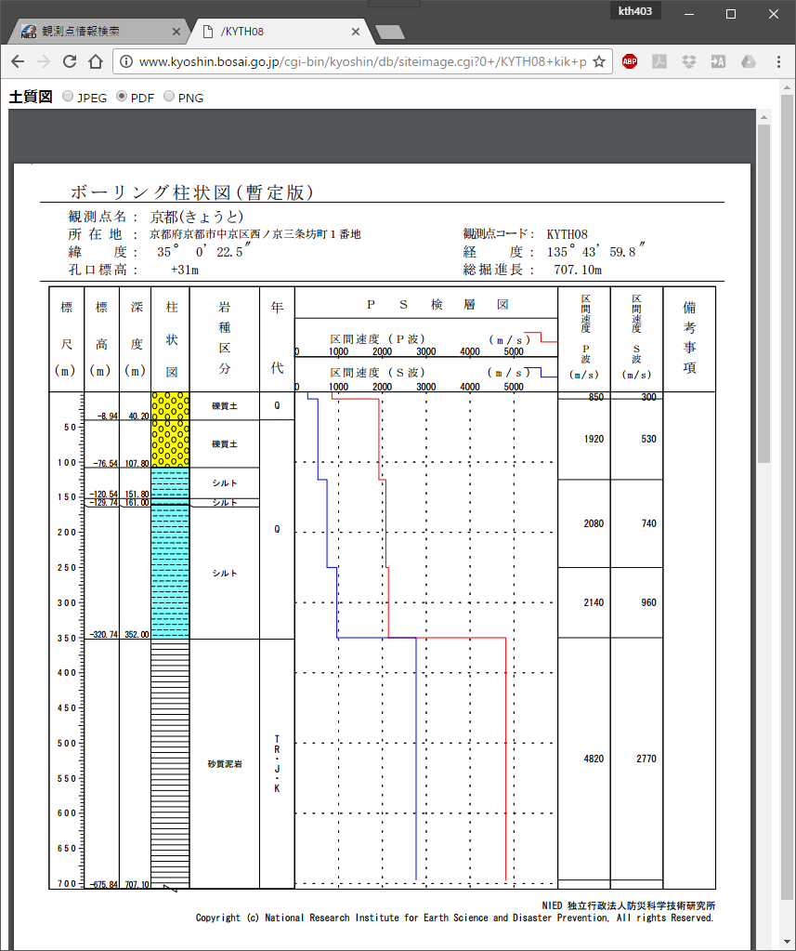
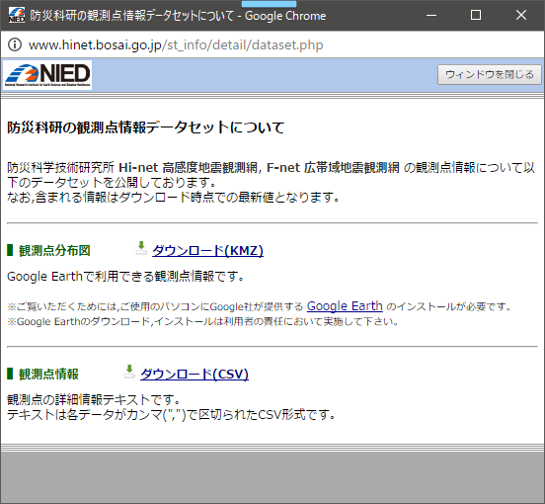
Station Information (Japanese Only)

Slide 13
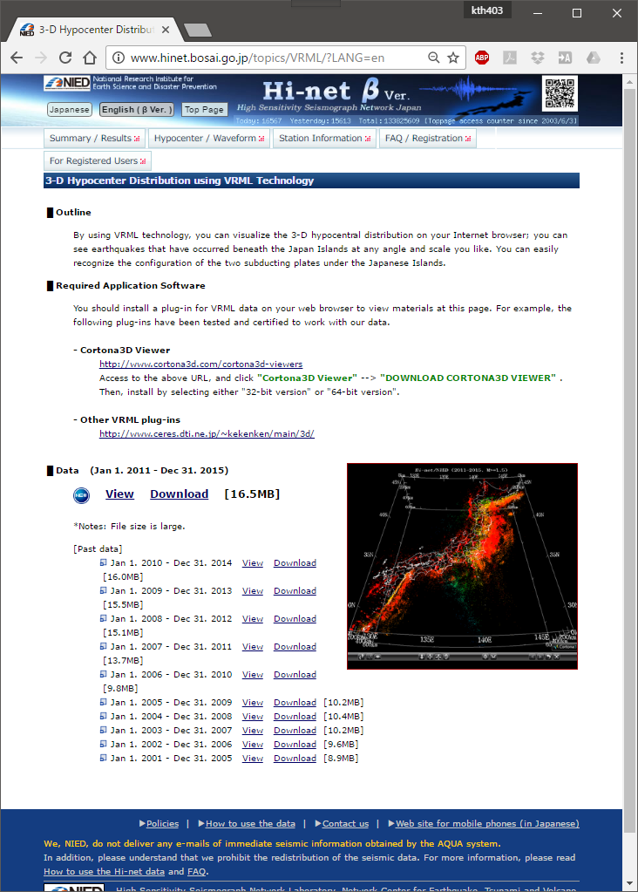
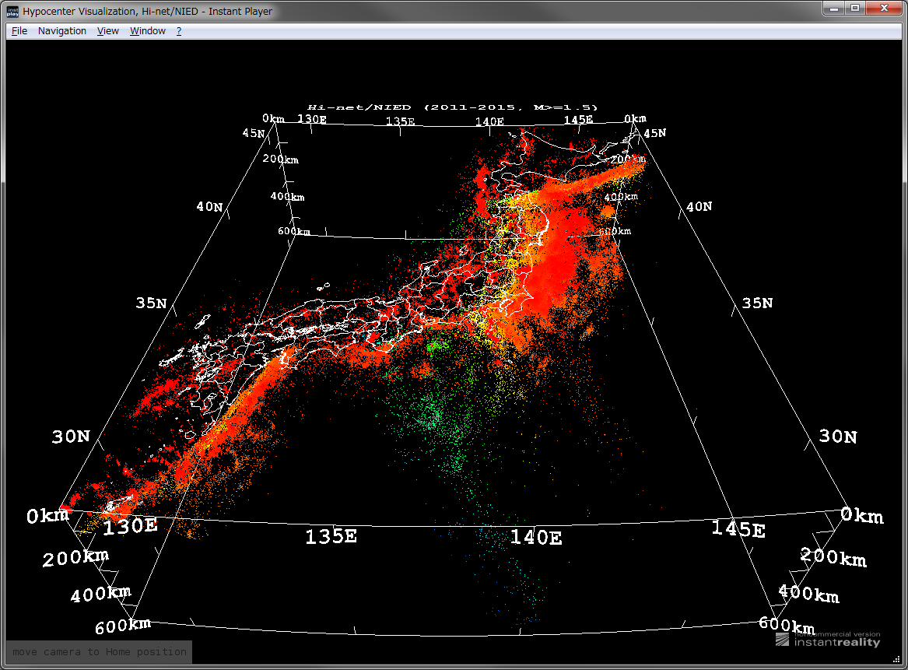
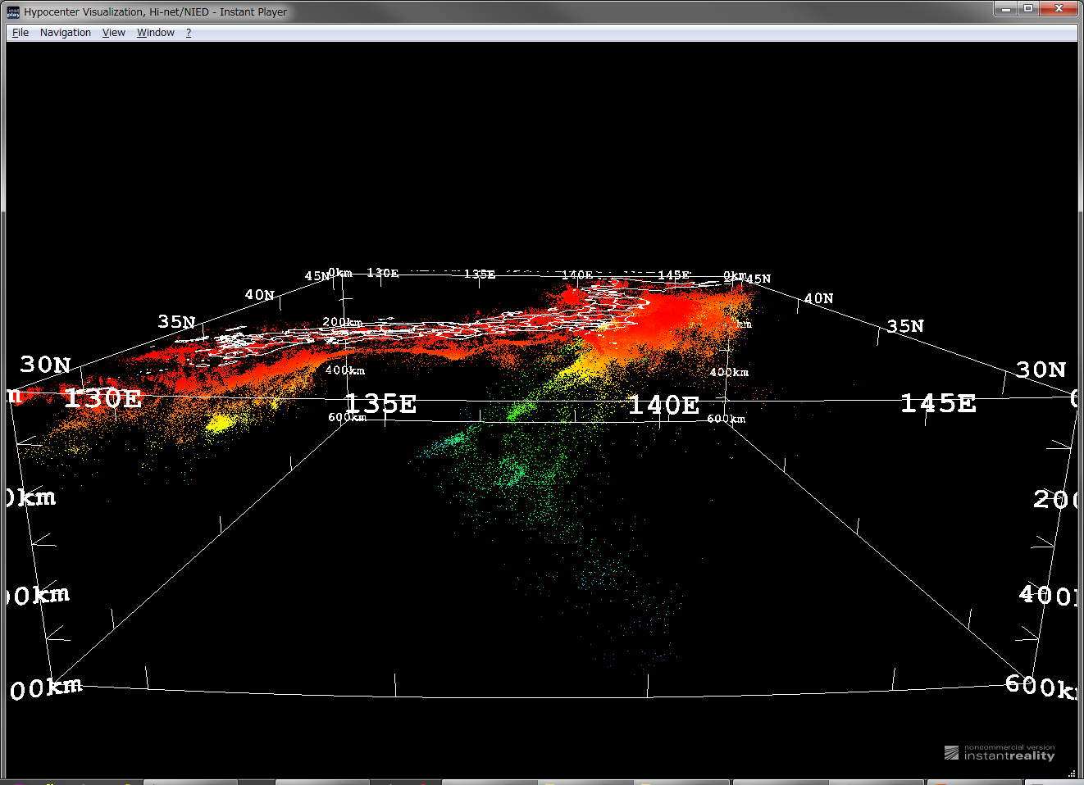
3-D Image Using VRML Technology
Pacific Plate
Philippine Sea plate

Slide 14
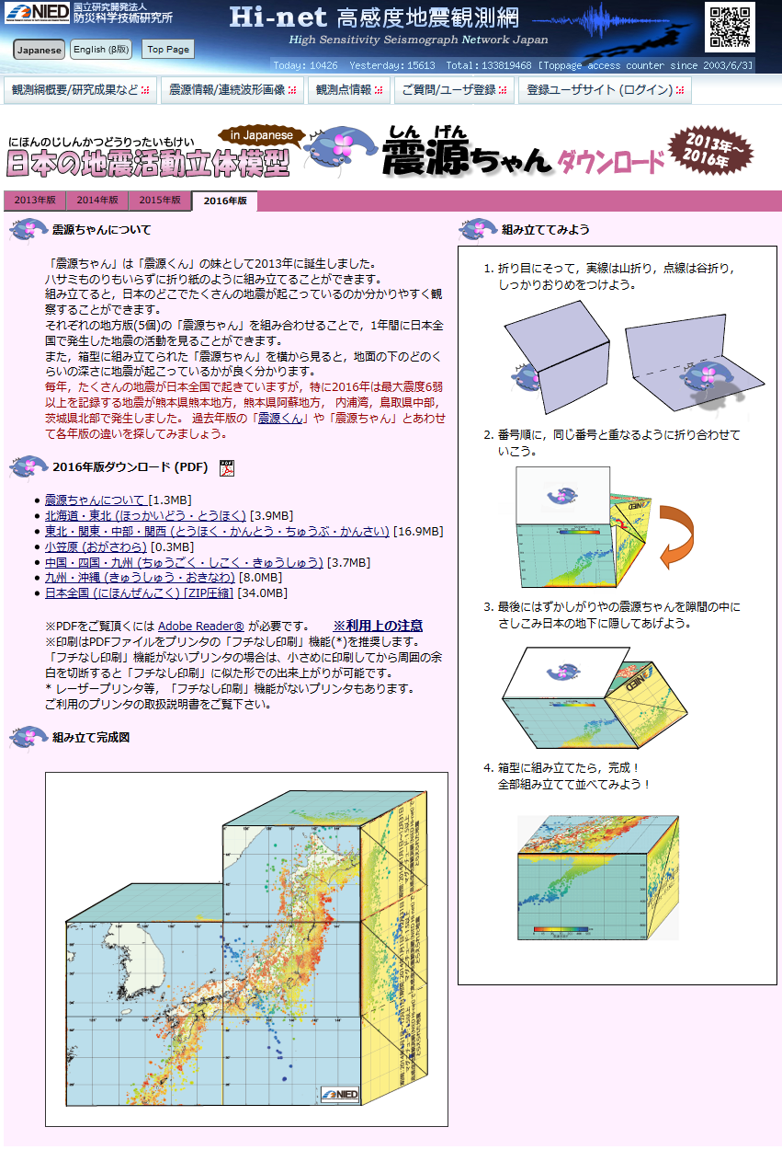
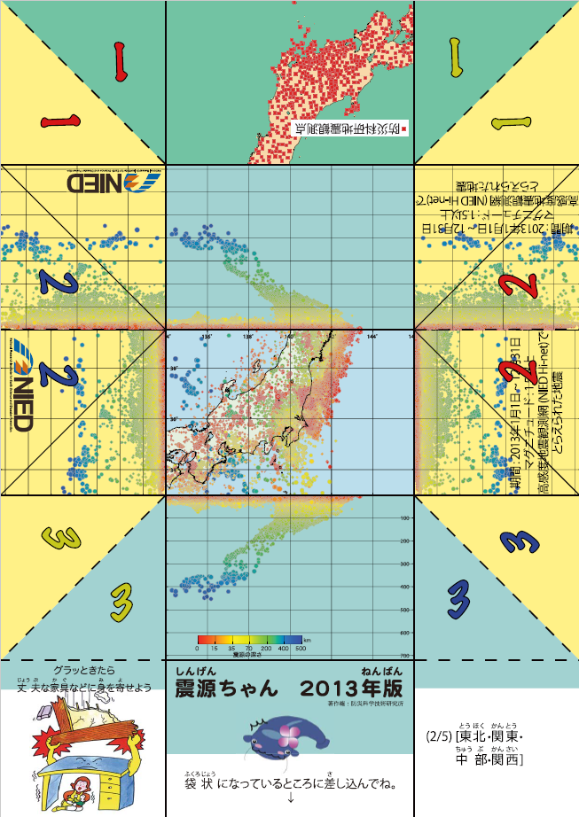
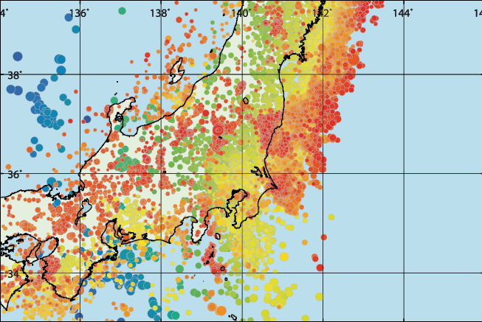
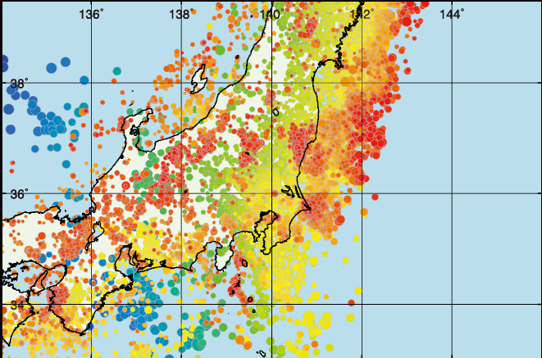
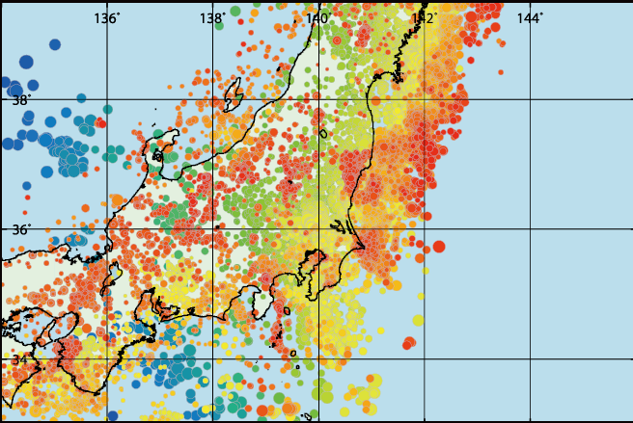
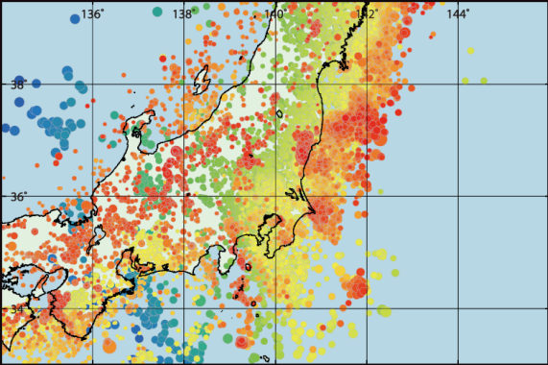
Outreach: Shingen-Chan / Origami Craft
2013年
2014年
2015年
PDF files are able to download via Hi-net website freely.
Printed sheets are distributed to visitors to NIED and exhibition booths.
We have sent the printed sheets to some schools in exchange for actual costs.
http://www.hinet.bosai.go.jp/Shingenchan/ (Japanese Only)
2016年

Slide 15
NIED Hi-net Website
http://www.hinet.bosai.go.jp/?LANG=en

Slide 16
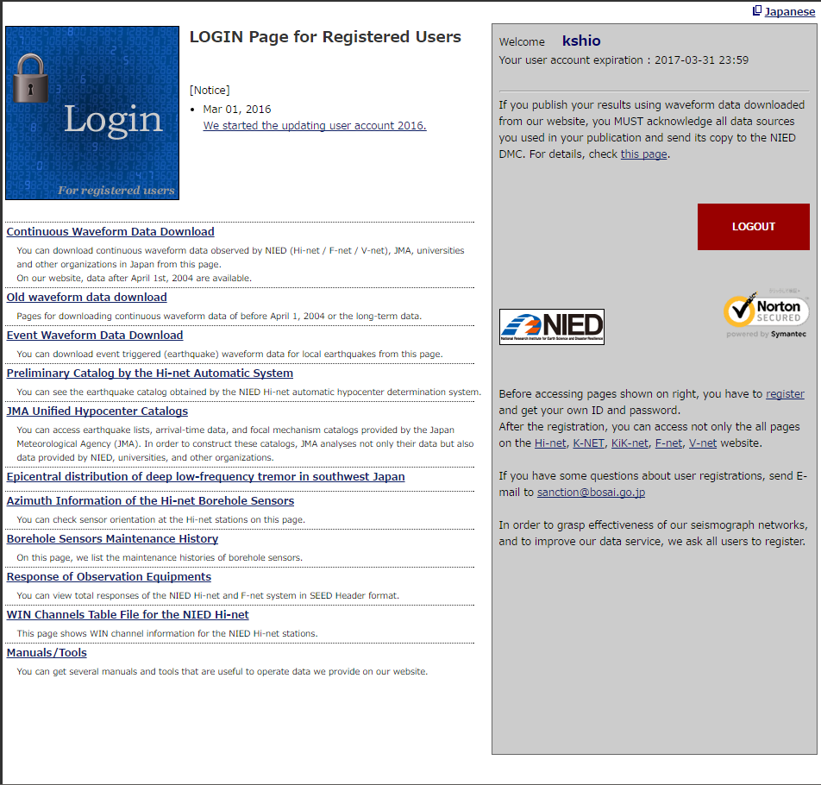
NIED Hi-net Website
USERNAME
All users who want to access waveforms, hypocenter catalogs and the other additional information have to register out website.
Number of active registered users is ~7000.

Slide 17
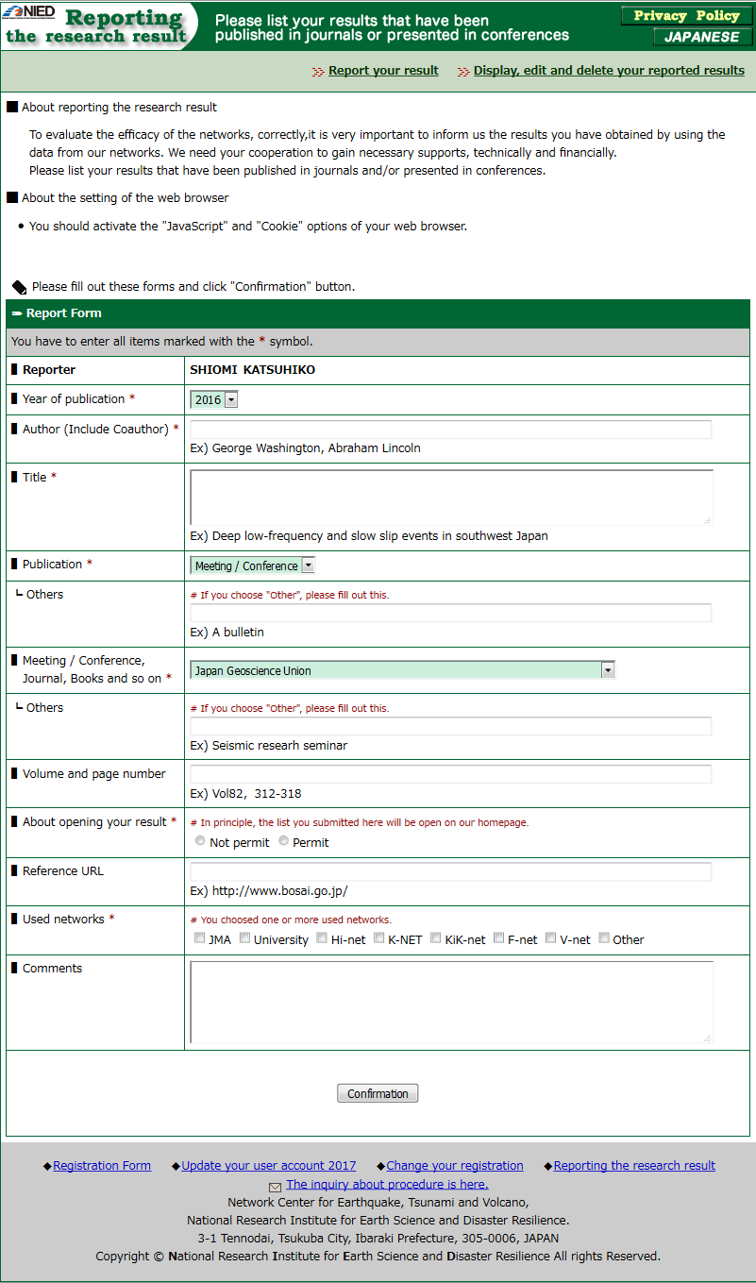
Collection of User Reports

Slide 18
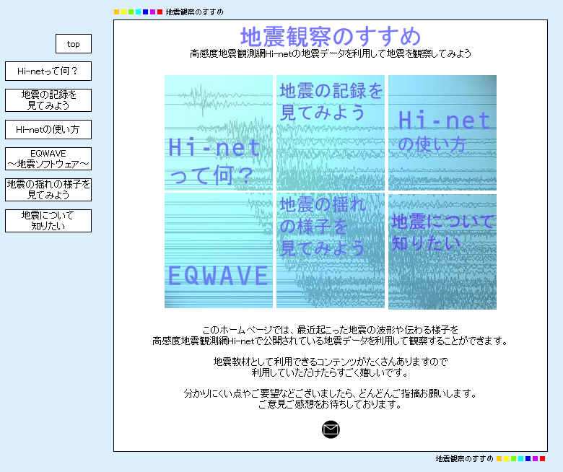
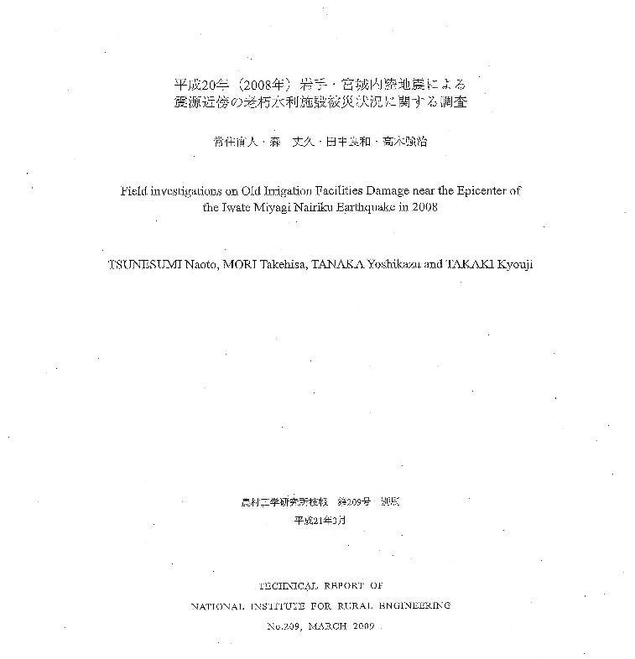
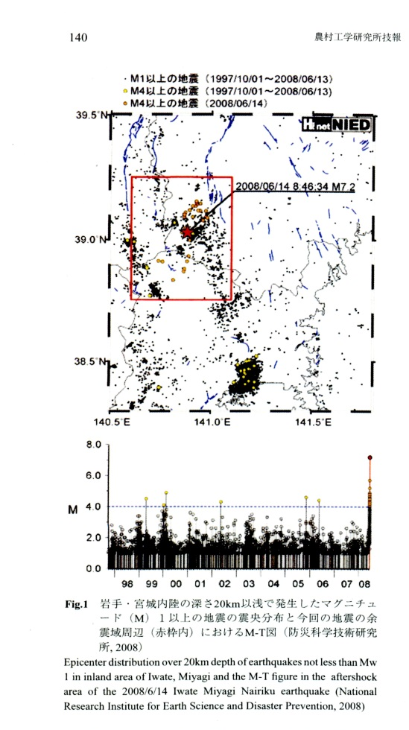

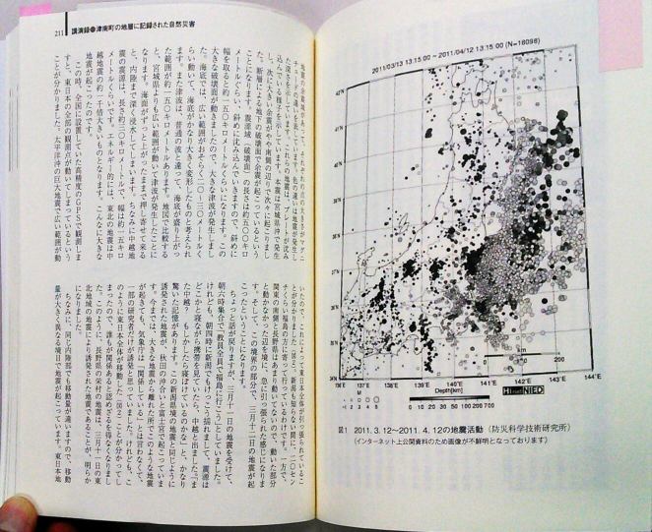
Collection of User Reports
Rural Engineering
Research for Graduation
(Dept. of Education)
Folklore

Slide 19
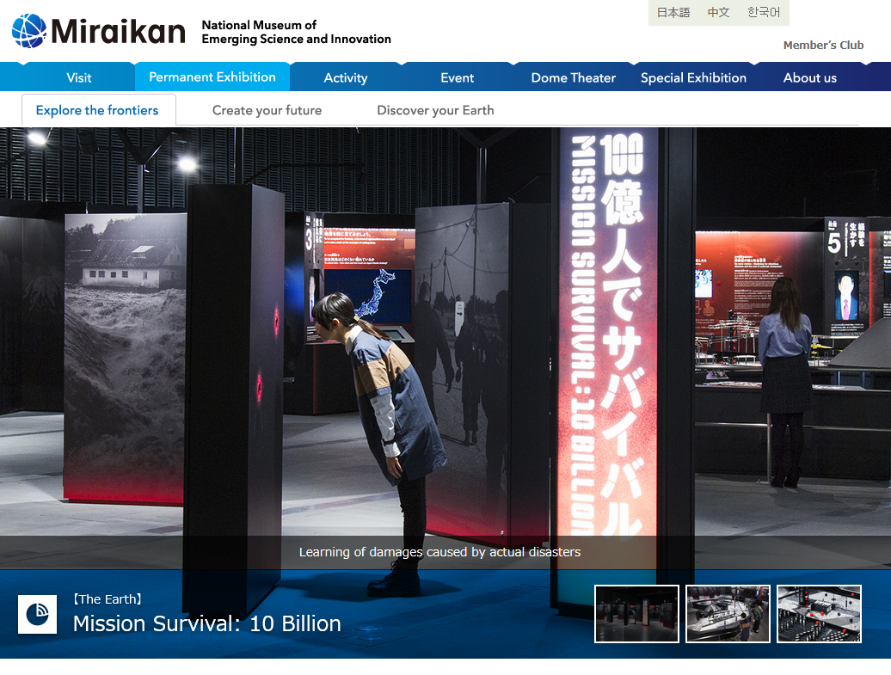

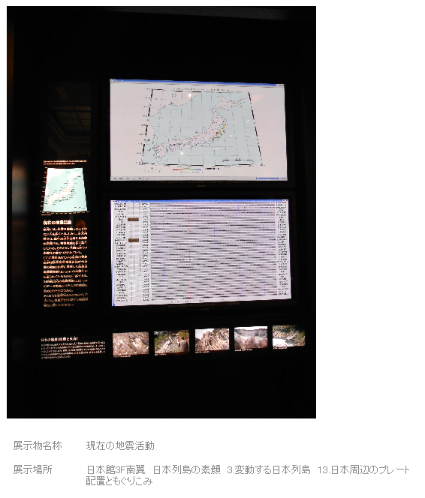
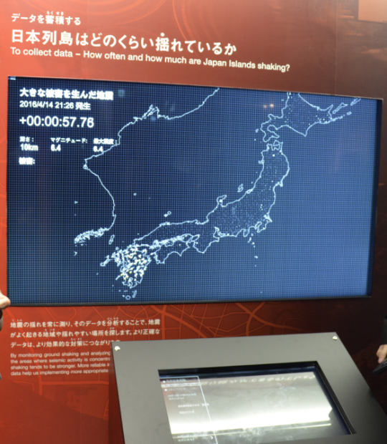
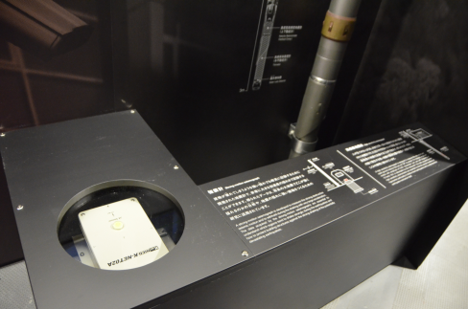


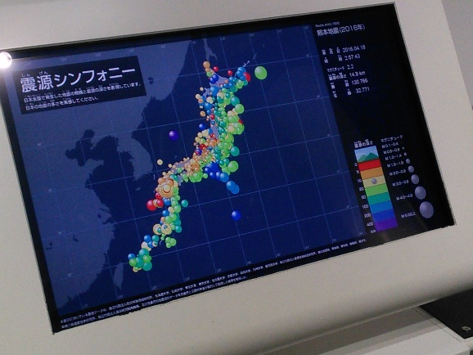
Usage: Collaboration with Museums
http://www.kahaku.go.jp/
Hypocenter Distribution &
Real-time Waveforms
Seismographs
Hypocenter Distribution
Ground Motions :
Real-time and Past Data
http://www.miraikan.jst.go.jp/
http://www.ncsm.city.nagoya.jp/

Slide 20
In the Near Future...
Soon we open the ocean bottom cable network (S-net / DONET) data to the public.
All networks, including V-net, are supported by the Japanese national budget. We have to report necessity of our networks to MEXT every year.
To maintain and upgrade our networks, we have to track the user.
We have a plan to introduce DOI to waveform data of NIED networks.

