Slide 1
ノイズを含む３次元流速データ からの有用情報抽出の試み A Trial of Extracting Useful Information from Noisy Velocity Data of a 3D Flow
〇尾亦範泰，安達健二，中塚祐喜，白山晋
（東京大学大学院工学系研究科）
第4回オープンサイエンスデータ推進ワークショップ
2017. 3. 1

Slide 2
Background
A large amount of quantitative data of fluid
Quantitative methods in fluid dynamics
Computational Fluid Dynamics (CFD) --Simulation
Particle Image Velocimetry (PIV)
Acquision of quantitative data with qualitative method
Much quantitative data is now acquired.

Slide 3
Background
A large amount of quantitative data of fluid
Analysis of "appearance" by direct visualization
Use of Proper Orthogonal Decomposition (POD)
「有意な原理，現象を発見・解明するには，従来の解析手法では困難」[平 2011]
It is difficult to discover significant principle or phenomenon with these method
Need for a method of flow data analysis

Slide 4
Background
Development of machine learning methods
Methods for time-series data
Analysis of human behavior with HMM
Autoplait [Matsubara et al. 2014]
Data with special characteristics
Analysis focusing on data in direction
von Mises Fisher clustering [Gopal and Yang 2014]
Apply to analysis of flow data!!

Slide 5
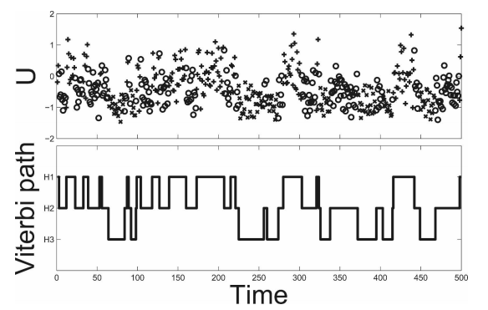
Related work
Analysys of flow time-series with machine learning
Applied HMM to the flow data [Franzke et al. 2008]
Proposed to segment flow temporally with HMM
Applied to artificial atmospheric flow data
Obtained meteorologically meaningful division
The flow of a certain time is represented by a scalar
Fig. 7

Slide 6
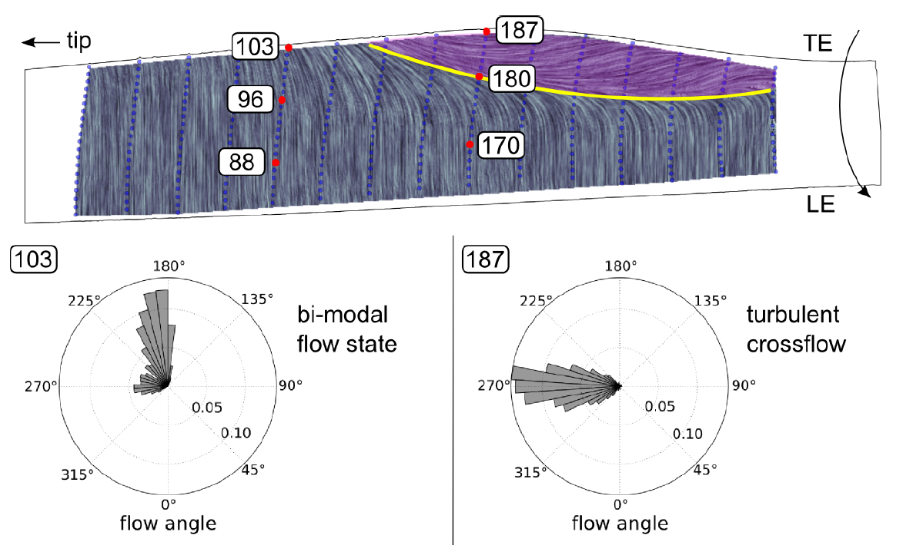
Related work
Quantitative analysis of Qualitative experiment data
Analysis of airflow on the wing surface of the windmill by tuft method
Histogram display of direction
[Vey et al. 2014]
[Vey et al. 2014]
Figure 2

Slide 7
Objective
Proposal of a quantitative method to segment flow temporally
Development of new data analysis method of flow
Segment the flow temporally
The flow condition is to be similar in each segment.

Slide 8
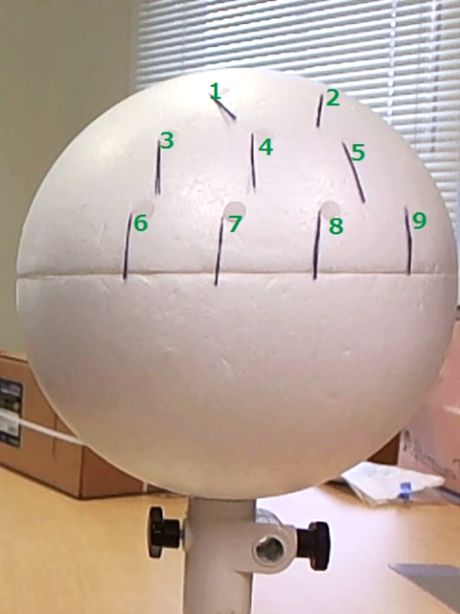
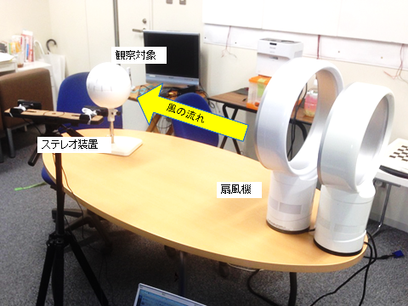
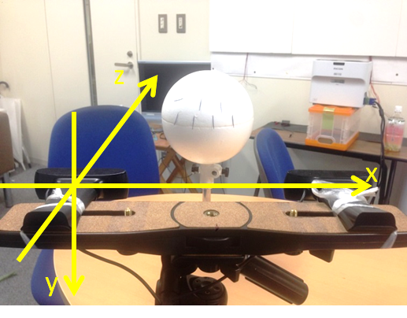
Target data
3D position of tufts are used
Real data of tuft method [白山，尾亦，安達 2015]
Time series data of 3D positon of tufts

Slide 9
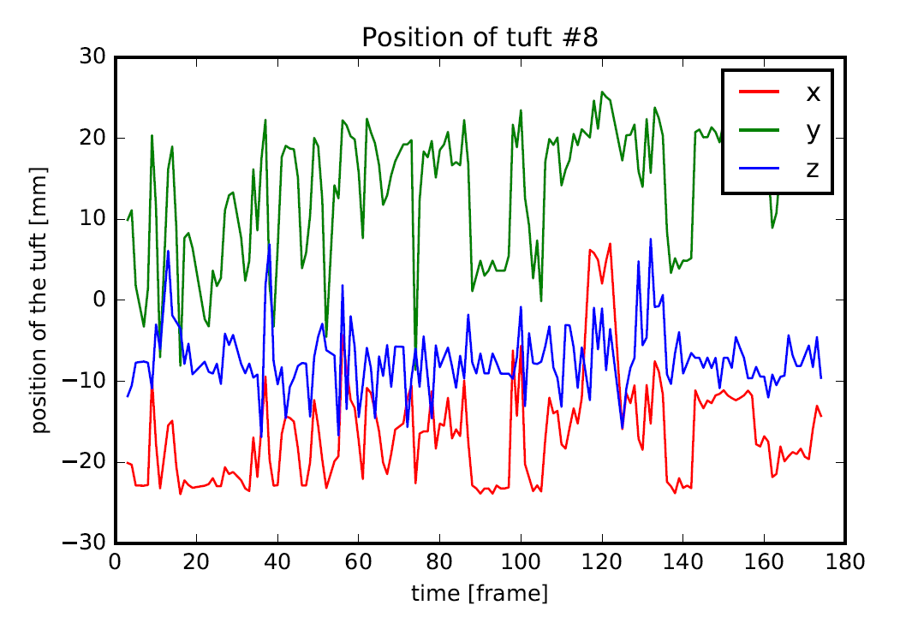
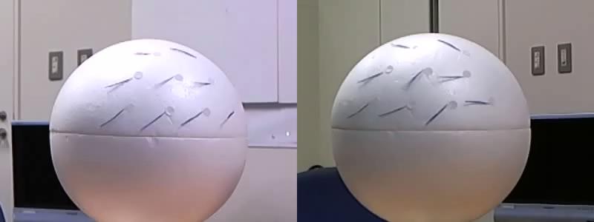
Target data
3D position of tufts are used

Slide 10
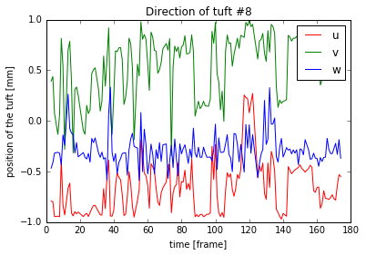

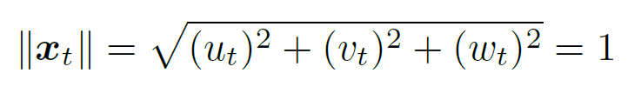
Target data
Extract directional information by Normalization
Normalize so that the norm comes to 1
(every tuft, every time period)
normalize
Data of tuft α at time t:

Slide 11
Our method
Apply vMF-HMM to multidimensional time-series flow data
Temporal segmentation with
Multidimensional
Directional
Hidden Markov Model.
To deal with multidimensional direction,
knowledge of directional statistics is used.
von Mises-Fisher distribution
Understand the data based on the result of segmentation

Slide 12

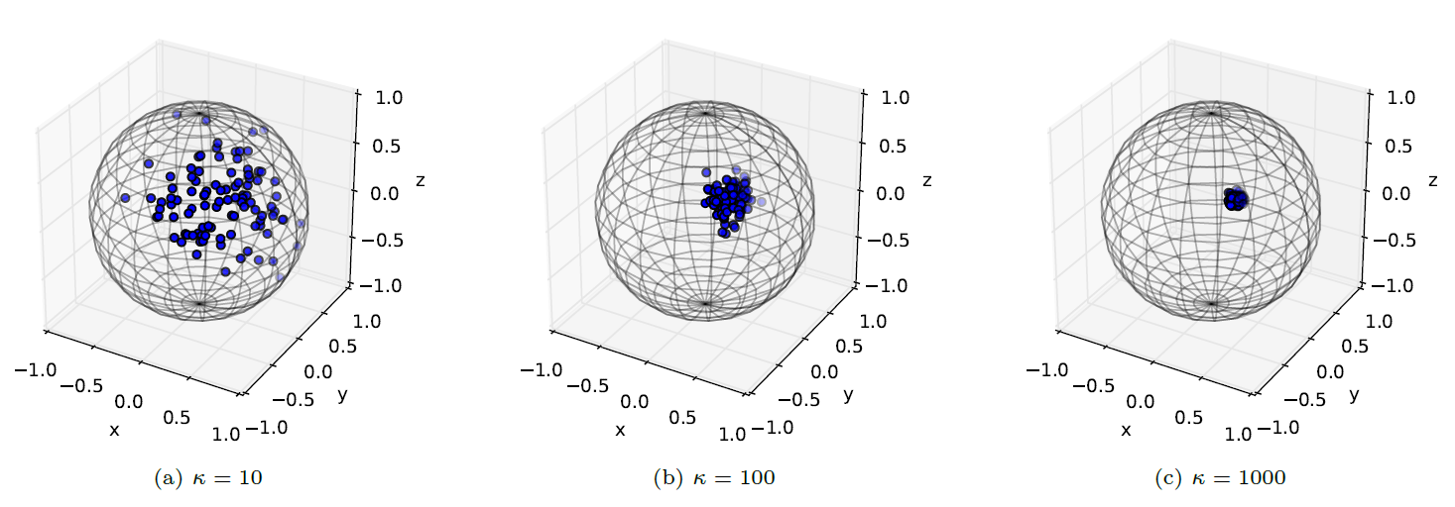
Stochastic model of direction
Use of directional statistics
Statistics for directional data
Domain of directional data is a unit hypersphere:
We consider 3D direction (p=3)

Slide 13
Stochastic model of direction
Distribution used in directional statistics
von Mises-Fisher distribution
Fundamental distribution of directional statistics
A mixture distribution well express the wind direction [Masseran et al. 2013]

Slide 14
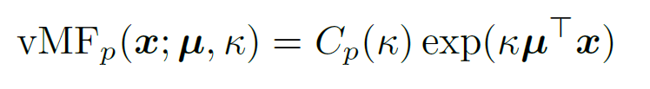
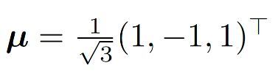
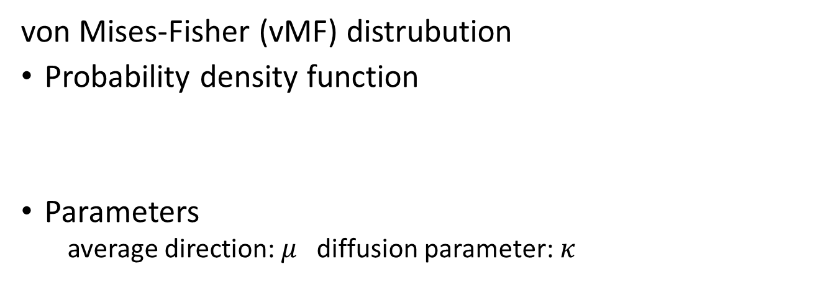
Stochastic model of direction
Distribution used in directional statistics
von Mises-Fisher (vMF) distrubution
Probability density function
Parameters
average direction: $μ$ diffusion parameter: $κ$
normalization
Main term

Slide 15
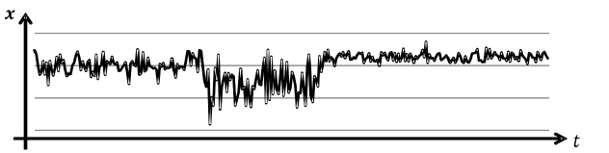
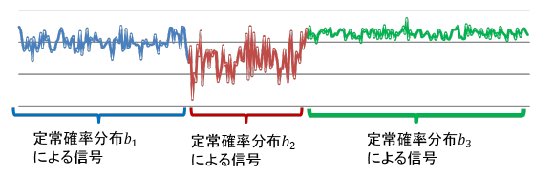
Hidden Markov Model
Stochastical modeling of data generation
Hidden Markov Model（HMM）
A method of machine learning（e.g. [Matsubara et al. 2014]）
Stochastic modeling of temporal evolution of data
Available to segment time-series data temporally

Slide 16
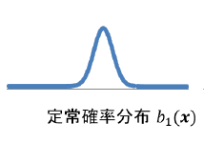
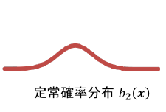
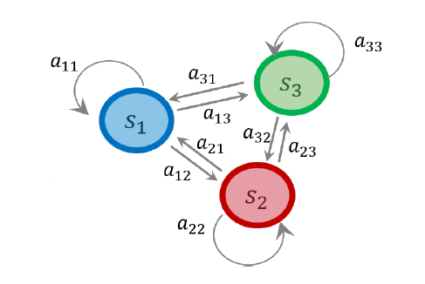
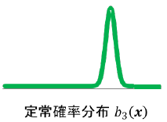



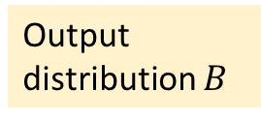

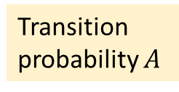
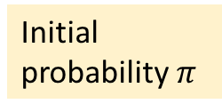
Hidden Markov Model
Structure of the model
$$\text{確率}π$$
HMM
（# of states: 3）
Output distribution $B$
Initial probability$π$
$$π_{3}$$
$$π_{1}$$
$$π_{2}$$
Transition probability $A$

Slide 17
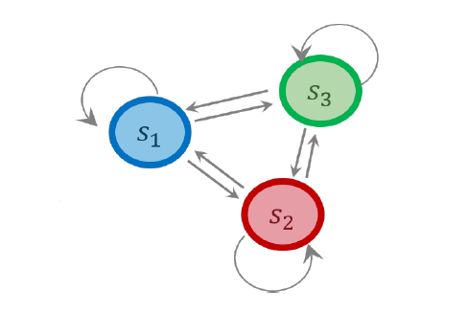


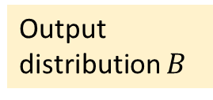





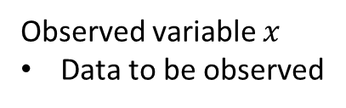



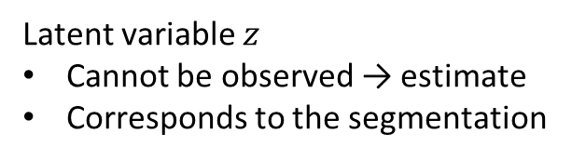
Hidden Markov Model
Structure of the model
$$\text{確率}π$$
HMM
（# of states: 3）
Output distribution $B$
Latent variable $z$
Cannot be observed → estimate
Corresponds to the segmentation
Initial probability$π$
$$z_{1}$$
$$z_{2}$$
$$z_{3}$$
$$x_{1}$$
$$x_{2}$$
$$x_{3}$$
Observed variable $x$
Data to be observed
Transition probability $A$
時刻$t$

Slide 18





Hidden Markov Model
Learning of the model
$$\text{確率}π$$
HMM
$$π$$
$$A$$
Latent variable $z$
Cannot be observed → estimate
Corresponds to the segmentation
$$B$$
$$z_{1}$$
$$z_{2}$$
$$z_{3}$$
Unknown
Estimation of
Parameters of HMM
Latent variables
→ called “learning”
Use Baum-Welch algorithm
$$x_{1}$$
$$x_{2}$$
$$x_{3}$$
Known
Observed variable $x$
Data to be observed
時刻$t$

Slide 19
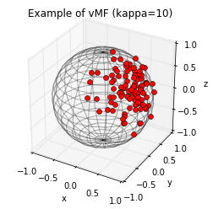
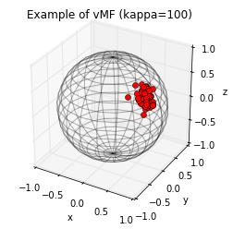
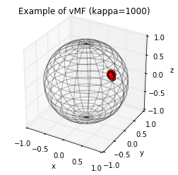
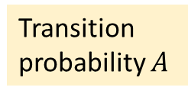


Our method
Apply vMF-HMM to multidimensional time-series flow data
Segment data temporally
vMF distribution based
Hidden Markov Model
Understand the data based on the segmentation
$$\text{確率}π$$
Output distribution $B$
HMM
Use of
vMF distribution
Initial probability$π$
Transition probability $A$

Slide 20
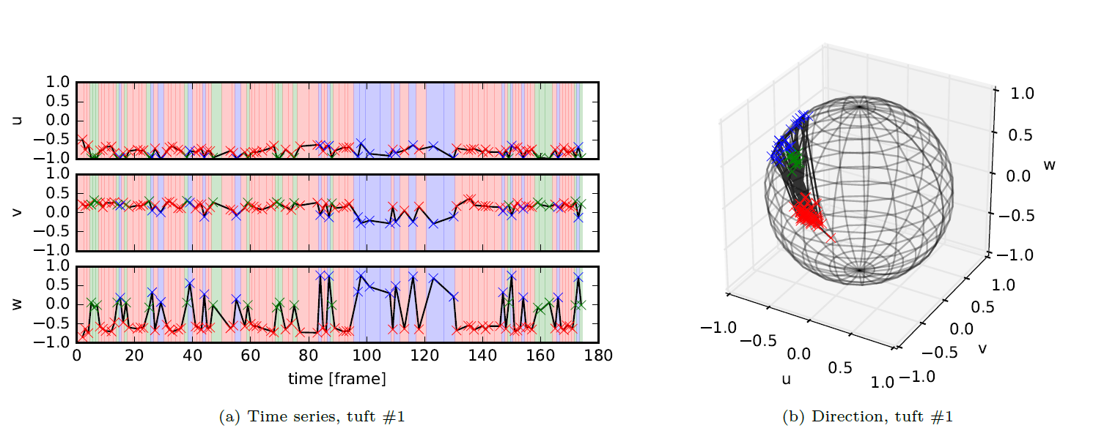
Experimental result
An example of states that have different average direction
Segmented time series
Plot of direction

Slide 21
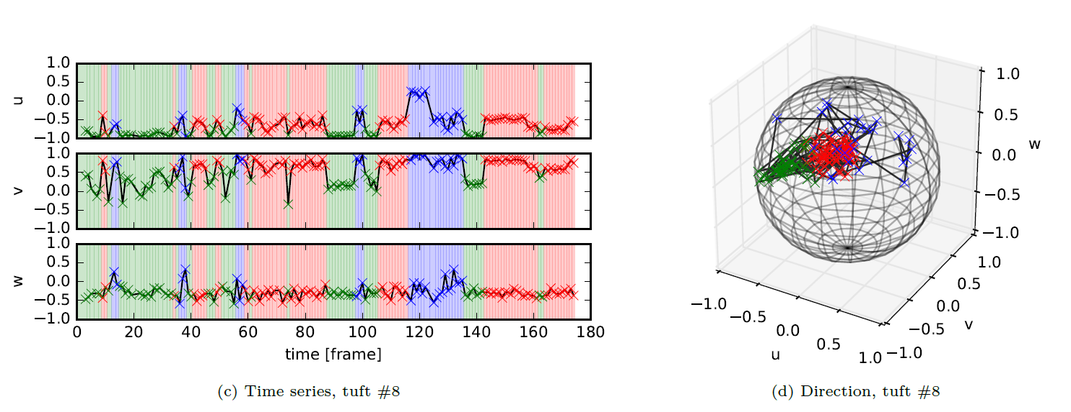
Experimental result
An example of states that have different diffusion
Segmented time series
Plot of direction

Slide 22
Summary
Summary and future work
Need for a method of flow data analysis
Proposed vMF-HMM based temporal segmentation
Applied to directional data of tuft method
Future work
Determine hyperparameters automatically
Application to other data
Comparative experiment with other methods
Extension of our method to the region

