Slide 1


International/Japanese Situation of Open Science and Research Data Sharing: Governmental, Academic, and Community Developments
Kyoto Univ. 4th Workshop for Promoting Open Science Data
28 Feb.-1 Mar. 2017, Science Seminar House, Graduate School of Science, Kyoto Univ.
Yasuhiro Murayama
Associate, Science Council of Japan
ICSU-WDS Scientific Committee ex officio
National Institute of Information and Communications Technology
International Programme Office Hosted by
Based in Tokyo, Japan

Slide 2
TOC
International Policy scene
Data sharing practice from printing to electronic culture
Technological+Social “Infrastructure” is needed.

Slide 3







My background
Geophysics, Atmospheric/Space Science
Board member of Japan Geoscience Union (2014-2015)
Visiting Professor, Kyoto University, (2013-2014)
Associate member, Science Council of Japan
Research Executive Director, Big Data Integration Res. Ctr. Natl. Inst. Information & Communications Technology
ICSU-World Data System Scientific Committee, ex officio member
Member of Cabinet Office Expert Panel of Open Science
Non-EU Member of EC’s High Level Expert Group of European Open Science Cloud
Data Management, Science Policy

Slide 4


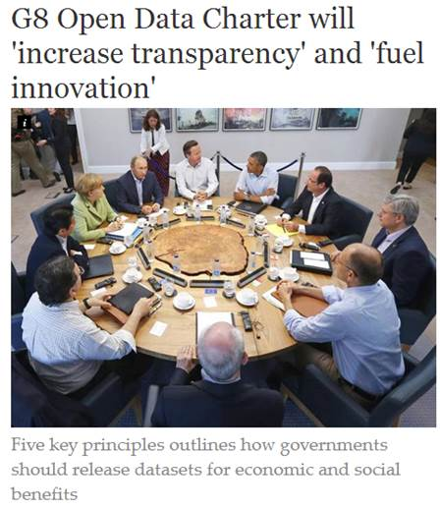
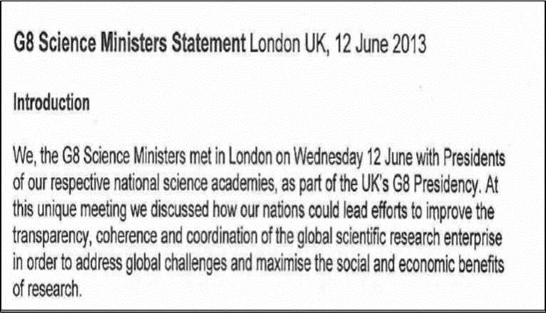
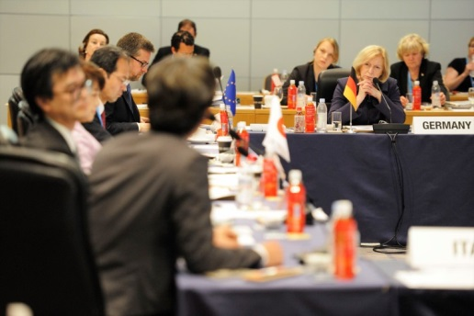
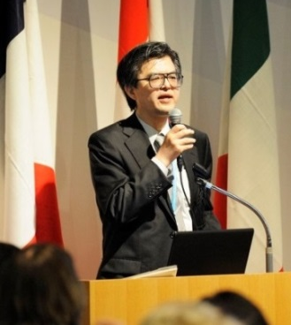
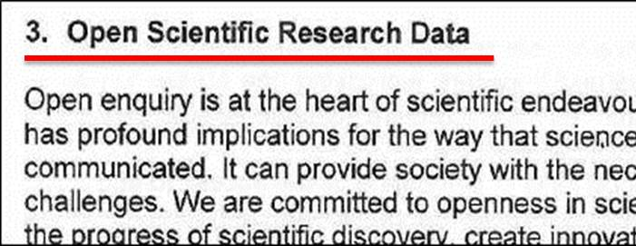
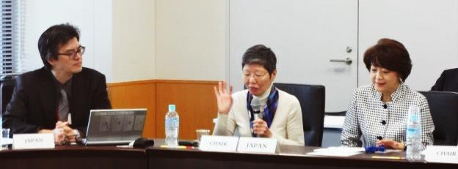
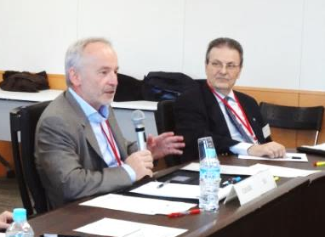
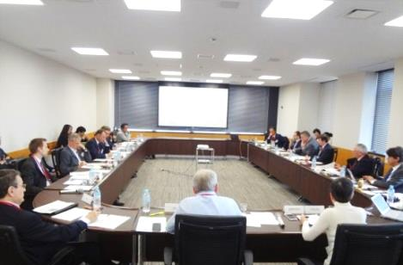
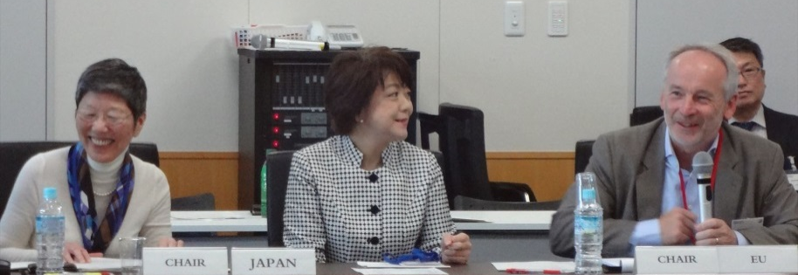
G8 2013 Science Ministers’ Meeting (UK)
G7 2016 Science Ministers’ Meeting (Japan)
科学技術大臣会合
つくば、2016.5.15-17
Photos by Cabinet Office of Japan, Ibaragi Prefectural Government, and Tsukuba City Government
“Open Science” was one of six themes オープンサイエンスは6議題の1つ
Agreed to create a new G7 Working Group of Open Science. オープンサイエンスに関するWG設置合意
“Open Research Data”のG8科学技術大臣合意
G7 Open Science WG: 1st expert meeting, 9th Nov. 2016, Tokyo
２０１６年G7科技大臣会合設置オープンサイエンス部会第1回会議 （内閣府、2016.11. 9)
Science Cloud or data infrastructure
Reward, Skills and Culture
Target to output a document to future G7
左から村山、原山議員（CSTI)、島尻前科技担当大臣
Y. Murayama, Y. Harayama (CSTI), A. Shimajiri (former S&T Minister)
J.C.Burgelman（EC DG RTD)、
L. Karapiperis（EU Delegation)
“Open Government Data”
4

Slide 5
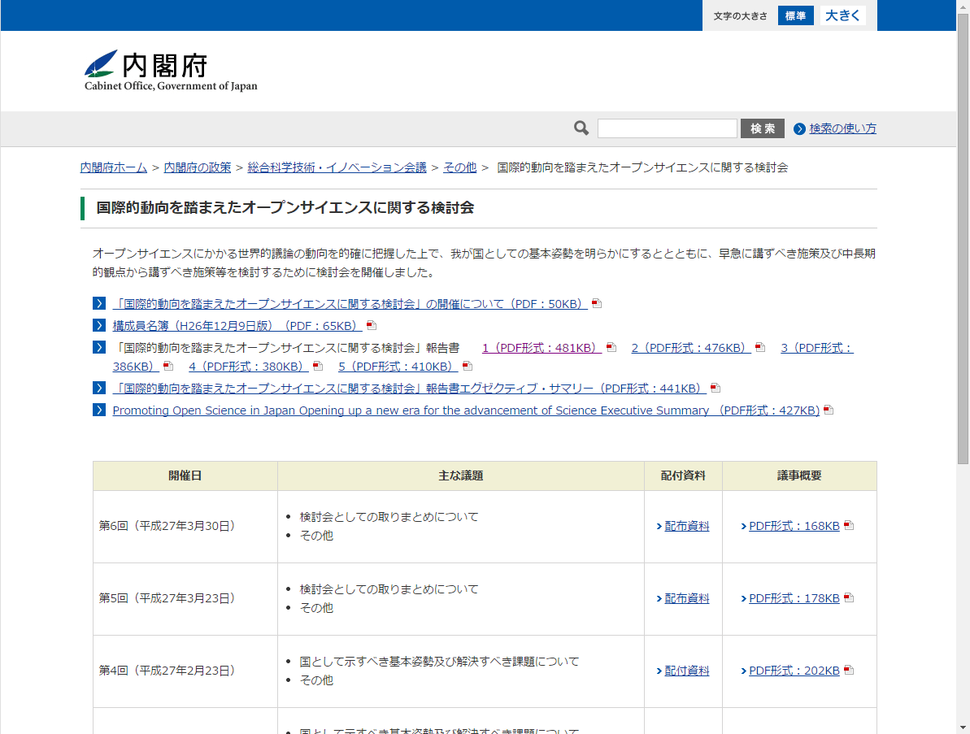
Expert Panel on Open Science based on Global Perspectives (Cabinet Office, Japan)
内閣府「国際的動向を踏まえたオープンサイエンスに関する検討会」
Promoting Open Science in Japan Opening up a new era for the advancement of science
Report by the Expert Panel on Open Science, based on Global Perspectives, Cabinet Office, Government of Japan (March 30, 2015)
[H. Manago, 2015]

Slide 6
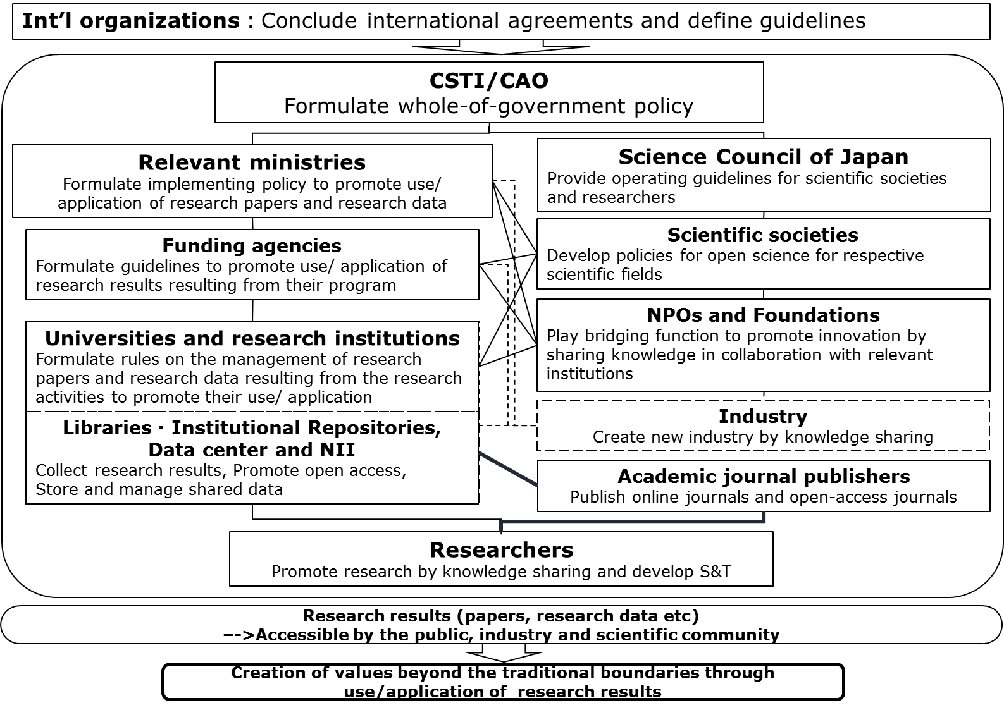
Cabinet Office/CSTI：National Principle of Open Science
Cabinet Office “Expert Panel of Open Science” （Dec, ‘14 ---March ‘15) http://www8.cao.go.jp/cstp/sonota/openscience/
=➔ Final Report was published at the Web site 30 March 2015.
[H. Manago, 2015]
Input to the 5th National Basic S&T Plan

Slide 7
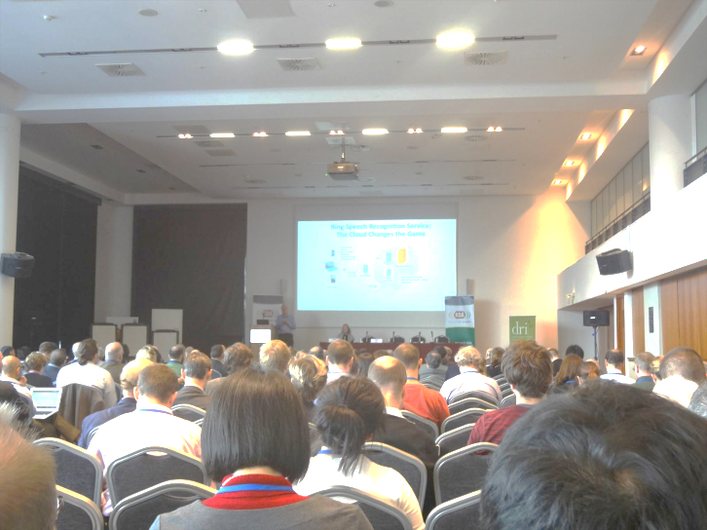
Conventional Scientific Method to Societal Decision Making
General Society/ political decision making 一般社会・政治的意思決定
Conventional Science Method
Facility
Community Consensus Forming 科学コミュニティのコンセンサス
Question
Hypothesis
Experiment/ Observatoin
Analysis/ Discussion
Conclusion
Software
Data Contributor
Open discussion and criticism
オープンな議論、批評、再検証
Data
Shared in the research community
コミュニティでの研究情報共有
Paper
Author
Reviewer
Affiliation
Editor
Funder
Publisher

Slide 8
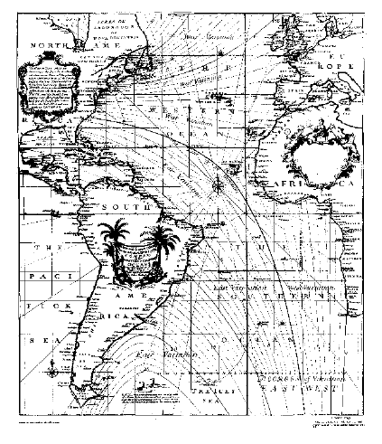

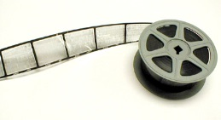
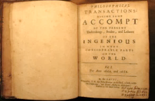



オープンサイエンスへ向けた取組み例：地球科学におけるデータ共有 For future Open Science practice: Legacy in Geophysical Data Sharing
18th Century
First geomagnetic map of Atlantic Oceans by E. Halley (1702)
20th Century 国際地球観測年→国際組織設置
International Committees were established for data preservation/services.
International Geophysical Year (1957-1958)
World Data Centre
e.g., https://www.ualberta.ca/~unsworth/UA-classes/210/notes210/D/210D2-2008.pdf
http://www.kakioka-jma.go.jp/intro/enkaku.html
Federation of Astronomical & Geophysical Data Analysis Services
21st Century
新たな委員会へ発展的改組 ICSU –WDS established (2008) toward a new data management.
情報・通信技術の発展 分野横断・多分野連携の必要 グローバル研究体制へ
Increasingly Required: - Use advanced IT/ICT - More multi & interdisciplinary - Global interoperable system
Notes:
科学情報の共有は、いまにはじまったことではない。一部（たとえば地球物理学）では100年200年の歴史がある。
しかし現代では、ＩＴ／ＩＣＴ技術を分野横断的に活用して、分野横断、国を超えて世界全体で活用できる体制が重要となっている

Slide 9
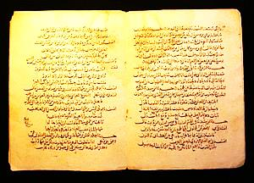
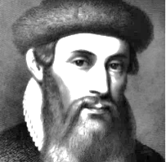
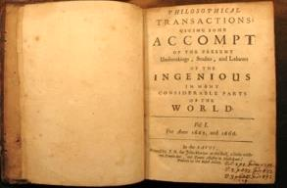
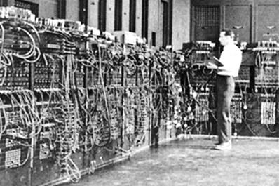
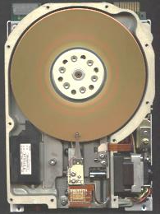


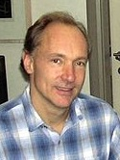

Print & Electronic Technologies as Social Info. Infrastructures --- 百年の印刷文化の基礎支えと、成長途中のディジタル・サイエンス
Public library (paper media) ：8c
Printing press/Gutenberg: 1445
First scientific journal: 1665
Intl. Assoc. Academies: 1899
ICSU established: 1931
World Data Center system : 1957
ENIAC, von Neumann: 1946
Hard Disk Drive: 1956
TCP/IP, dial-up (64kbps): 1982
WWW (CERN): 1991
Broadband internet (>1Mbps)：～2000
351 years
70 years
Print Media
Electronic Media
New global data initiatives: ICSU-WDS, RDA etc.：2008～2013

Slide 10
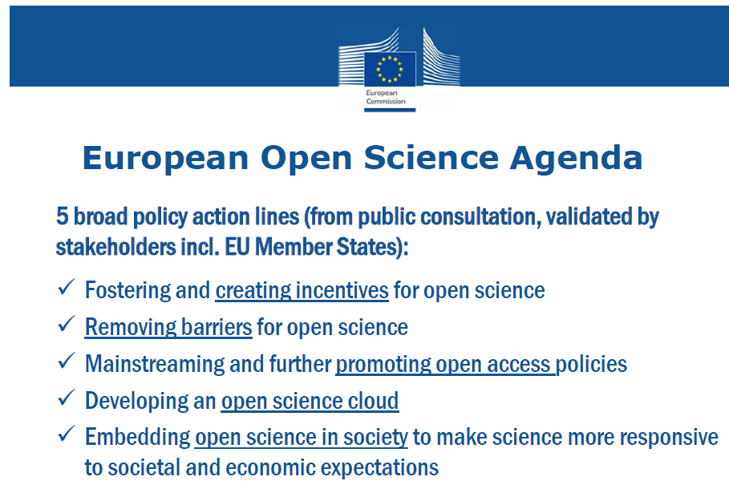
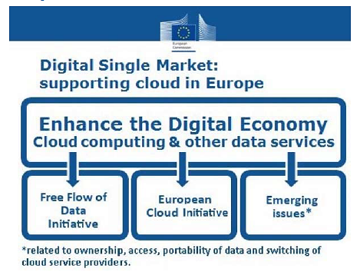
DSM and European Open Science Cloud 欧州オープンサイエンス・クラウドと欧州経済
デジタル単一市場戦略： 欧州クラウドを支援する
デジタル 経済を強化
(5億人、年間50兆円の経済効果）
新課題：インター オペラビリティ、 標準化等
データ流通自由化イニシアチブ
欧州クラウド イニシアチブ
欧州オープンサイエンスクラウド計画 （EUは6.7B€投資。うち2B€はHorizon2020).

Slide 11

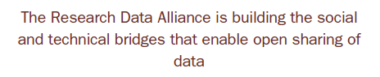
Infrastructures and Management for Scientific Data
Develop computer+ICT systems ➔ Technological Infrastructure
Develop best practices in data management & curation/ research culture/science data ecosystem ➔Social Infrastructure
https://www.rd-alliance.org/sites/default/files/attachment/Booklet_OutputsSeptember2015_web.pdf

Slide 12
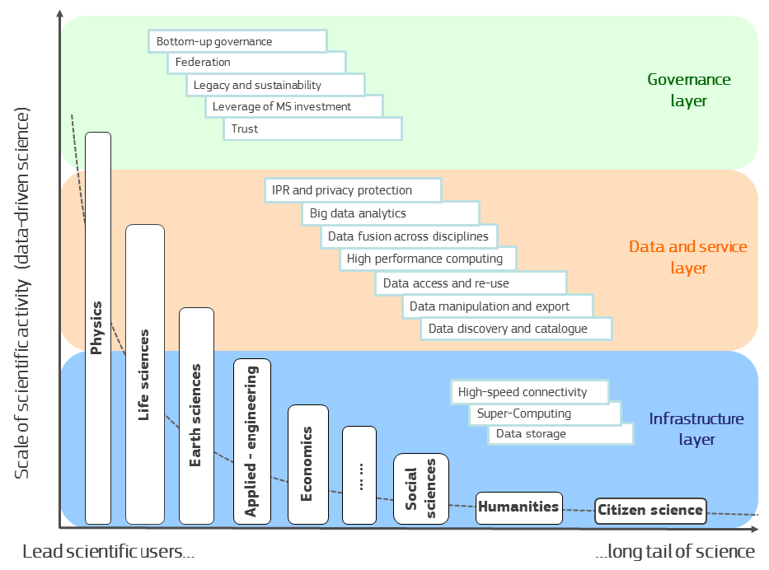
European Open Science Cloud
[J.C.Burgelman, 2016]
ボトムアップ経営/
連携体制/ 過去資産・継続性/
信頼性
ガバナンス層
データキュレーション/ マッシュアップ/ データアクセス・再利用/ カタログ・検索．．．
データ/サービス層
超高速インターネット通信/ スーパーコンピューティング/ データストレージ．．．
基盤層

Slide 13
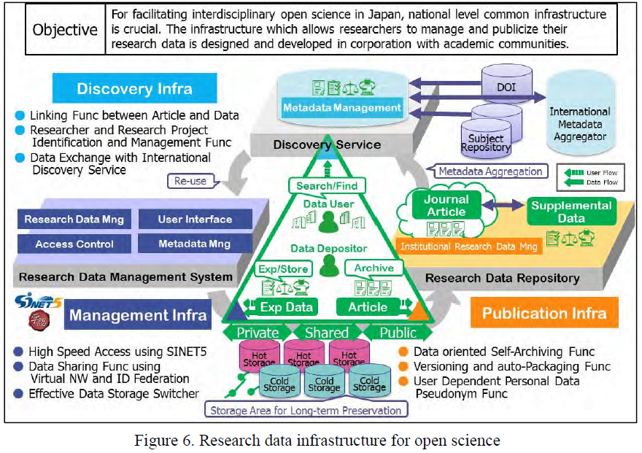
Planning an academic data infrastructure in Japan
Recommendations Concerning an Approach to Open Science That Will Contribute to Open Innovation http://www.scj.go.jp/ja/info/kohyo/pdf/kohyo-23-t230-en.pdf
Computer, organization, human dimension
Human resource mng. (reward, recognition, career path, cultural issue)

Slide 14
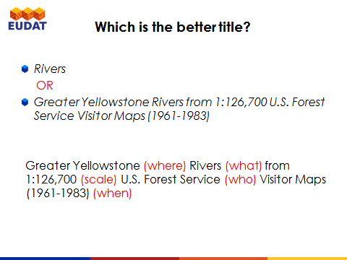
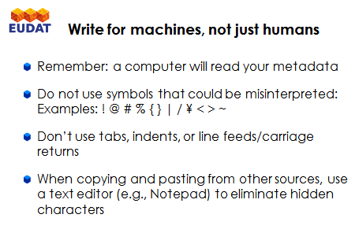
Guideline examples for metadata
[EUDAT, “Introduction to Metadata”, 2016]

Slide 15











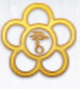




















Community Overview of Open Science
WDS （世界科学データ システム）
European Open Science Cloud
EUDAT, …
2008-
Future Earth
(ICSU, UNESCO, UNEP, UNU, Belmont Forum,…)
Earth, Space,
Physics,
Informatics,…
Seismology
WDS Intl. Program Office, Tokyo
Stakeholders
日本学術会議
Science Council of Japan
科学技術振興機構 Japan Sci. & Tech Agency
Space Sci.
Computer Sci.
Physics
UNESCO Ocean Data Exchange
National Diet Library
Social Science
Ionosphere
Space Weather
ROIS
Cabinet Office of Japan
Natl Inst. Informatics
Linguistics
History
Psychology
Linguistics
総合科学技術・
イノベーション会議
Council for Sci. Tech. & Innovation
…etc.(95 Member Bodies)
文部科学省
OECD Open Science WG etc.
RDA
(Research Data Alliance)
G8 2013
G7 2016
2012-

Slide 16







Global Coordination for Global Data Infrastructures (policy-level, technical, governance, global designing…)
Inter-governmental Coordination (G7 ministerial etc. …)
G7 2016
2013
National Initiatives/Programs for Research Data Infrastructures
日本学術会議オープンサイエンスの取組に関する検討委員会、Recommendations Concerning an Approach to Open Science That Will Contribute to Open Innovation http://www.scj.go.jp/ja/info/kohyo/pdf/ kohyo-23-t230-en.pdf
Visioning by Open Science committee in Science Council of Japan
International Initiatives (non-governmental) for Data System Harmonization/Transformation

Slide 17
Concluding Remarks
International Policy scene
International-regional-national-institutional actions are underway (even in Japan! Slowly though.)
Data sharing practice from printing to electronic culture
From academic practice to global infrastructure
Technological+Social “Infrastructure” is needed.
Having viewpoints at multiple levels is important, from a research lab to global harmonization.

Slide 18

JpGU-AGU joint Meetnig 2017
オープンサイエンスのセッション 「Open Science with Research Data Sharing and Science Infrastructures for Earth & Planetary Sciences」
コンビーナ
村山泰啓（NCIT、JpGU情報システム委員会）
近藤康久（地球研、JpGU情報システム委員会）
小口高（東大空間情報、 JpGU情報システム委員会）
Baptiste Cecconi (Observatoire de Paris)
Shean Toczko (Science Services Department, JAMSTEC)
Kerstin Lehnert（AGU Earth&Space Science Informatics FG）
Brooks Hanson (AGU Publication)
➔初のJpGU/AGUジョイントオープンサイエンス会合
注：JpGUに地球・宇宙情報学セクションがない（AGU、EGUにあり） ➔セクションでなくても何かできないか？

