Slide 1
Yukinobu KOYAMA
ex-National Astronomical Observatory Japan (NAOJ)
ex-World Data Center for Geomag., Kyoto
ex-Research Organization of Information and Systems (ROIS) / National Institute of Informatics (NII)
Lecturer, Department of Information Engineering, National Institute of Technology, Oita College

Slide 2
Yukinobu KOYAMA2
I have attended …
Open Repositories (2009-
World Data System (2009-
CODATA(SciDataCon) (?-
RDA (2014-, 3rd, 4th, 5th, 6th, 7th)

Slide 3
After his presentation…
From now, I’ll tie his presentation to this workshops theme.
It isn't serious that positive data isn't obtained in Oita.
He is enough young (20 years old!!).
Engineering is more important than science because we belong to engineering course.
One of my aims: I’d like to experience the stage which begins to start managing data (at Small Laboratory). I thought this viewpoint was necessary to this workshop.

Slide 4
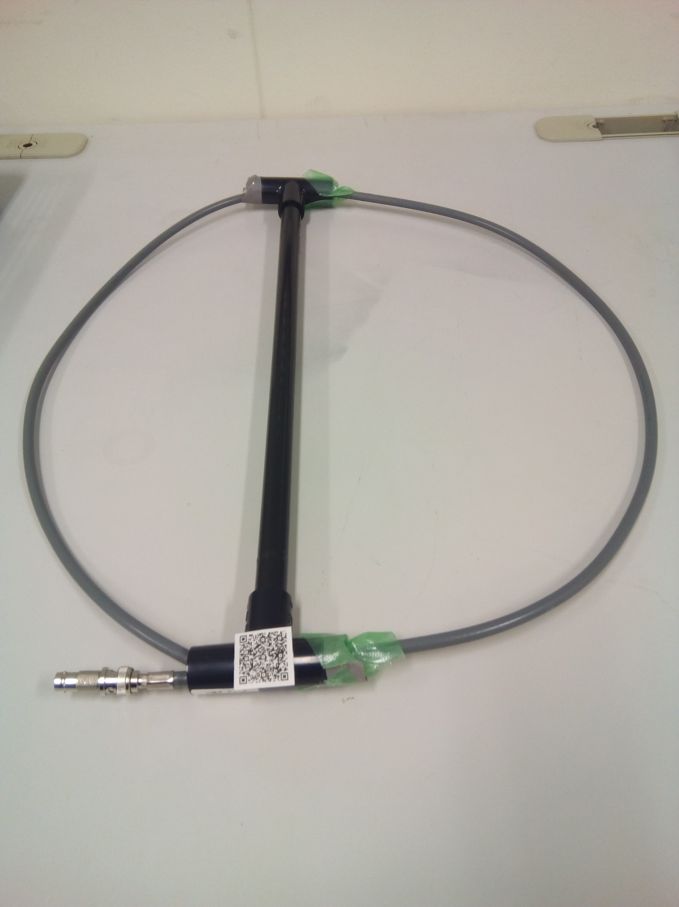
Our next step
We will prepare the metadata.
Current instrument is too simple, and everyone can reproduce.
However, he will add pre-amplifier, baran, bandpass filters. This increases in originality of the antenna.
Metadata is needed.
Before describing the metadata, I mint the Identifier to the instrument.
This is original usage of QR Code.
QR code is developed by DENSO which is in TOYOTA group.

Slide 5
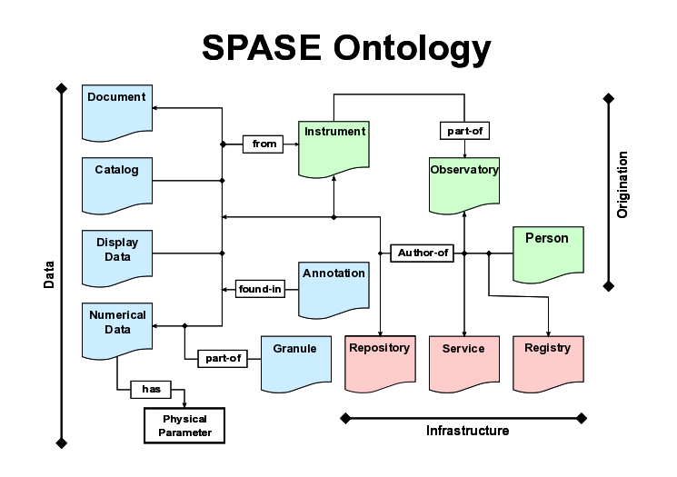
Metadata describing
It is not done yet, but we will describe the metadata including the identifier for the instruments.
IUGONET schema.
If positive result is obtained, we will open to the public with metadata.

Slide 6
When and who learns data management (in the future)?
The 1st Day
“Graduate students concentrate to get scientific outcome.” by NOSE-san
To embed it into education system, so I thought (just last night).

Slide 7
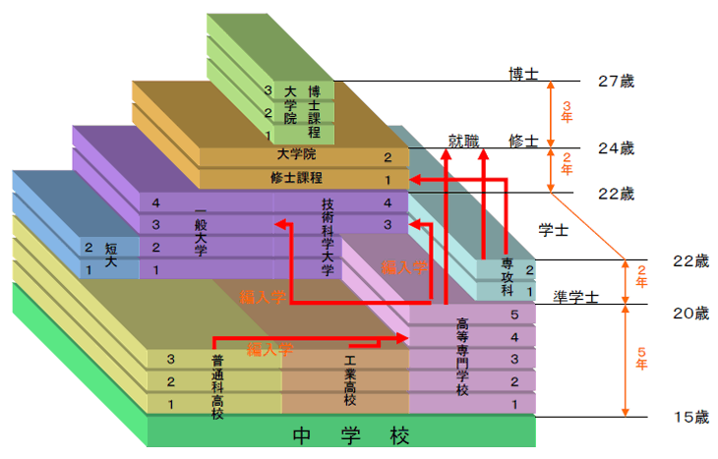
Education system in Japan
Many people make a choice this way

Slide 8
His case
Advanced
Course
NIT

Slide 9
Geographical Distribution of NIT
Headquarters is in Tokyo.
51 NIT is one financial body.
Oita College:
Teacher 60
Stuff 30
Students 40x4x5
Headquarters is located in the same building of NII.

Slide 10
My case

Slide 11
Kaz’s case

Slide 12
When and who learns data management?
The 1st Day
“Graduate students concentrate to get scientific outcome.” by NOSE-san
[My Opinion] Under graduate course / NIT is good learning opportunity.

Slide 13
Conclusion
We showed the stage which begins (not begin?) to start managing data at the Small laboratory. (Let’s pay attention to smaller institute.)
To embed the learning of data management into under graduate student education.
How about considering NIT as an application destination of teaching materials of the data management? > AMANO-san (Pls discuss with Kaz.)

