Slide 1
Minna de Honkoku
Online transcription project of historical earthquake documents
みんなで翻刻
地震史料のオンライン翻刻プロジェクト
Yasuyuki Kano, Yuta Hashimoto, and Ichiro Nakanishi (Kyoto University)
Junzo Ohmura, Tama Amano, Tomoyo Kuba, Haruno Sakai, Kazuyuki Ito, Yoko Odagi, Makiko Nishikawa, Haruo Horikawa, Kazuya Mizushima, Ryoichi Yasukuni, Munehisa Yamamoto, and
“Minna de Honkoku” participants

Slide 2

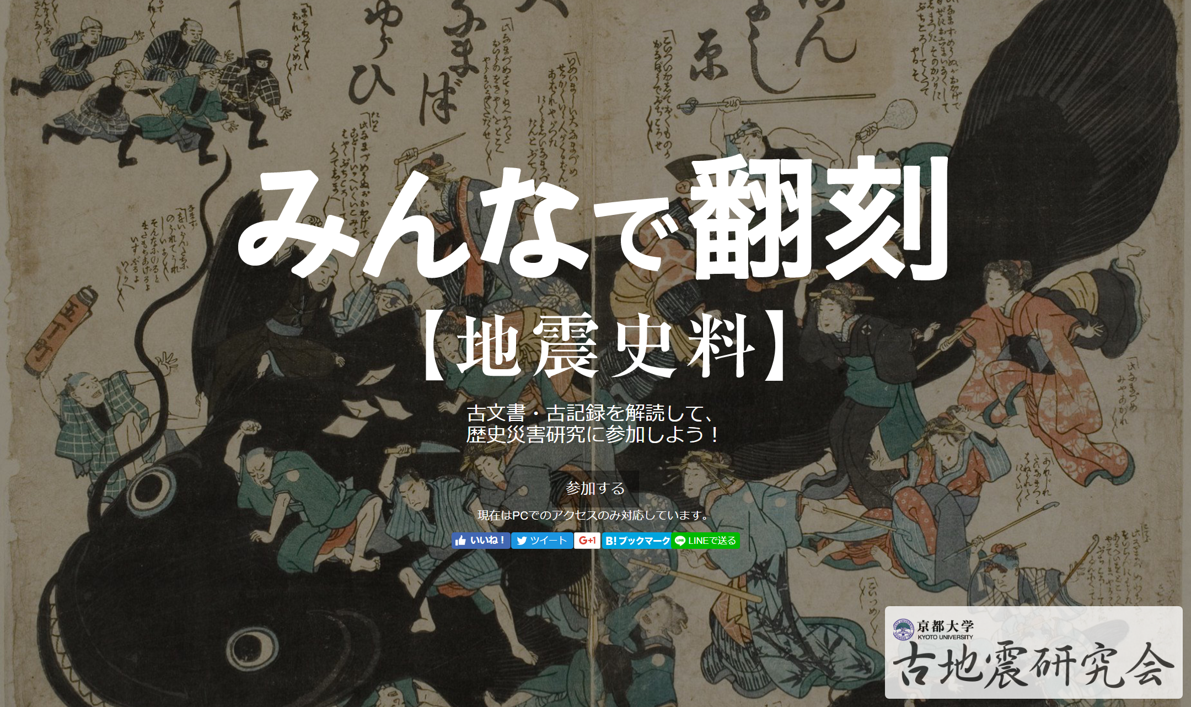
https://honkoku.org/
#みんなで翻刻

Slide 3
Minna de Honkoku
Project for transcription of historical earthquakes (disasters) with citizens.
Crowd-sourced transcription.
Opens on January 10, 2017.

Slide 4
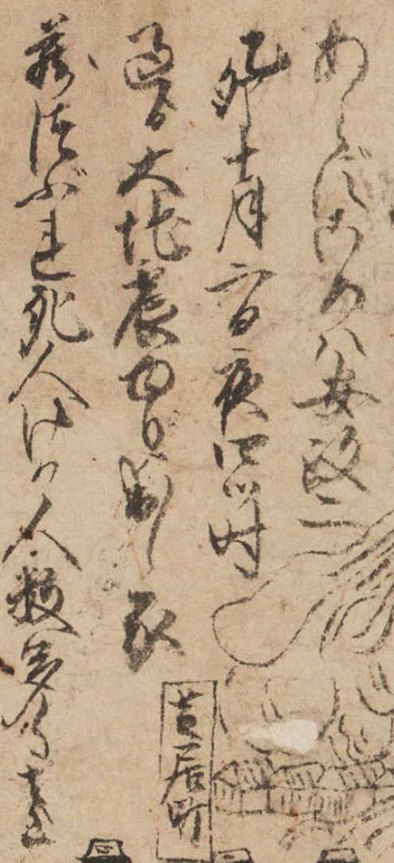



Honkoku = transcription
Make (digital) text from (old) (Japanese) documents written with Kuzushi-ji.
大地震
信州

Slide 5
Historical Earthquake Study
Investigate past earthquakes
Use historical documents
  official / private, letter diary, essay, etc.
When, where, how the earthquake occurred?

Slide 6
Why?
Large earthquake with severe damage is rare.
Experience is necessary to understand nature of earthquake.
Modern, instrumented seismology began only ~100 years ago.

Slide 7
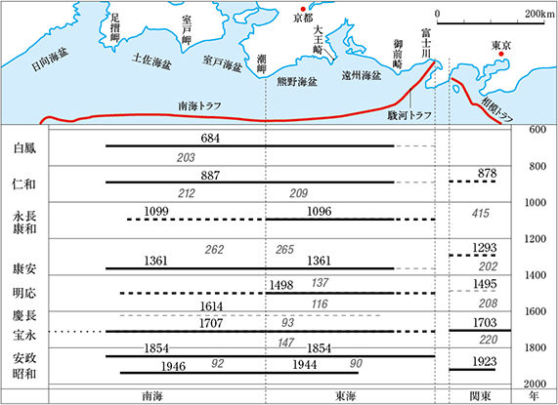
［石橋克彦『南海トラフ巨大地震―歴史・科学・社会』（岩波書店，2014）］

Slide 8
Catalogue &
Collections of Documents
Historical earthquake catalogues have been published.
  「日本被害地震総覧」
  理科年表「日本付近のおもな被害地震年表」
Collection of historical earthquake documents (articles over 20,000 pages)
  『日本地震史料』『新収日本地震史料』など

Slide 9
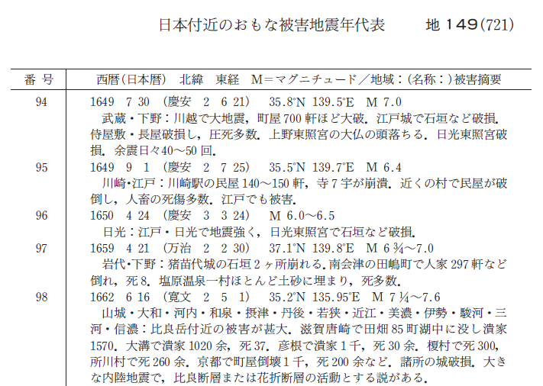
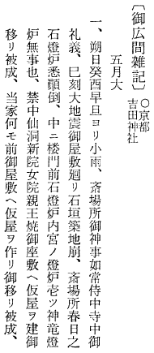
Catalogue &
Collections of Documents
[纐纈(2016)理科年表]
1662-06-16
[東京大学地震研究所(2016)]

Slide 10
Japanese Historical Documents
Huge number of historical documents are left.
  Those may contain information on earthquakes.
  Written in Kuzushi-ji (skill required)
Transcripted texts are useful for (usual) seismologists, but limited.
  Read, search, analyze
We need help from not only experts but also citizens.

Slide 11
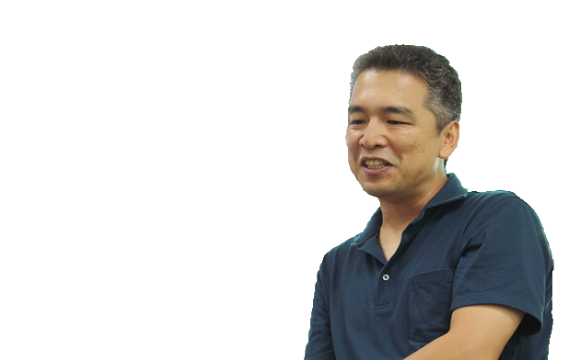
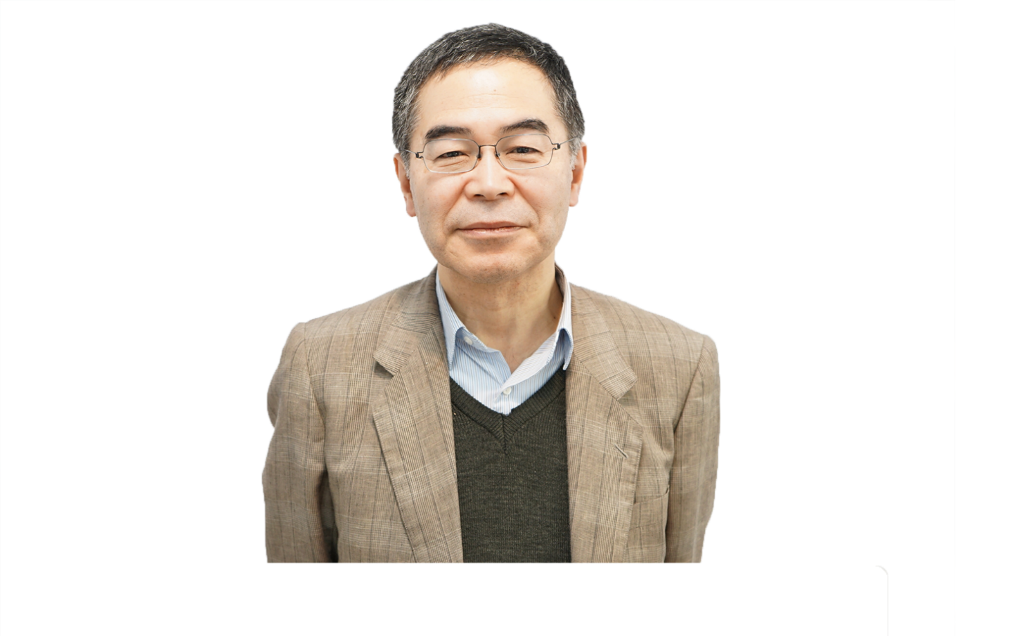
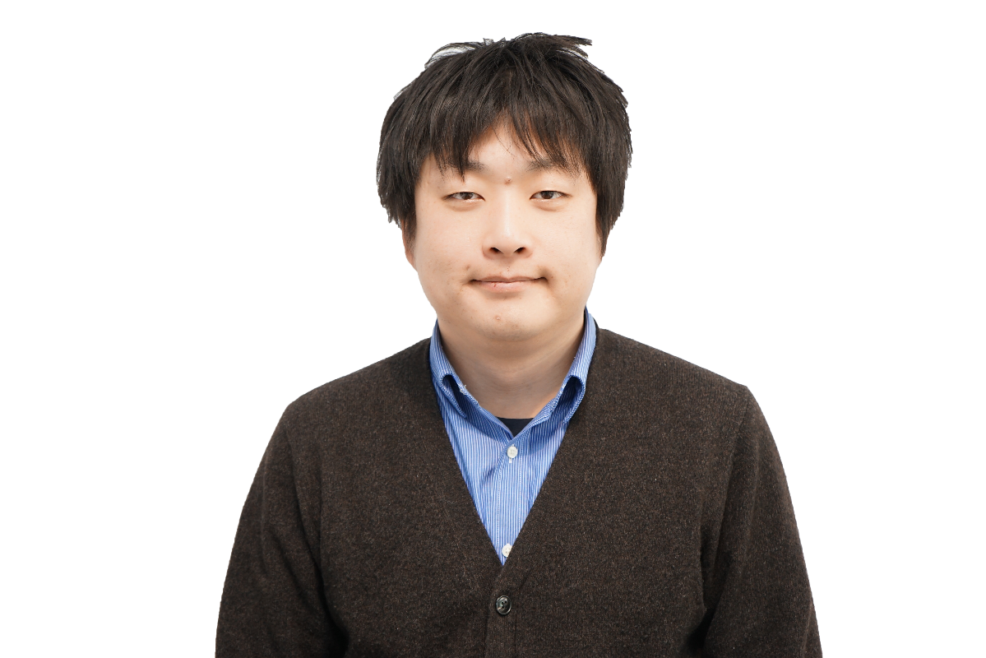
Motivation
古地震研究会 主催
京都大学大学院理学研究科
中西一郎教授
京都大学防災研究所
附属地震予知研究センター
加納靖之
開発・設計担当
京都大学大学院文学研究科
橋本雄太 氏
Not many seismologist can read historical documents.
Speed up transcription with citizens via ICT.
Notes:
しかし今、地震史料の研究には２つの問題があります
この古地震研究会を立ち上げた理学研究科 中西一郎教授は
「くずし字を読める人が少なく、翻刻する前に史料がなくなってしまう」という問題を、
また民間でプログラマーの経験がある文学研究科の橋本雄太氏は「テキストデータにして、ウェブで公開すれば、だれでも資料を見ることができ、また保存されていくが、とても研究者だけでは人手が足りない」という問題

Slide 12
Motivation
Obtain new data for past earthquakes
Re-examination of data used by studies
History of disaster -> Improve awareness for disasters
Speedup transcriptions
Find unknown historical documents
Preserve historical documents
Strategy for digital archives and open data

Slide 13
Material & Goal
Ishimoto Collections owned by Earthquake research Institute, University of Tokyo.
  114 documents of historical earthquake and volcano eruptions
  Digital images are provided on the Web site
Make full text transcription of 114 documents.

Slide 14
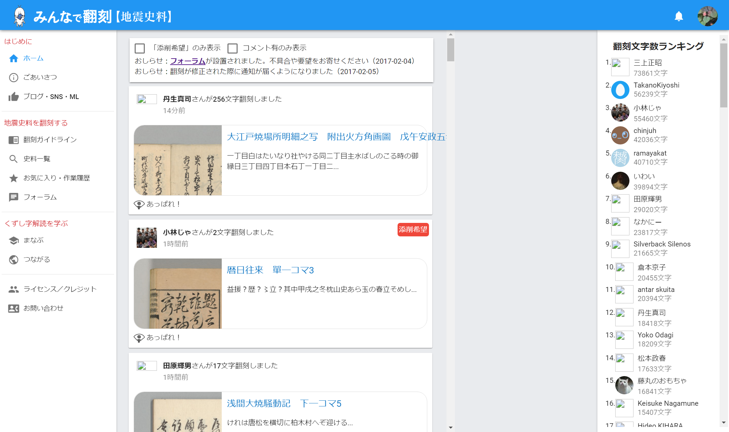
Timeline

Slide 15
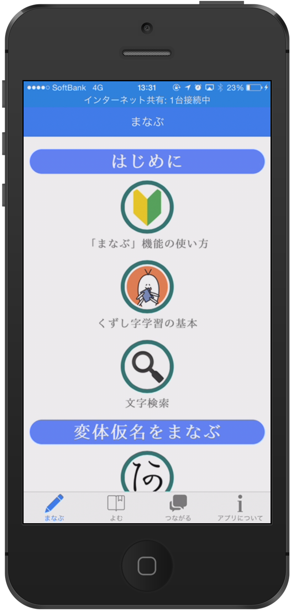
Link with KuLA
Kuzushiji Learning Application
App for Kuzushi-ji lerning support.
  Developed at Osaka University
  iOS & Android
  3000 images of Kuzushi-ji
  Learn & quiz
  Training with documents, such as “Hojo-ki” and Token (sword) book.

Slide 16
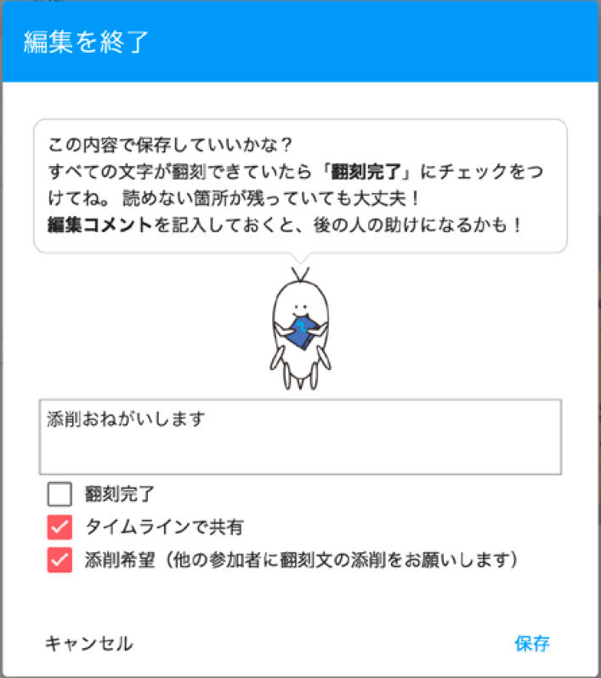
Collaboration and Learning
Request for edit
  Promote learning each other
  Improve transcription
Forum
  Discussion
  Information

Slide 17
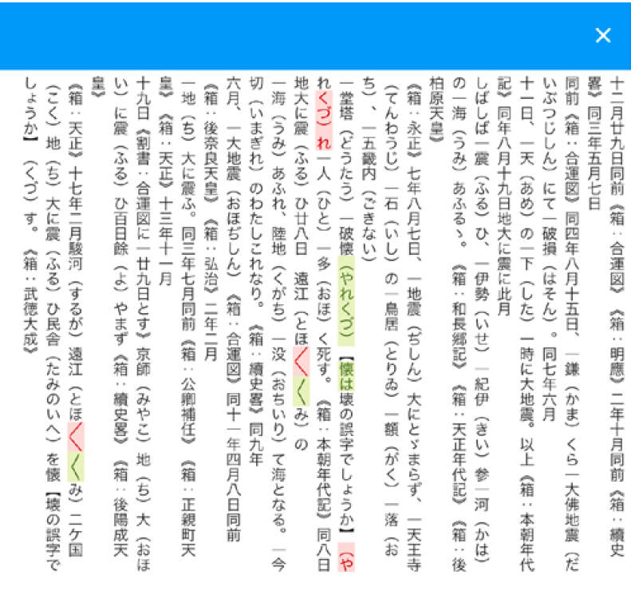
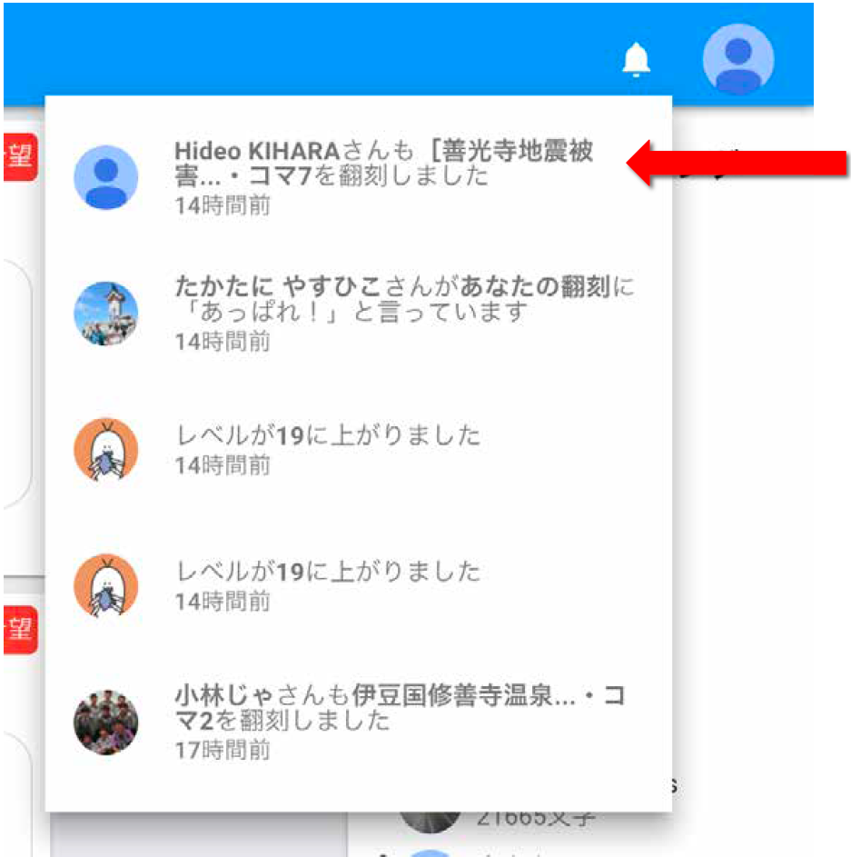
Diff & Notification

Slide 18
Progress report: 50 days
Over 50% images are「翻刻完了」(complete)
Completed documents: 50/114
Completed images: 1650/3193
Participants: 1850
Inputted characters: 1,104,417

Slide 19
Todos
Continuity
  Skilled participants / community
  Another documents for earthquake etc.
  Different fields / institutions
Evaluation
  Open data / Open science
Utilize the transcripted data
  Earthquake / disaster research
Non Web based system

Slide 20
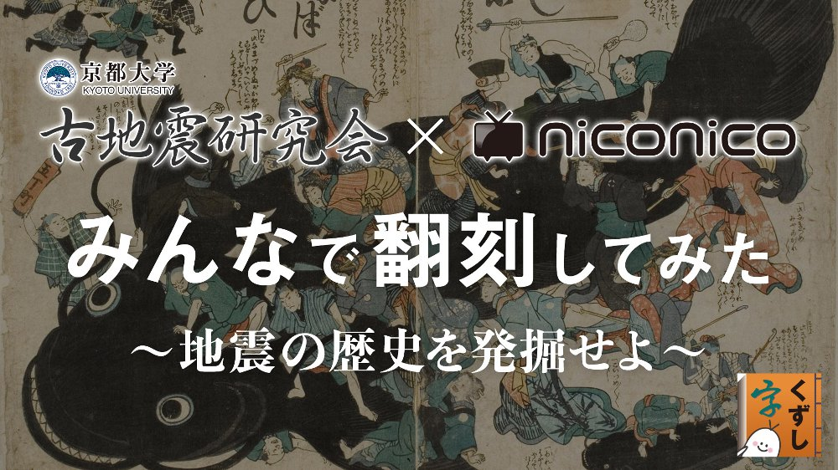
#みんなで翻刻

