Slide 1
再現性と共有性を兼ね備える
学際的なデータ可視化サービス
Web service for reproducible and shareable multidisciplinary data visualization
情報通信研究機構（NICT） 今井 弘二（Koji IMAI）

Slide 2





Do you believe a ghost?
（幽霊を信じますか？）
The problem is the “reproducibility (再現性) ”
Notes:
By the way, do you believe a ghost?
Could you rise your hands, the people who believe a ghost?

Slide 3

Reproducibility is one of the foundations of the scientific method.
Reproducible evidence is imperative to build new scientific knowledge.
⇓ However,
It is not easy especially for studies dealing with scientific data of different fields.
I will introduce a prototype web service to reproduce, remake, share a charts.
Brimming with information.
We need a system to control the data.
How could we control so much data?
Reproducible?
Shareable?
Remarkable?
Notes:
Now, we live in the society brimming with information.
The “Big Data” is growing bigger day by day.
And we are thinking, “how could we control so much data?”
But I also think, “is it necessary to control all the data?”
It is more important to think seriously,
“What is the minimum amount of information for scientists or the people who need data?”
Today I will introduce a better web service in the transition period to “Open Science”.
I’m Koji Imai from NICT.

Slide 4
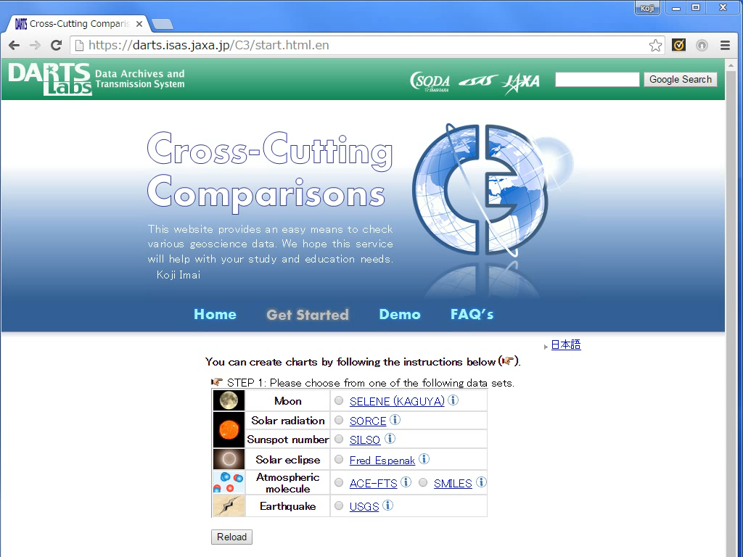
Easily imagine the data set through the thumbnails!
Inductive interface!
Notes:
This is the “Get Started” page.
You can easily imagine the data set through the thumbnails.
These are the names of the data sets, mostly termed from the project name, which are linked to each original project page.
I will show you some charts.
The first is a sunspot number.
If you select the data set, you can go to the next step.
Then, select the product of the data set and go to the next step.
In step three, you can select a figure type and the parameters.
For example, I select January to March in 2010.
Finally, click the “Show” button to get the chart.

Slide 5
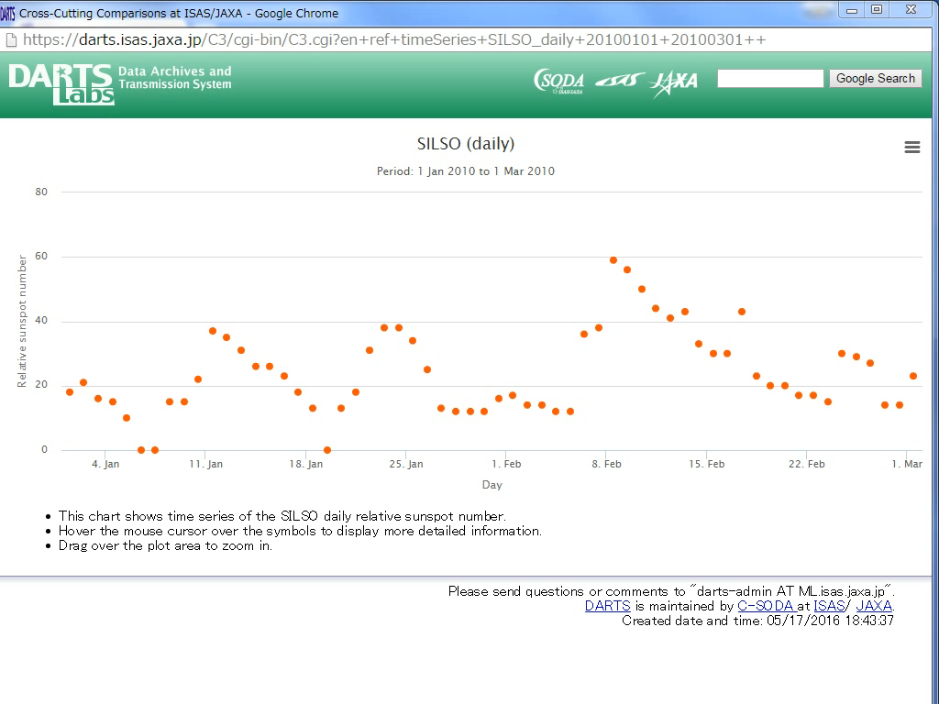
Print out the chart and download it in some image formats.
Hover the mouse cursor over the symbols to display more detailed information.
Drag over the plot area to zoom in.
Notes:
This shows the time series of sunspot number.
The subtitle shows the setting to make this chart.
Hover the mouse cursor over the symbols to display more detailed information.
Drag over the plot area to zoom in.
From the top-right button, you can print out the chart and download it in some image formats for example PNG, JPEG, PDF and SVG.

Slide 6
Notes:
Next, I will show you an earthquake map of USGS.
The same as before, if you select the data set, you can go to the next step.
In step three, you can select a figure type and the parameters.
In this case, you can input the parameters of period, latitude, longitude, magnitude and depth of earthquake.
Then, click the “Show” button to get the chart.

Slide 7
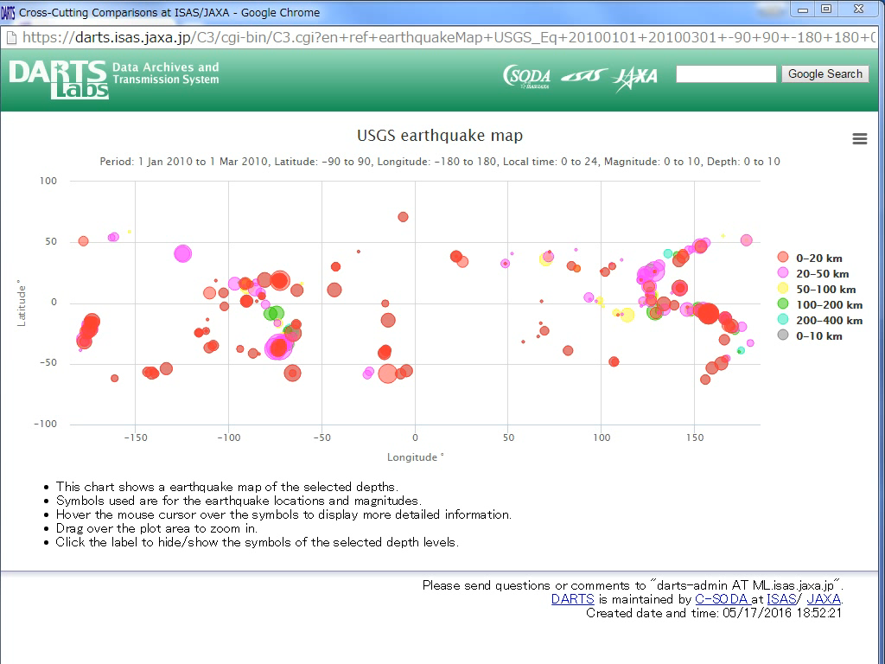
Click the label to hide or show the symbols.
The circle size shows the magnitude level.
Notes:
This is the earthquake map.
y-axis is latitude and x-axis is longitude.
The circle size shows the magnitude level, for example, this large circle is M6.8.
Click the label to hide or show the symbols.
Drag over the plot area to zoom in.

Slide 8
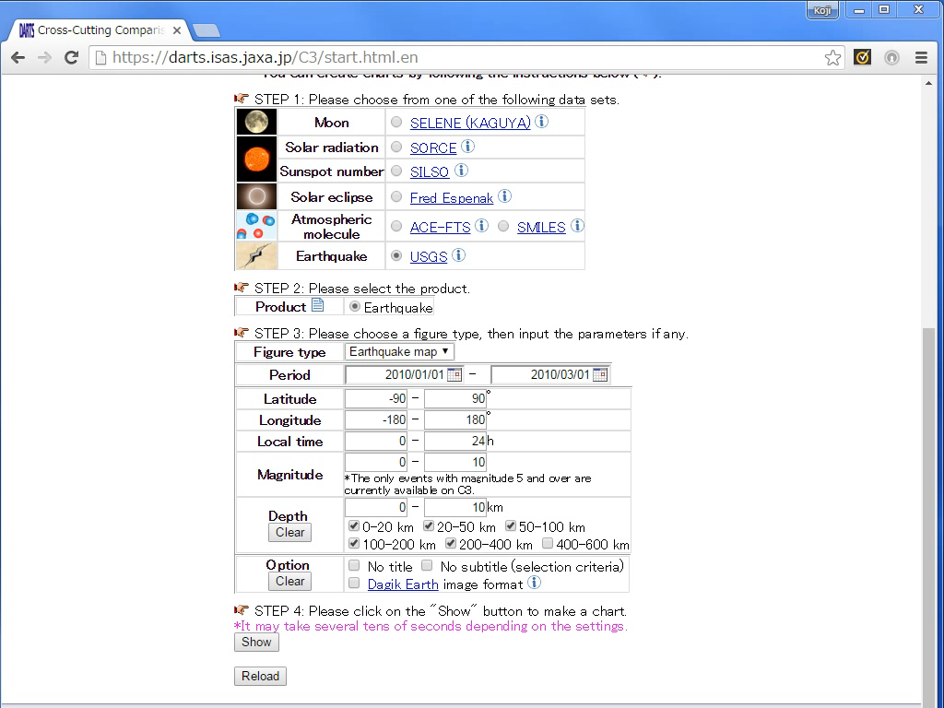
Notes:
Step back and check an option of Dagik Earth image format.

Slide 9
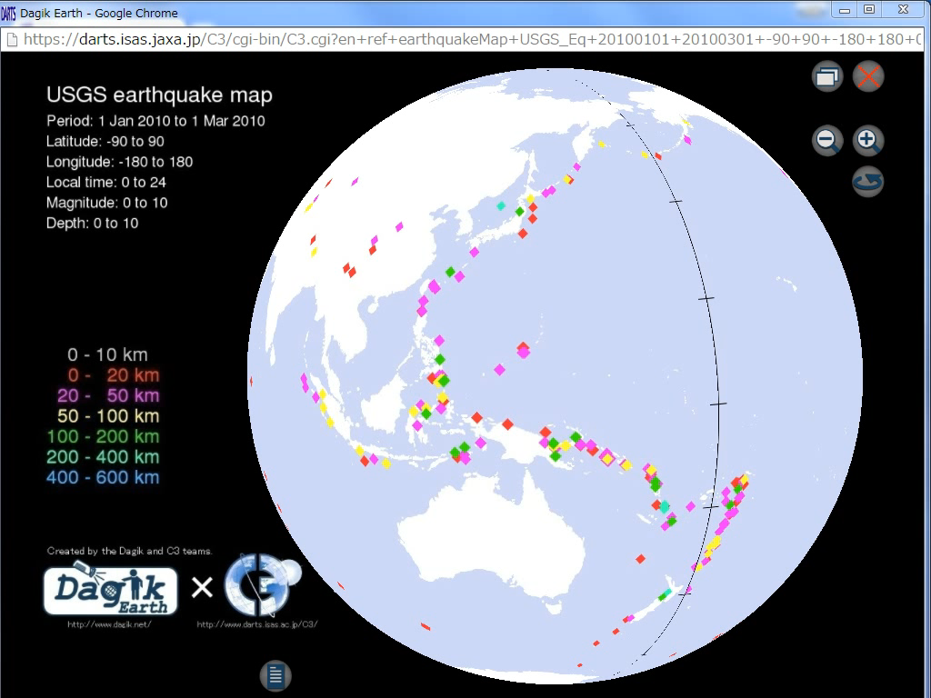
Notes:
Then, you can check the same image but it shows 3D map.

Slide 10
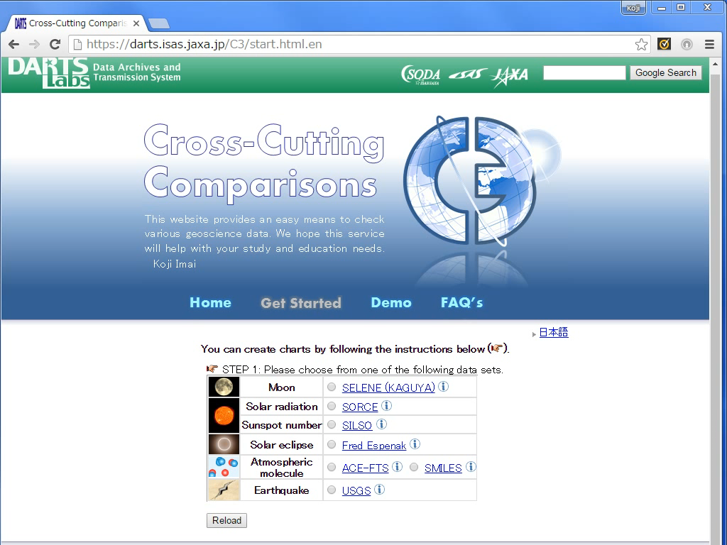
Notes:
Next is the chart of solar eclipse.
The same as before, if you select the data set, you can go to the next step.
I will show you the simulation data in March of this year.
After select a figure type, click the “Show” button to get the chart.

Slide 11
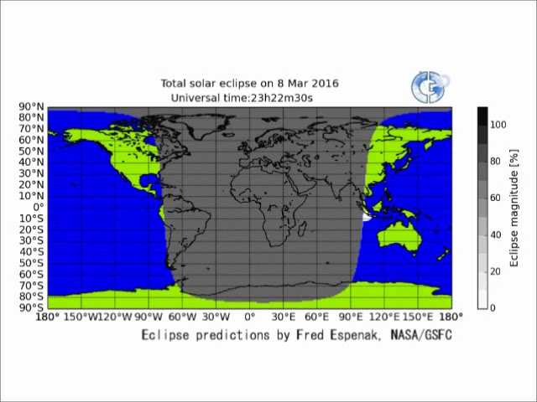
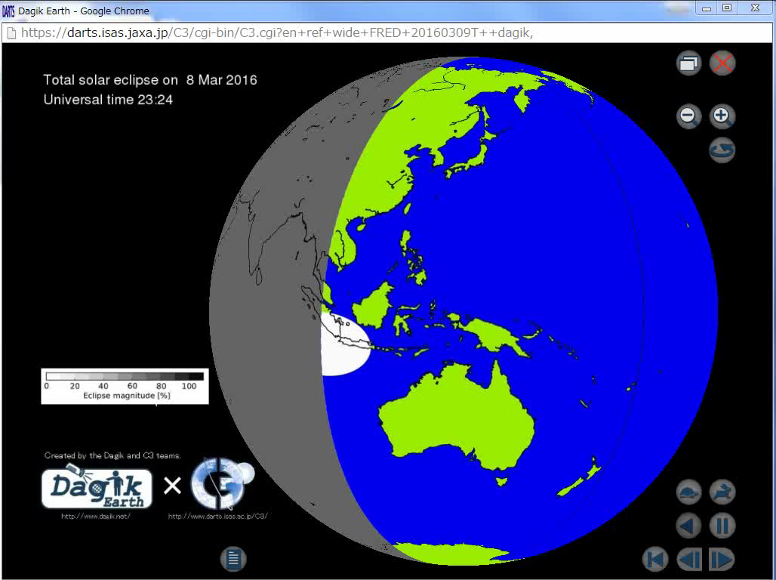
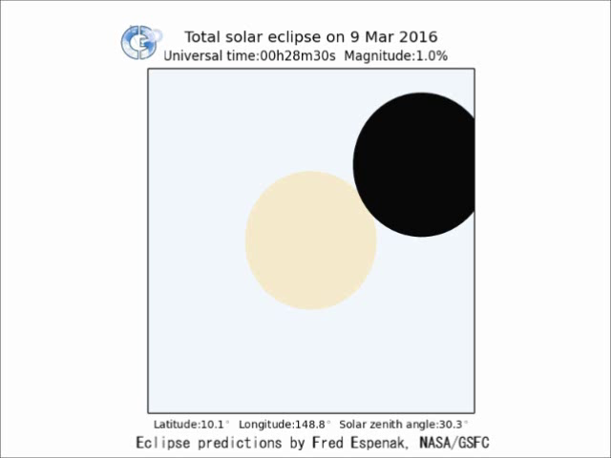
Eclipse path
These are the examples of the solar eclipse.
Pseudo 3D map
Eclipse at the maximum point
Notes:
These are the examples of the solar eclipse on March of this year.
The top panel shows the eclipse path.
The dark area is nighttime and the blue and green area is daytime.
The gray contour shows the shadow of the Moon.
You can see the shadow of the Moon from the sky on a solar eclipse.
The left panel is the same as the top panel but it’s a 3D map.
The right panel is the eclipse at the maximum point on ground.

Slide 12
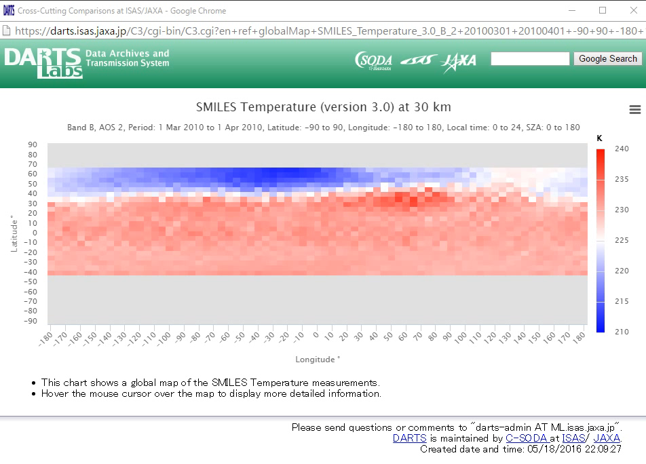
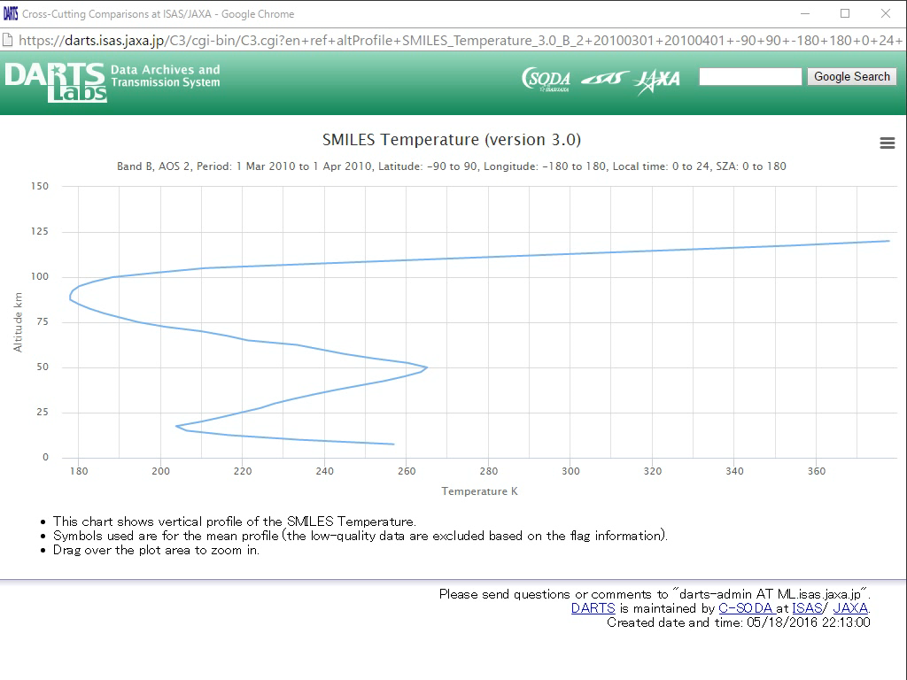
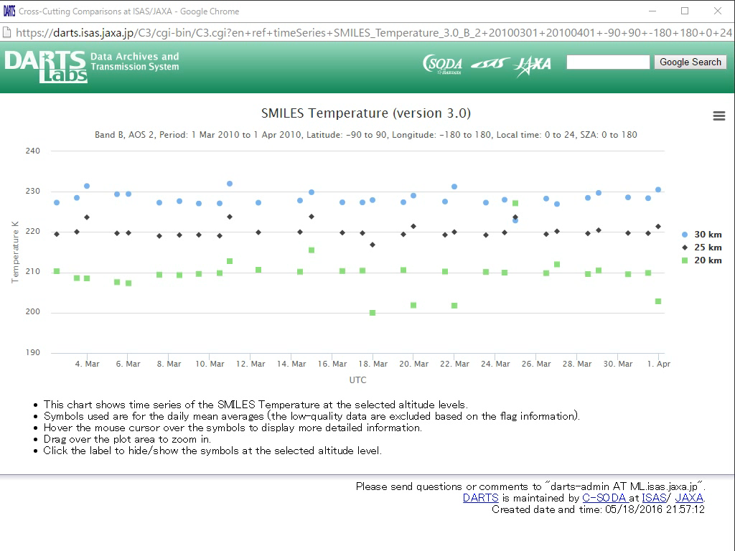
Global map
Altitude profile
Time series
Notes:
These are examples of temperature observed by SMILES.
The top panel is the global map.
The left panel is the altitude profile.
The right panel is the time series.
The interactive interface supports users.
And all these charts have an URL query in the address bar.

Slide 13
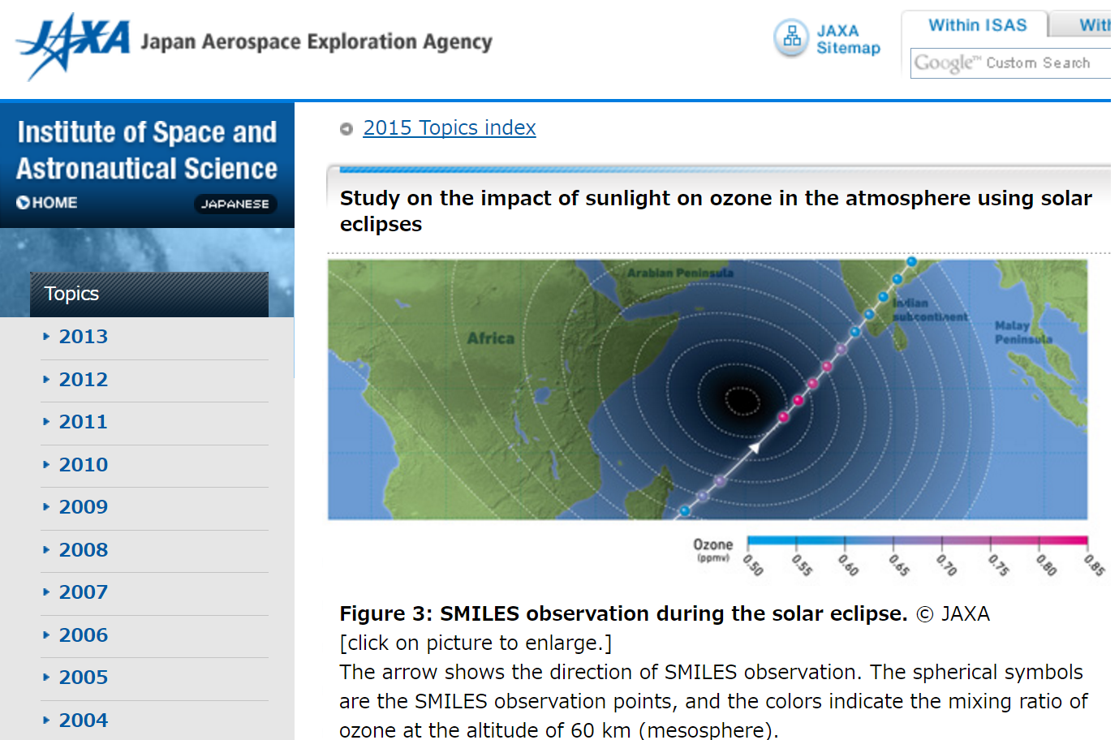
Example of a cross-cutting research by using C3
http://www.isas.ac.jp/e/topics/2015/0629.shtml
Notes:
These are examples of the Moon observed by Kaguya.
The left panel shows the elevation map and the right panel shows the global 3D image.

Slide 14
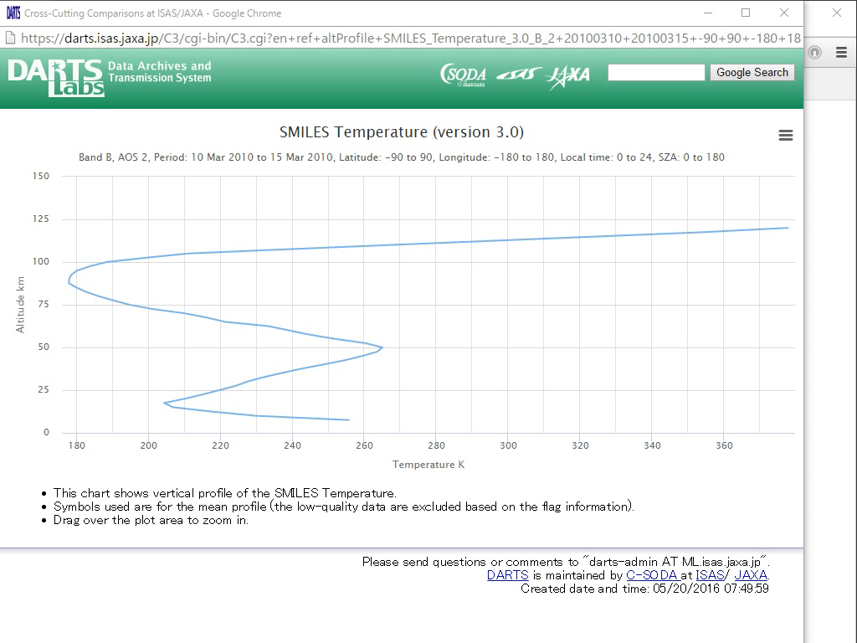
All charts have a query string in the adrress bar.
You can check the same charts by using the same query.
Notes:
You can check the same charts by using the same URL query, like this.

Slide 15
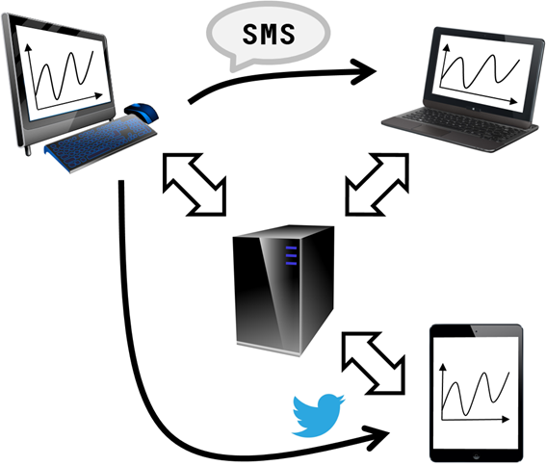
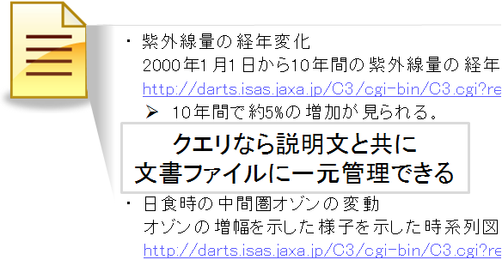
The structure of the URL query is:
en+SORCE_TSI_17_timeSeries+20100101_20100201
header + selection + extraction + (analytic method)
query
query
Easy to share the charts by using text-based communication tools.
Like a identifier in a document
Notes:
So it is easy to share charts by using text-based communication tools, like E-mail, Twitter, SMS.

Slide 16

Summary
Quick look service, C3 is:
  No subscription,
  No installation,
  No manual.
It is easy to
  get the charts in geoscience,
  reproduce the chats,
  share the charts,
  cite the charts.
NICT C3
search
Notes:
OK, today, I introduced the quick look service, C3.
C3 is no subscription, no installation, no manual by the inducing interface.
Someone who is interested in the data set, could visit the original project page and get the whole data.

