Slide 1











From project related data management to sustainable data and knowledge services - Berlin Declaration on Open Access to Knowledge in the Sciences and Humanities -
Data Preservation and Open Data Workshop京京都大学理学研究科,7/8 December 2015
B. Ritschel (GFZ/京都大学), Ch. Seelus (GFZ), G. Neher (FHP),
T. Iyemori, Y. Koyama (Kyoto University),
A. Yatagai (Nagoya University), Y. Murayama (NITT),
T. King (University of California), J. Hughes (JPL),
S. Fung (NASA GSFC), I. Galkin (University of Massachusetts),
M. Hapgood (STFC), A. Belehaki (National Observatory of Athens)

Slide 2

Berlin Declaration*
Berlin Declaration on Open Access to Knowledge in the Sciences and Humanities, 22 October 2003
Preface (part 1)
The Internet has fundamentally changed the practical and economic realities of distributing scientific knowledge and cultural heritage. For the first time ever, the Internet now offers the chance to constitute a global and interactive representation of human knowledge, including cultural heritage and the guarantee of worldwide access.
*http://openaccess.mpg.de/Berliner-Erklaerung

Slide 3
Berlin Declaration*
Preface (part2)
In accordance with the spirit of the Declaration of the Budapest Open Access Initiative, the ECHO Charter and the Bethesda Statement on Open Access Publishing, we have drafted the Berlin Declaration to promote the Internet as a functional instrument for a global scientific knowledge base and human reflection and to specify measures which research policy makers, research institutions, funding agencies, libraries, archives and museums need to consider.
*http://openaccess.mpg.de/Berliner-Erklaerung

Slide 4
Berlin Declaration*
Goals …
Definition of an Open Access Contribution (part 1)
Establishing open access as a worthwhile procedure ideally requires the active commitment of each and every individual producer of scientific knowledge and holder of cultural heritage. Open access contributions include original scientific research results, raw data and metadata, source materials, digital representations of pictorial and graphical materials and scholarly multimedia material.
*http://openaccess.mpg.de/Berliner-Erklaerung

Slide 5
Berlin Declaration*
Definition of an Open Access Contribution (part 2)
A complete version of the work and all supplemental materials, including a copy of the permission as stated above, in an appropriate standard electronic format is deposited (and thus published) in at least one online repository using suitable technical standards (such as the Open Archive definitions) that is supported and maintained by an academic institution, scholarly society, government agency, or other well-established organization that seeks to enable open access, unrestricted distribution, inter operability, and long-term archiving.
*http://openaccess.mpg.de/Berliner-Erklaerung

Slide 6

DFG Denkschrift* (1998)
Sicherung guter wissenenschaftlicher Praxis (1998)
Ergänzte und aktualisierte Denkschrift "Sicherung guter wissenschaftlicher Praxis„ (2013)
Vorschläge zur Sicherung
guter wissenschaftlicher Praxis
Empfehlungen der Kommission
„Selbstkontrolle in der Wissenschaft“
Basis fur Bewilligung von DFG-Mitteln
(1998)
*http://www.dfg.de/foerderung/grundlagen_rahmenbedingungen/gwp/

Slide 7
DFG Memorandum* (1998)
Safeguarding Good Scientific Practice (1998)
Amended and updated white paper entitled "Safeguarding Good Scientific Practice„ (2013)
Proposals for Safeguarding
Good Scientific Practice
Recommendations of the Commission
on Professional Self Regulation in Science
Basis for approval of DFG founding (1998)
*http://www.dfg.de/en/research_funding/principles_dfg_funding/good_scientific_practice/index.html

Slide 8


Japanese-German Symposium in Tokyo: Self-control and self-obligation in Science (1 October 2015)
Bilaterale Symposium „Contribution to promoting scientific integrity“ about guidlines of safeguarding good scientific practice and rules about handling of violations
*http://www.jst.go.jp/researchintegrity/symposium150930d.html

Slide 9
Recent sample about inner communication about publication of data at GFZ Potsdam* (1)
Topic: EOSの記事：地震データとDOI From: Yasuhiro Murayama, 25 November 2015
Dear Bernd, How are you doing? Prof. Emritus Tadahiko Ogawa introduced me an EOS artcile about siesmological data and DOI. > https://eos.org/opinions/why-seismic-networks-need-digital-object-identifiers I found the lead author is from GFZ Potzdam. Just for your interest. Take care, for the climate getting cold rapidly. Best Regards, Yasuhiro Murayama
*Email from Yasuhiro Murayama

Slide 10
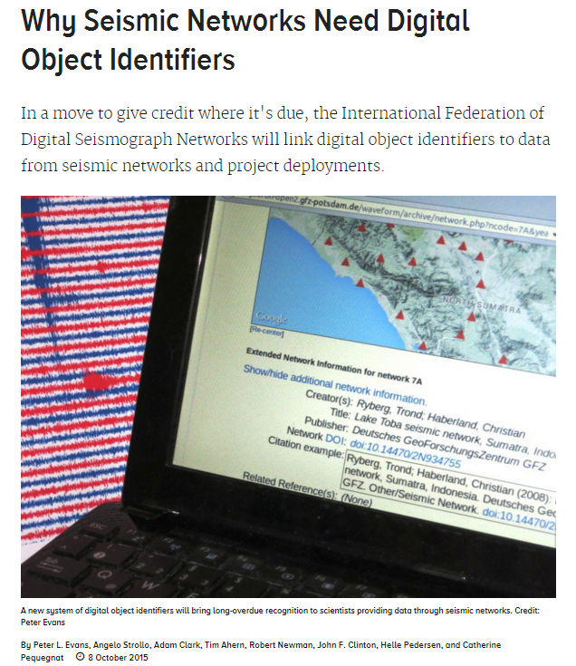
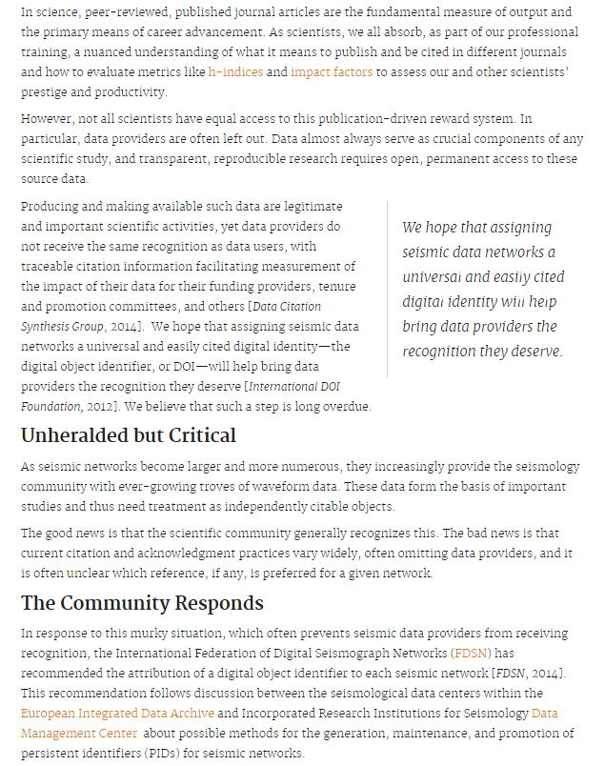
*
...
https://eos.org/opinions/why-seismic-networks-need-digital-object-identifiers

Slide 11
Recent sample about inner communication about publication of data at GFZ Potsdam* (2)
Topic: Re: EOSの記事：地震データとDOI From: Bernd Ritschel, 03 December 2015
Dear Yasuhiro, …
Yes indeed 2 authors (Peter L. Evans, Angelo Strollo) of the EOS article are from GFZ Potsdam, but they are no Germans. Unfortunately I do not know these persons. At GFZ there are working more than 1200 people now, and the inner communication at GFZ alwyas has been a challange. GEOFON, a huge network of seismometers and the appropriate data center are hosted by GFZ institution. I am surpised that the scientific library of Einstein Campus (mainly hosted and supported by GFZ) is not involved in these activities and related article. I know the head of the scientific library Roland Bertelmann, and he always was/is supporting the use of DOI for referncing data. There are some CHAMP data also referenced by DOI done in cooperation with the library some years ago already. That's for now. Let us discuss the impact of this article and related activities at the workshop next week. And of course, I could ask the GFZ people for more details... Best wishes, Bernd
*Email from Yasuhiro Murayama

Slide 12
GFZ ISDC

Slide 13
GFZ ISDC (Proof of concept)

Slide 14
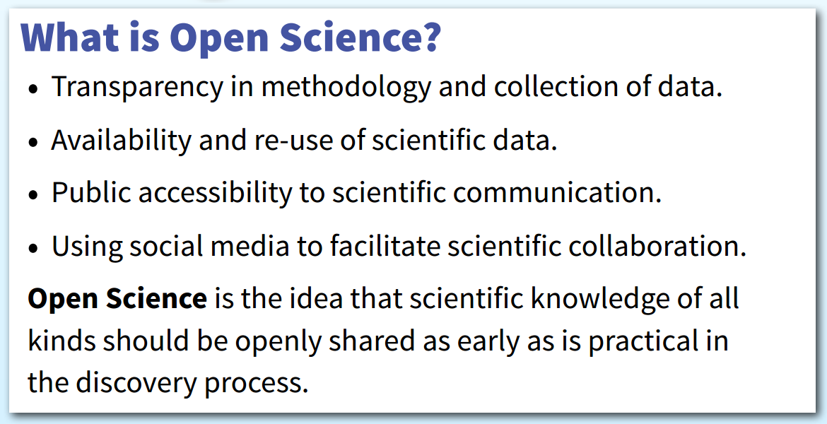
Open Data/Open Science
The Open Science Project: OpenScience.org*
*http://www.openscience.org/blog/wp-content/uploads/2013/06/OpenSciencePoster.pdf

Slide 15
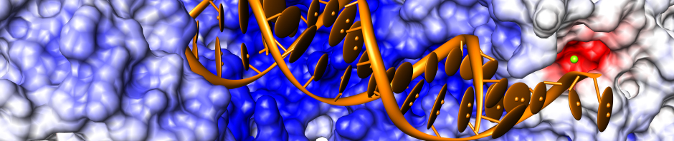
Open Data/Open Science
About OpenScience*
The OpenScience project¹ is dedicated to writing and releasing free and Open Source scientific software. We are a group of scientists, mathematicians and engineers who want to encourage a collaborative environment in which science can be pursued by anyone who is inspired to discover something new about the natural world.
¹Initiated by a group led by Dan Gezelter (Theoretical & Computational Chemistry)
*http://www.openscience.org/blog/?page_id=44

Slide 16
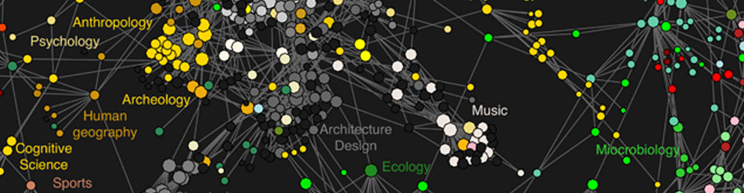


Open Data/Open Science
6 Open Science Principles*
Open Methodology (documentation of used methods)
Open Source (software and hardware)
Open Data (free access to data)
Open Access (publishing in open access journals)
Open Peer Review (transparent and open review process)
Open Educational Resource (use of free and open materials)
*http://openscienceasap.org/open-science/
*Source: Open Science AS A Practice initiative from University of Graz

Slide 17
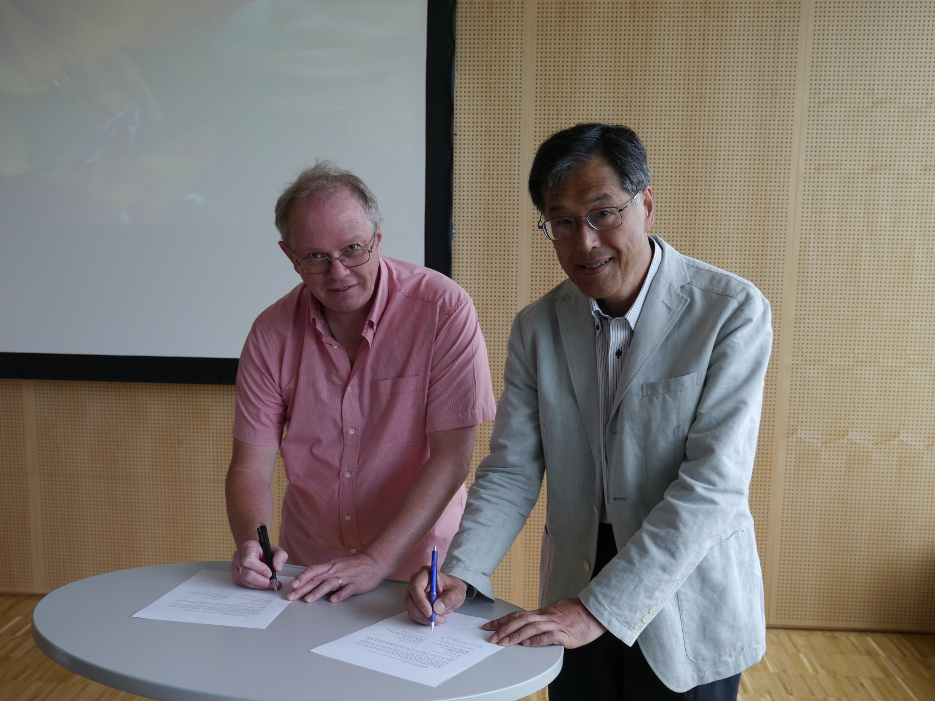
MoU between ESPAS and IOGONET
Mike Hapgood
RAL, STFC
Oxford, England
Toshihiko Iyemori
京都大学, WDC
Kyoto, Japan
Neustrelitz, 19 June 2013

Slide 18
Major Objectives and Scope
The aim of the cooperation is to promote and establish a research community to build the infrastructures to solve the global data issues.
1. Activities
The primary activities are agreed as follows:
- Exchange of information including data
- Exchange of researchers
- Promotion of cooperative projects in a common field of interest
2. Cooperation field
The cooperation will focus on the following studies, and personnel of the other field of interest by either institute may be invited to participate in the joint work independently from other institutions with mutual agreement.
- Make global geophysical data accessible for other science domains
- Make network of global observation data for integrated approach with
the same metadata vocabulary
- Enhance usage of the common observational infrastructure
- Promote cooperation in the area of studies on solar, heliospherical, solar-
terrestrial and geophysical activity
- Use the e-infrastructures for education and for capacity building
o
×
o
o
Major Objectives according to the Open Science Principles
×
o
×
o
×
o
o

Slide 19

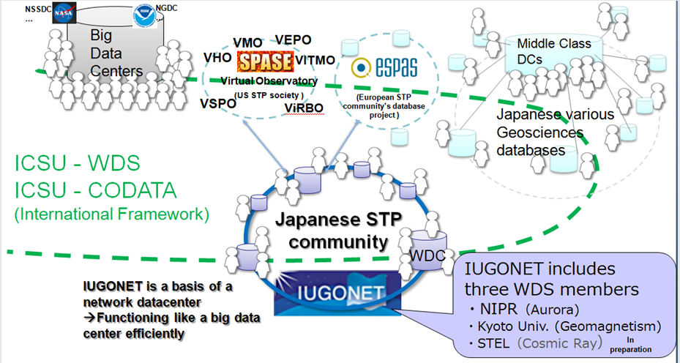
Cooperation among data systems
Future direction: To establish a close collaboration among various data systems
Source: Presentation from T. Iyemori at
ESPAS meeting, Neustrelitz,19.06.2013

Slide 20
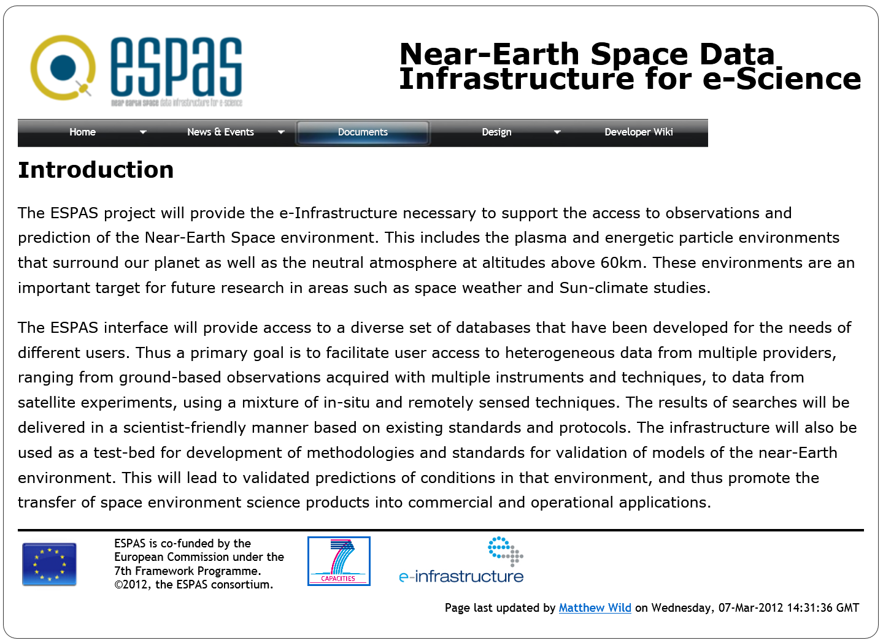























Objectives:
A platform to integrate heterogeneous data from earth’s
thermosphere, ionosphere, plasmasphere & magnetosphere
Provides unique access to scientific near-earth space data
Offers Web-based applications and services
ESPAS User Interface:
http://www.espas-fp7.eu
Next ESPAS release: October 2013
Final ESPAS release: November 2015

Slide 21
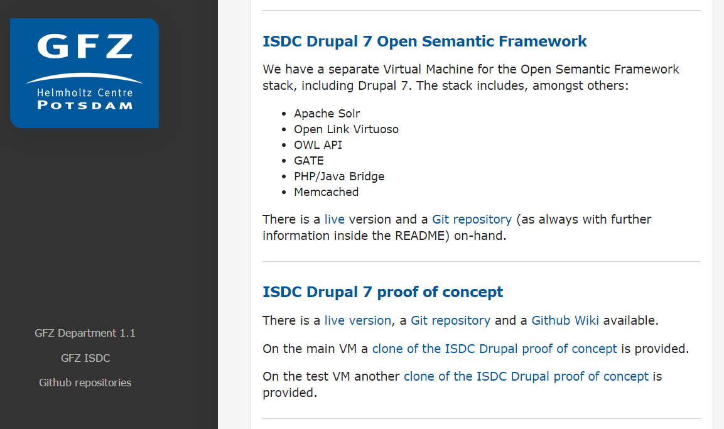


GFZ ISDC Semantic Web Project*
*https://gfz.github.io

Slide 22
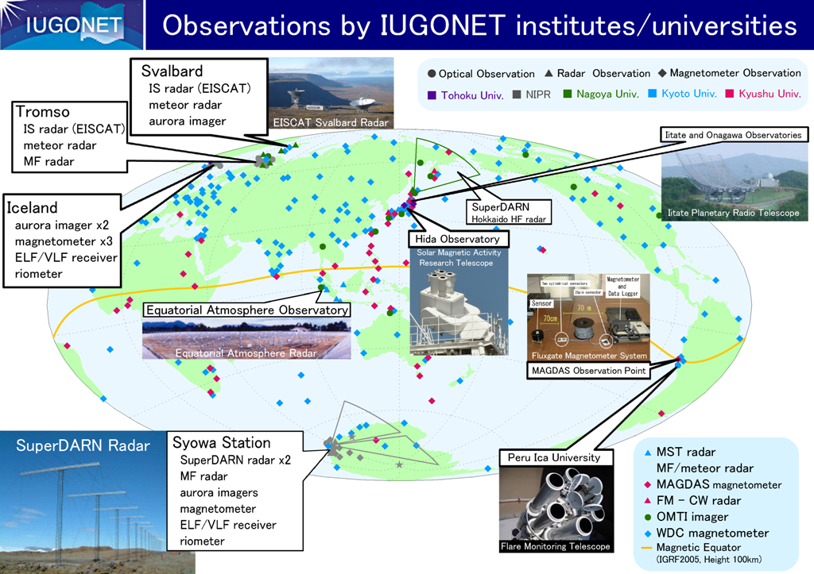
Near-earth space data of ESPAS and IUGONET
measure and use the same type of data and information
share the common use of observatories and instruments
http://www.iugonet.org/en/figures/observations1_en.png

Slide 23
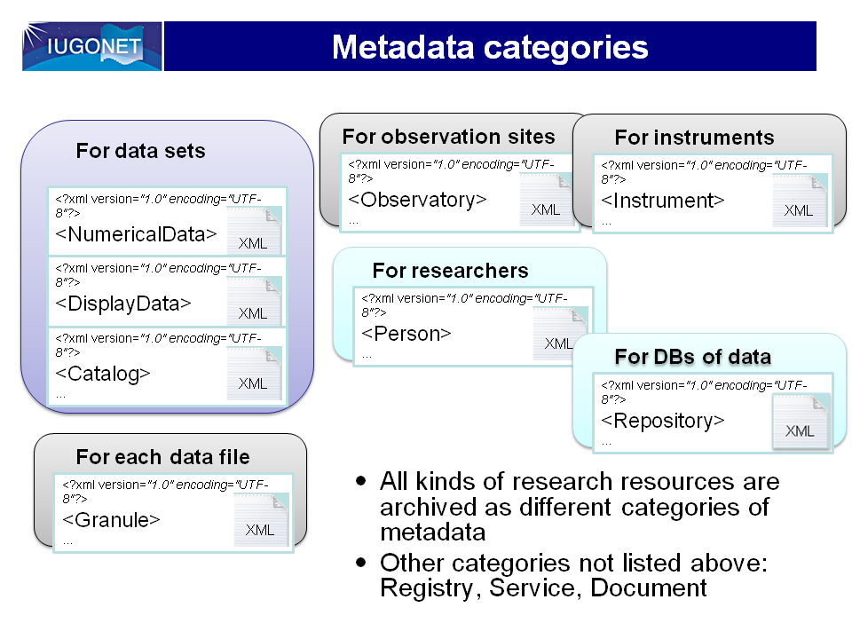
source: http://www.iugonet.org/en/figures/mdf_category.png
*... we selected the SPASE data model/metadata format as the base of the IUGONET metadata format because SPASE matches best the upper atmosphere data and holds versatility and expandability in terms of the international standardization. Our original modifications have been added to SPASE to create the IUGONET common metadata format.
*http://www.iugonet.org/en/mdformat.html

Slide 24
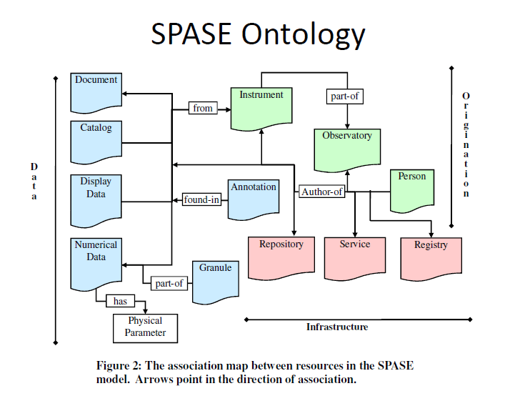
*SPASE 2.2.2 Data Model
IUGONET’s data model is based on SPASE¹
¹ A Space and Solar Physics Data Model from the SPASE Consortium, Version: 2.2.2
Release Date: 2011-02-27
¹ http://www.spase-group.org/docs/dictionary/spase-2_2_2.pdf

Slide 25
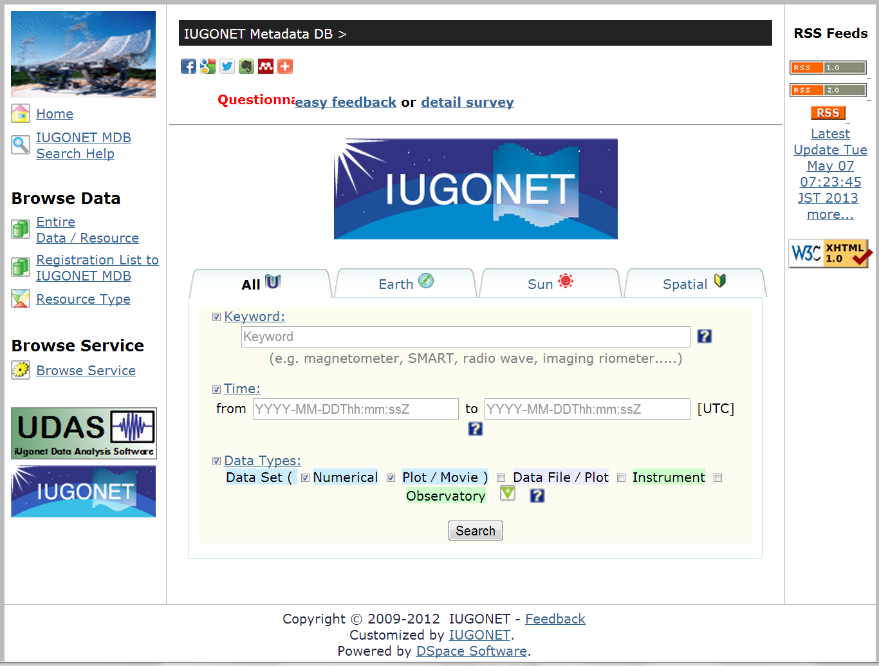
IUGONET Metadata DB Portal*
*http://iugonet1.stelab.nagoya-u.ac.jp/iugonet/

Slide 26
Objectives:
A platform to integrate heterogeneous data from earth’s
thermosphere, ionosphere, plasmasphere & magnetosphere
Provides unique access to scientific near-earth space data
Offers Web-based applications and services
ESPAS User Interface:
http://www.espas-fp7.eu
Next ESPAS release: October 2013
Final ESPAS release: November 2015

Slide 27
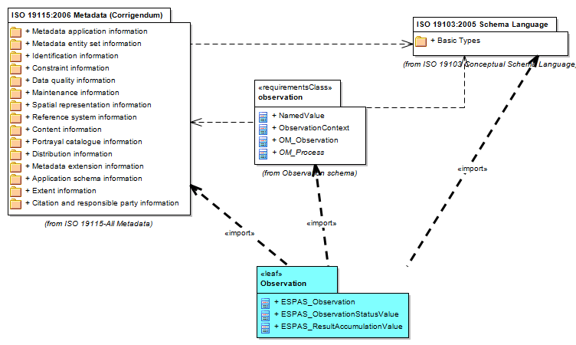
Part of ESPAS’s data model based on ISO 19xxx and OGC standards
¹
¹ http://www.iso.org/iso/home/store/
catalogue_tc/catalogue_detail.htm?
csnumber=53798

Slide 28


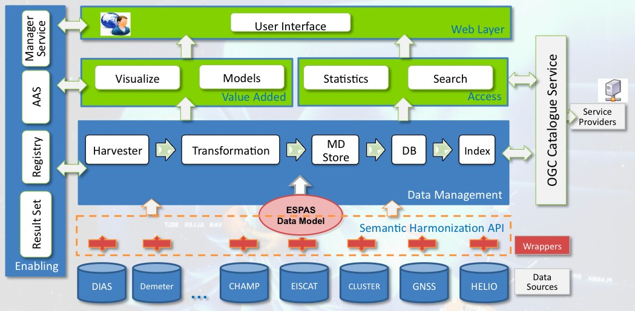
ESPAS System Architecture¹
²
¹http://www.espas-fp7.eu/trac/wiki/WP7ESPASCoreServicesDevelopment
²http://www.d-net.research-infrastructures.eu

Slide 29
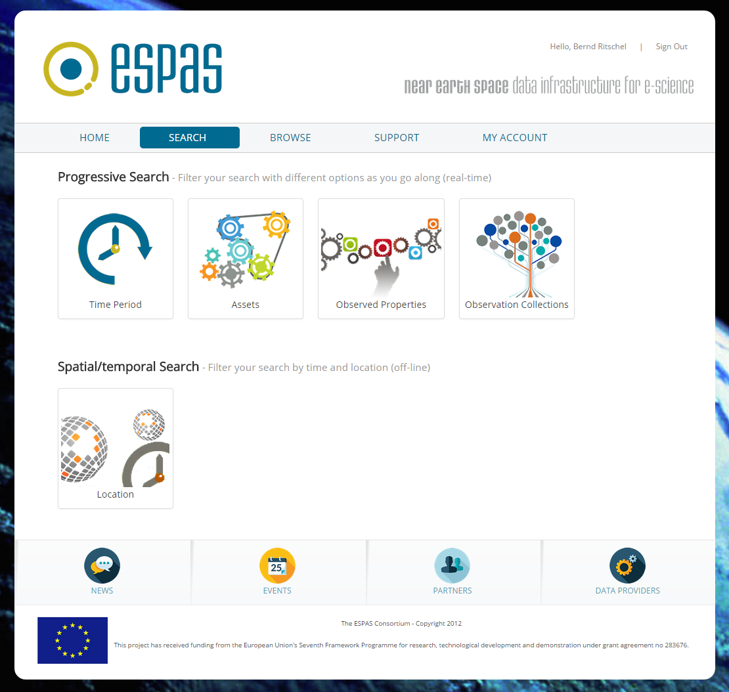
ESPAS Data Portal*
Final data server
release:
November 2015
*https://www.espas-fp7.eu/portal/

Slide 30
GFZ ISDC Semantic Web Project*
*https://gfz.github.io

Slide 31
ISDC Ontology Class Model (simplified)
Controlled Vocabulary*
Free Vocabulary
Keyword
Keyword
c
ISDC
Project
Platform
Instrument
Science Domain
Geophenomenon
Context
Institution
Product Type
Content
Personell
Country
Data Product
*http://gcmd.gsfc.nasa.gov/Resources/valids/archives/keyword_list.html

Slide 32
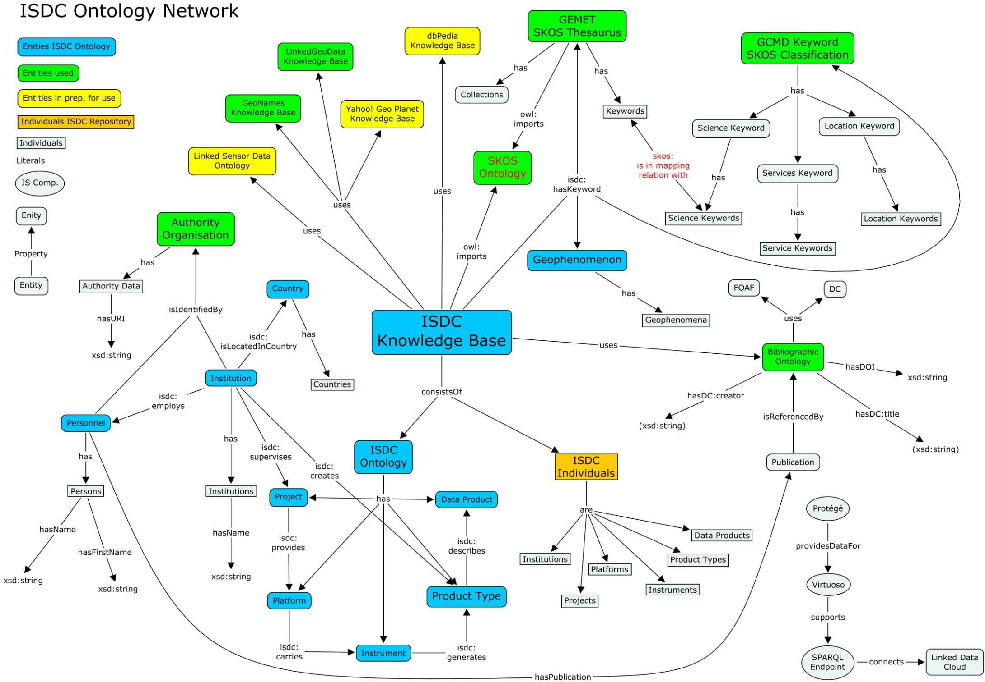
ISDC Ontology Network
*
Domain Ontologies
*December 2011
Notes:
Domain ontologies, such as ISDC ontology Version 2, with the classes, e.g. product type, instrument, platform (observatory, satellite, airplane, …), institution, project, …
+
FOAF (used in social networks), GeoNames for location information, dbPedia, for general context information, bibo for combining data and publications

Slide 33
ISDC Ontology Network
*
Terminological Ontologies
*December 2011
Notes:
Terminological ontologies based on classifications or thesauri
=> GCMD science keywords, GEMET and SPASE are combinded and merged in order to find and use other data resources form same or different domains

Slide 34
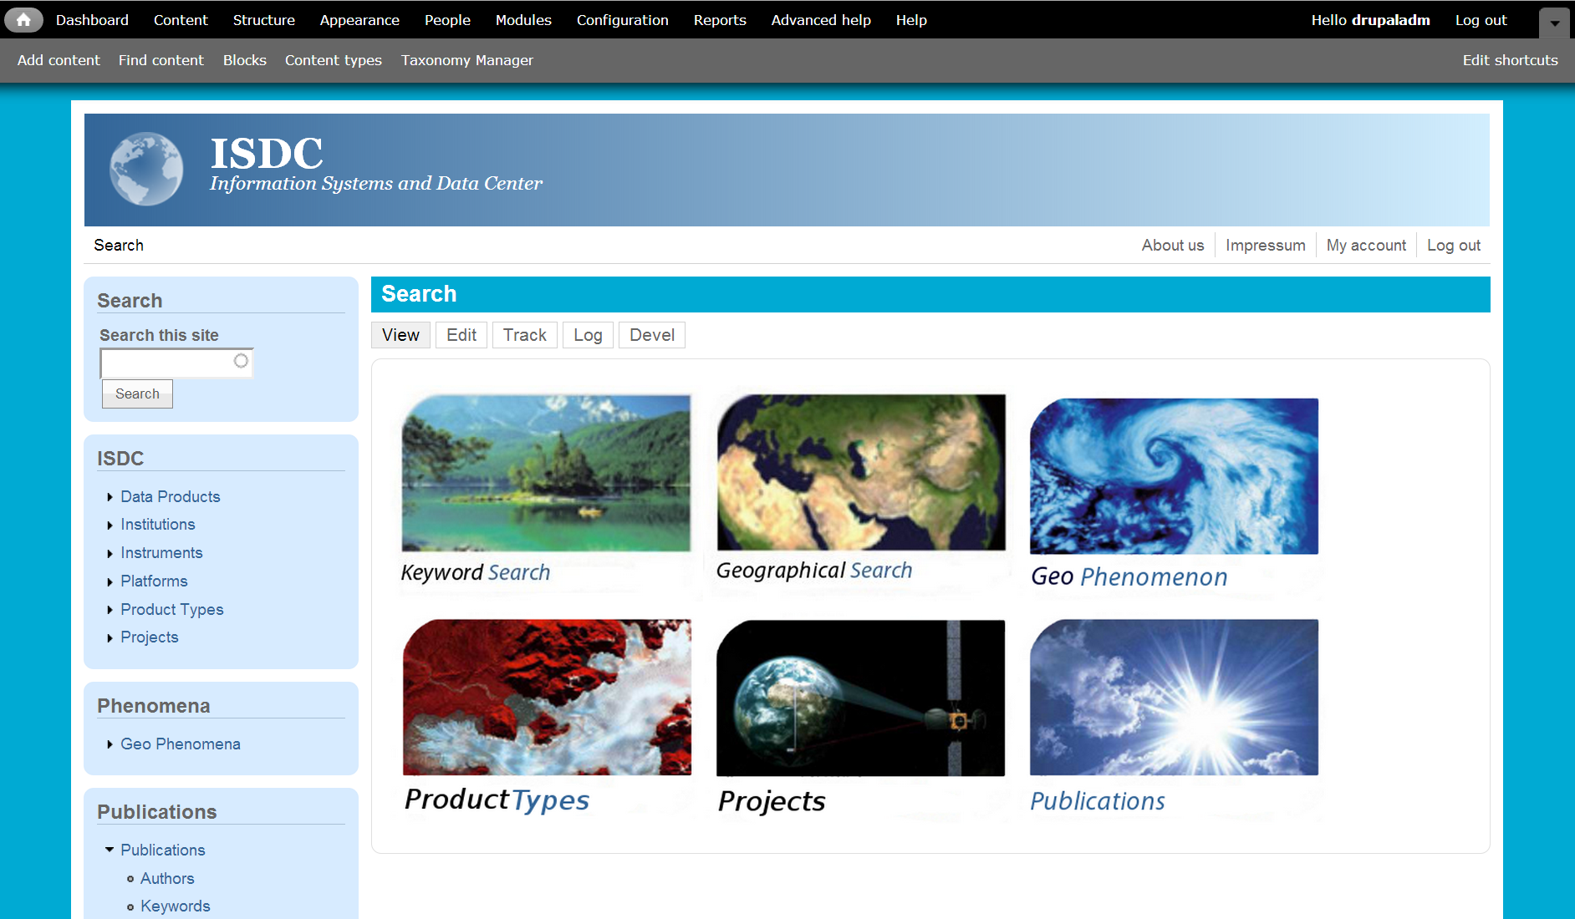
Semantic Web based GFZ ISDC Portal*
- Proof of Concept -
*http://rz-vm30.gfz-potsdam.de/drupal-7.9/
Based on ISDC ontology network, ISDC RDF and ISDC RDB resources
Implemented via Drupal V7 CMS, Virtuoso RDF Triplestore, D2RQ Platform

Slide 35
Metadata, Data Models, Frameworks
Differences
Commons
Metadata
SPASE (IUGONET)
ISO/OGC (ESPAS)
NASA DIF (ISDC)
Metadata models
SPASE version 2.2.2
ISO/OGC 19xxx
ISDC ontology version 1.4
Frameworks/Apps
DSpace
D-Net
OSF software stack (Drupal/Virtuoso/Solr/…)
Data (scientific domain related)
Metadata & Metadata model entities
Data (granuals/products)
Catalog (classification)
Instruments
Platforms (observatories)
Persons and Institutions
Projects and Phenomena
Vocabulary entities
Classifications (keywords)
Thesauri (keywords+links)

Slide 36
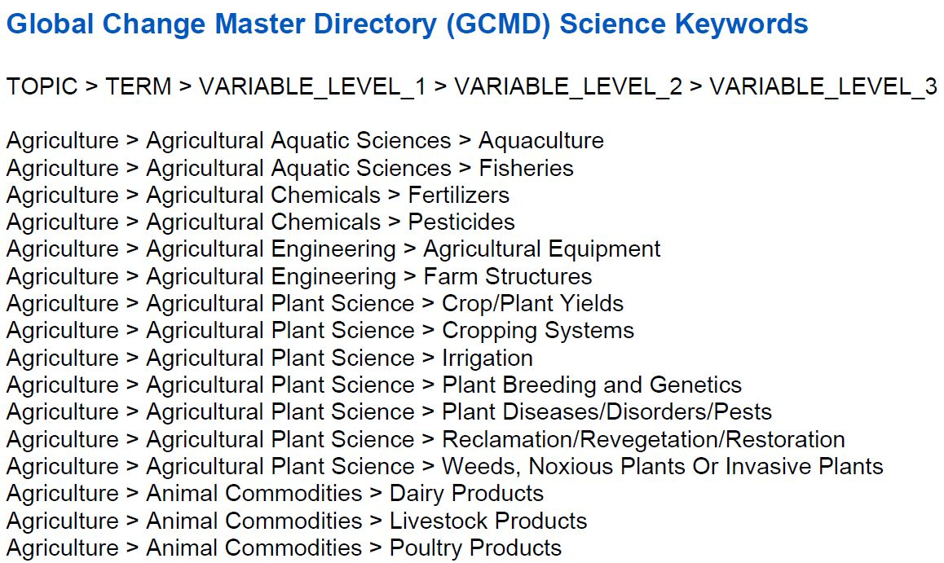
*GCMD Science Keywords
Transferred into
SKOS standard**
**Juliane Pilgrim,
University of Applied Sciences Potsdam
Faculty of Information Science
*http://gcmd.gsfc.nasa.gov/Resources/valids/archives/GCMD_Science_Keywords.pdf
Notes:
GMCD science keywords are modeled and transformed into SKOS => can be used as semantic web standard for the combination with domain ontologies and/or other tesauri/classifications

Slide 37
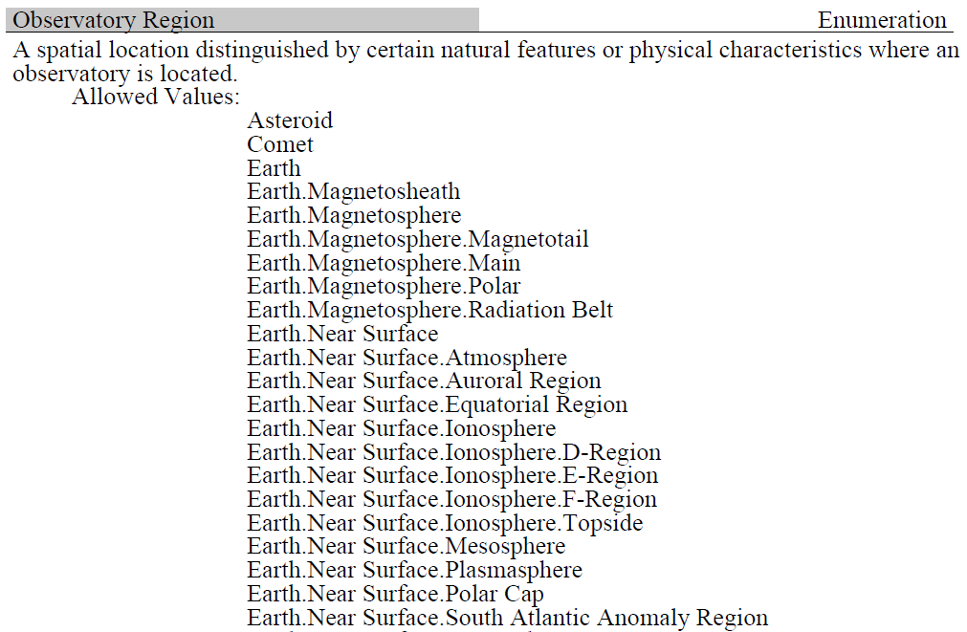
*SPASE „allowed values“ Classification
*A Space and Solar Physics Data Model
from the SPASE Consortium
Version: 2.2.2
Release Date: 2011-02-27
Document Generated: 2012-Feb-28
Top Concept
Transferred into
SKOS standard
Concepts
(hierarically
structured)
Notes:
SPASE is standard used in heliophysics for the description of data, archives and retrieval systems and services
=> Domain ontology + classification
=> Extraction of the allowed values and creation of a SKOS based ontology

Slide 38
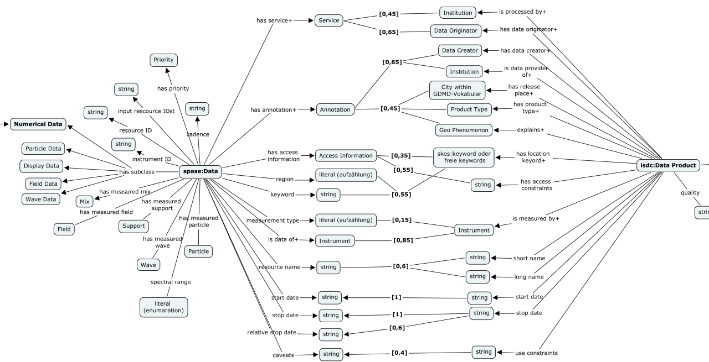
*Merging ISDC and SPASE|VMO/VHO Ontologies Example: spase:Data <=> isdc:Product Type
SPASE
ISDC
spase:Data
isdc:Product Type
*based on S. Schildbach’s Bachelor thesis
Notes:
SPASE domain ontologie merged with ISDC ontology, e.g. properties (relations) valid for isdc:product type and spase:data
=> OWL construct same as is use for the connection of same or very similar properties
=> Connection of different data modes is possibel

Slide 39
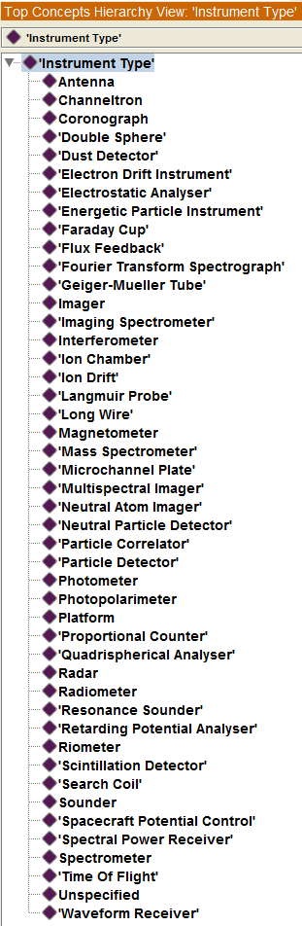
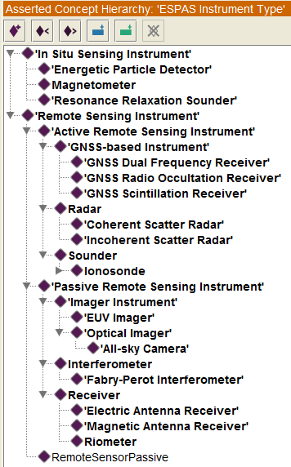
SPASE “allowed values” <=> ESPAS ontology (Collaboration project between ESPAS and IUGONET)
IUGENT
ESPAS Instrument Type
ESPAS SKOS
resource browser:
espas.spaceweatherservices.com
RDF + OWL + SKOS
iugonet:Imager
owl:closeMatch
espas:Imager Instrument
espas:Optical Imager
espas:All-sky Camera

Slide 40
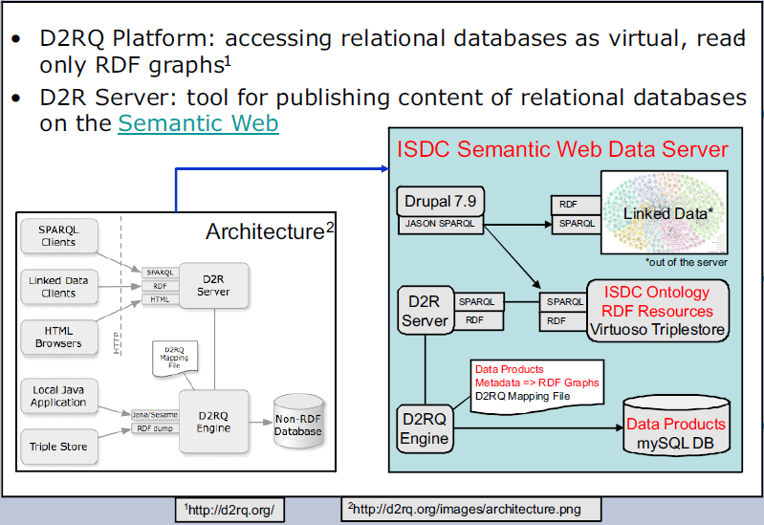
D2RQ for mashup of RDBMS with Triple Stores

Slide 41
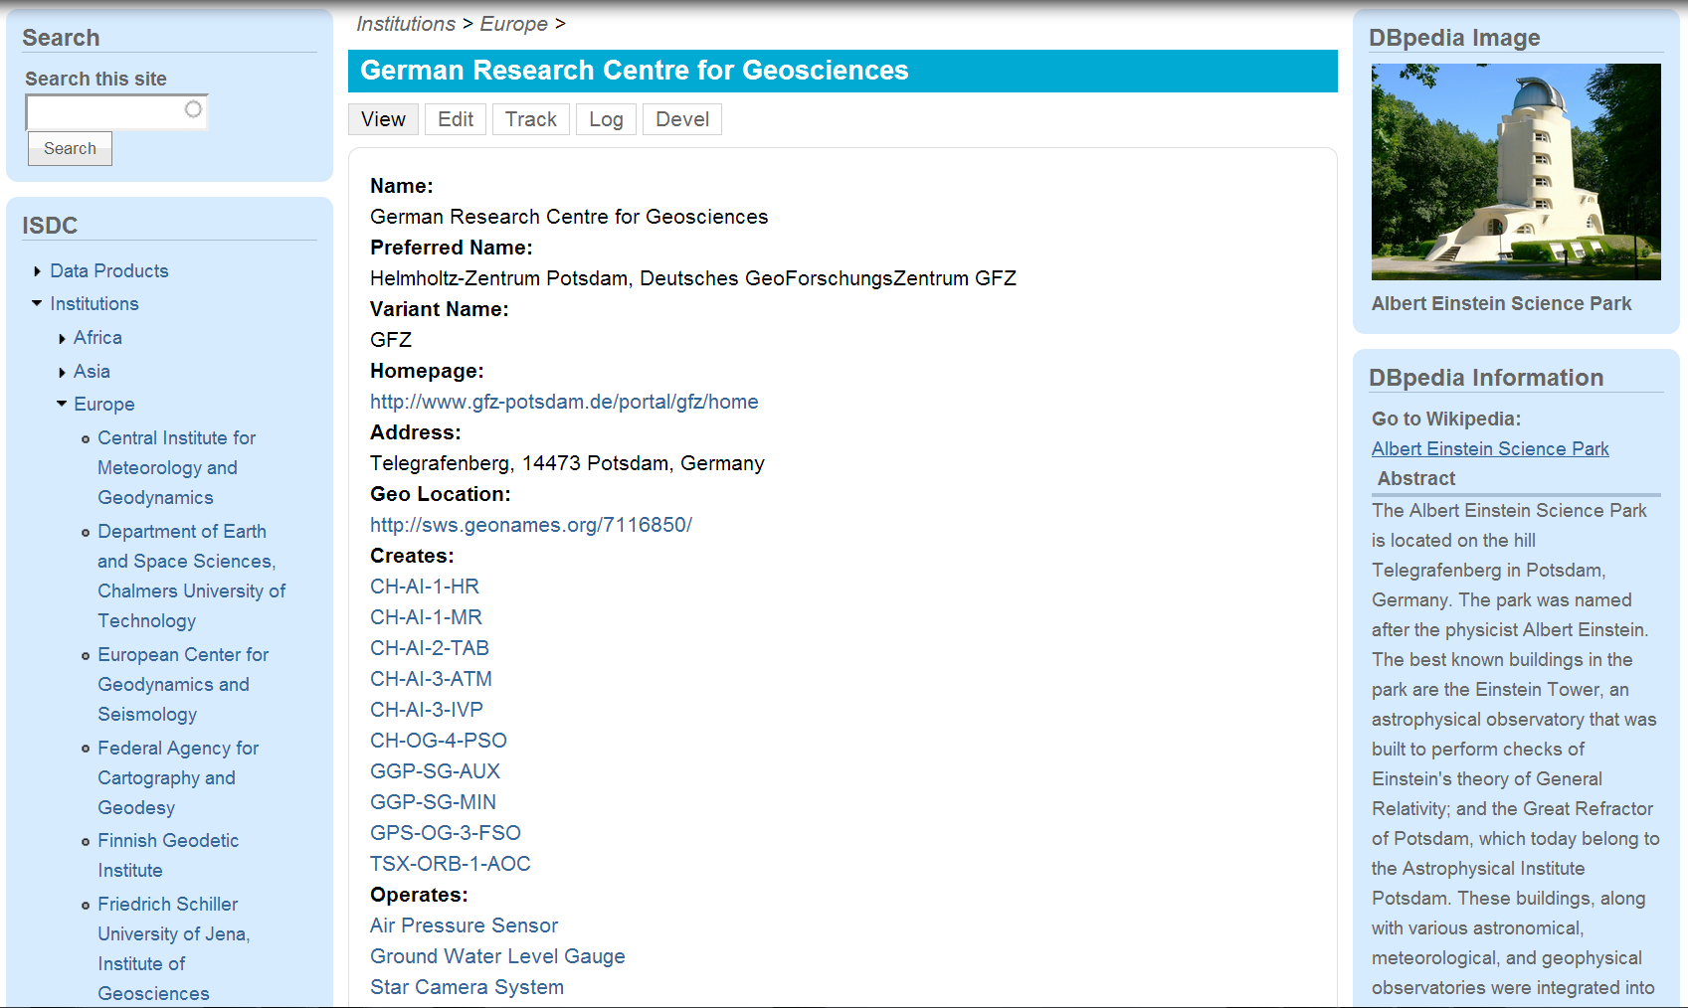
Institution Data Linked with DBpedia Data Institutions => Europe => GFZ
isdc:properties
of institution
creates
operates
runs
supervises
has research focus
is providing service
is located in
…
DBpedia
GFZ institution page:
Interactive links to product types, instruments, platforms, geophenomena, …

Slide 42
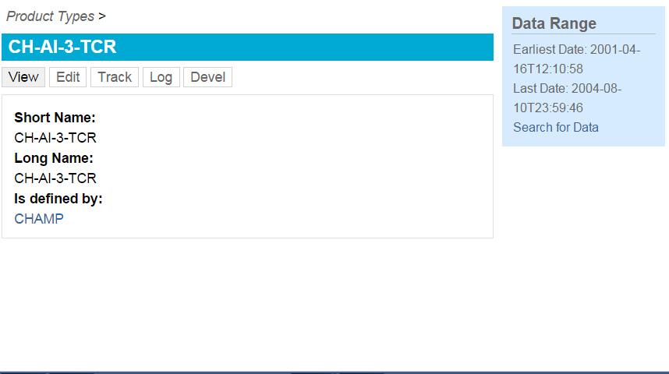

Data Products Metadata derived from D2R Server Product Types/Data Products => CH-AI-3-TCR
isdc:properties
of CH-AI-3-TCR
hasStartTime
hasStopTime
hasDoY
CH-AI-3-TCR page:
Links to related entities and SPARQL/D2R server search capabilites

Slide 43
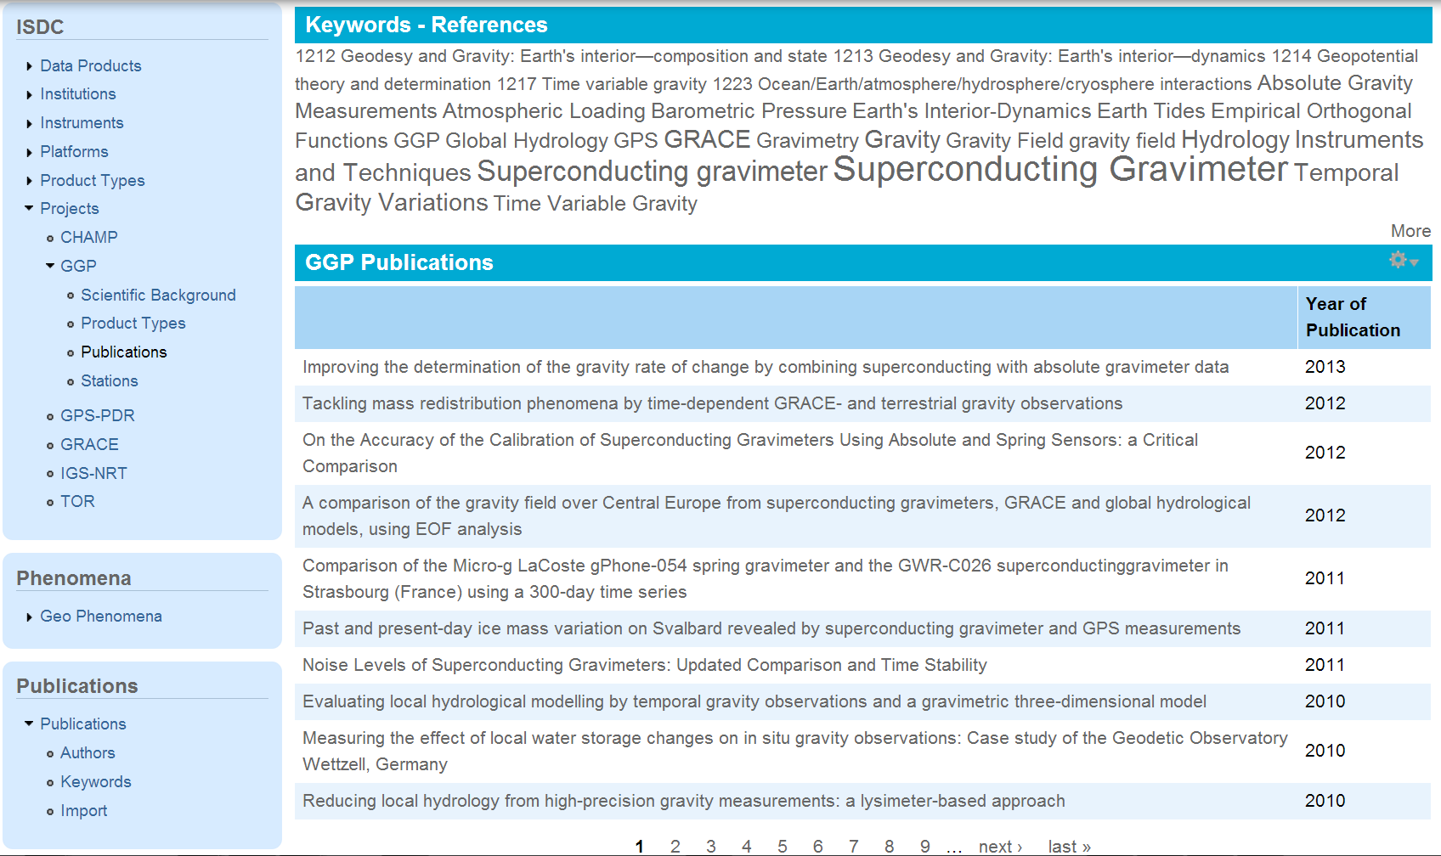
Projects => GGP => Publications
Interactive tag cloud
DOI <=> URI/IRI is Semantic Web based identifier,
publishes data and connects data and publications
GGP publications linked to SG stations, instruments, product types (data), geopheonomena, institutions, persons, … via merged keyword ontologies

Slide 44


Education
Research
Research Data Management with Semantic Web Technology
Collaboration in education and project based research since 2010
Education and research in information science => data scientist
Current topics: 4 work packages
Transformation of GFZ XML data to RDF for GFZ semantic Web based ISDC prototype
Merging of terminological ontologies for integration of further structured LOD data
Data mining and named entity recognition/relation extraction for integration of unstructured web data
Implementation of semantic Web application based on OSF stack (Drupal 7, Virtuoso, Solr, OWL API)
FHP: http://informationswissenschaften.fh-potsdam.de/index.1.html
Notes:
Very fruitful collaboration with University of applied sciences in potsdam,
=> Students in information science are educated in semantic web domain
=> the deal with topics in research and system development for the semantic web based ISDC

Slide 45
Actual state of scientific outcome
projects
data
applications
publications

Slide 46
Role of Scientific Libraries in Open Science
Body or agency of institutional scientific data, information and knowledge (application) provider
Librarians (becomes) and data scientists bridging the gap between domain scienes and e-sciences
Libraries host the infrastructure (data server/services, information systems, open applications)
Powerful use cases are necessary (scientific one, educational, data publications, societal, decission making, ...) to show the benefit of this approach
(Some) money, reputation and power has to flow from the scientific projects to the libraries for providing this services (overcoming egoism)
At GFZ Potsdam this approach failed because of too many egoisms

Slide 47



Planed Actions
Creation of a Semantic Knowledge Network
WDS is establishing a Knowledge Network (KN) for scientific metadata (similar to Web of Science)*
KN implementation working group in WDS
D2RQ Framework (e.g. using GFZ/FHP experiances)
Mashup of semantic/vocabulary resources (e.g. IUGONET, ESPAS, ISDC)
...
Whether looking at data, books, journals, proceedings or patents,
Web of Science provides a single destination to access the most reliable, integrated, multidisciplinary research. Quality, curated content delivered alongside information on emerging trends, subject specific content and analysis tools make it easy for students, faculty, researchers, analysts, and program managers to pinpoint the most relevant research to inform their work.
*Wim Hugo, Membmer of the Scientific Committee of the ICSU WDS

Slide 48
Call for design of scientific vocabularies
CAWSES-II Nagoya 2013, AGU/EGU/JpGU/AOGS 2013/2014/2015
Please help to create a well agreed keyword vocabulary
for space weather and climate including neighbor disciplines
such as e.g. earth magnetic field or solar-terrestrial physics.
Report the keyword vocabulary you are using
Find common agreement in the use => standard
Discuss and agree about concordances and mash-ups in your own domain and cross-domain
Please contact IUGONET or ESPAS:
iyemori@kugi.kyoto-u.ac.jp, rit@gfz-potsdam.de
Notes:
Very fruitful collaboration with University of applied sciences in potsdam,
=> Students in information science are educated in semantic web domain
=> the deal with topics in research and system development for the semantic web based ISDC

Slide 49
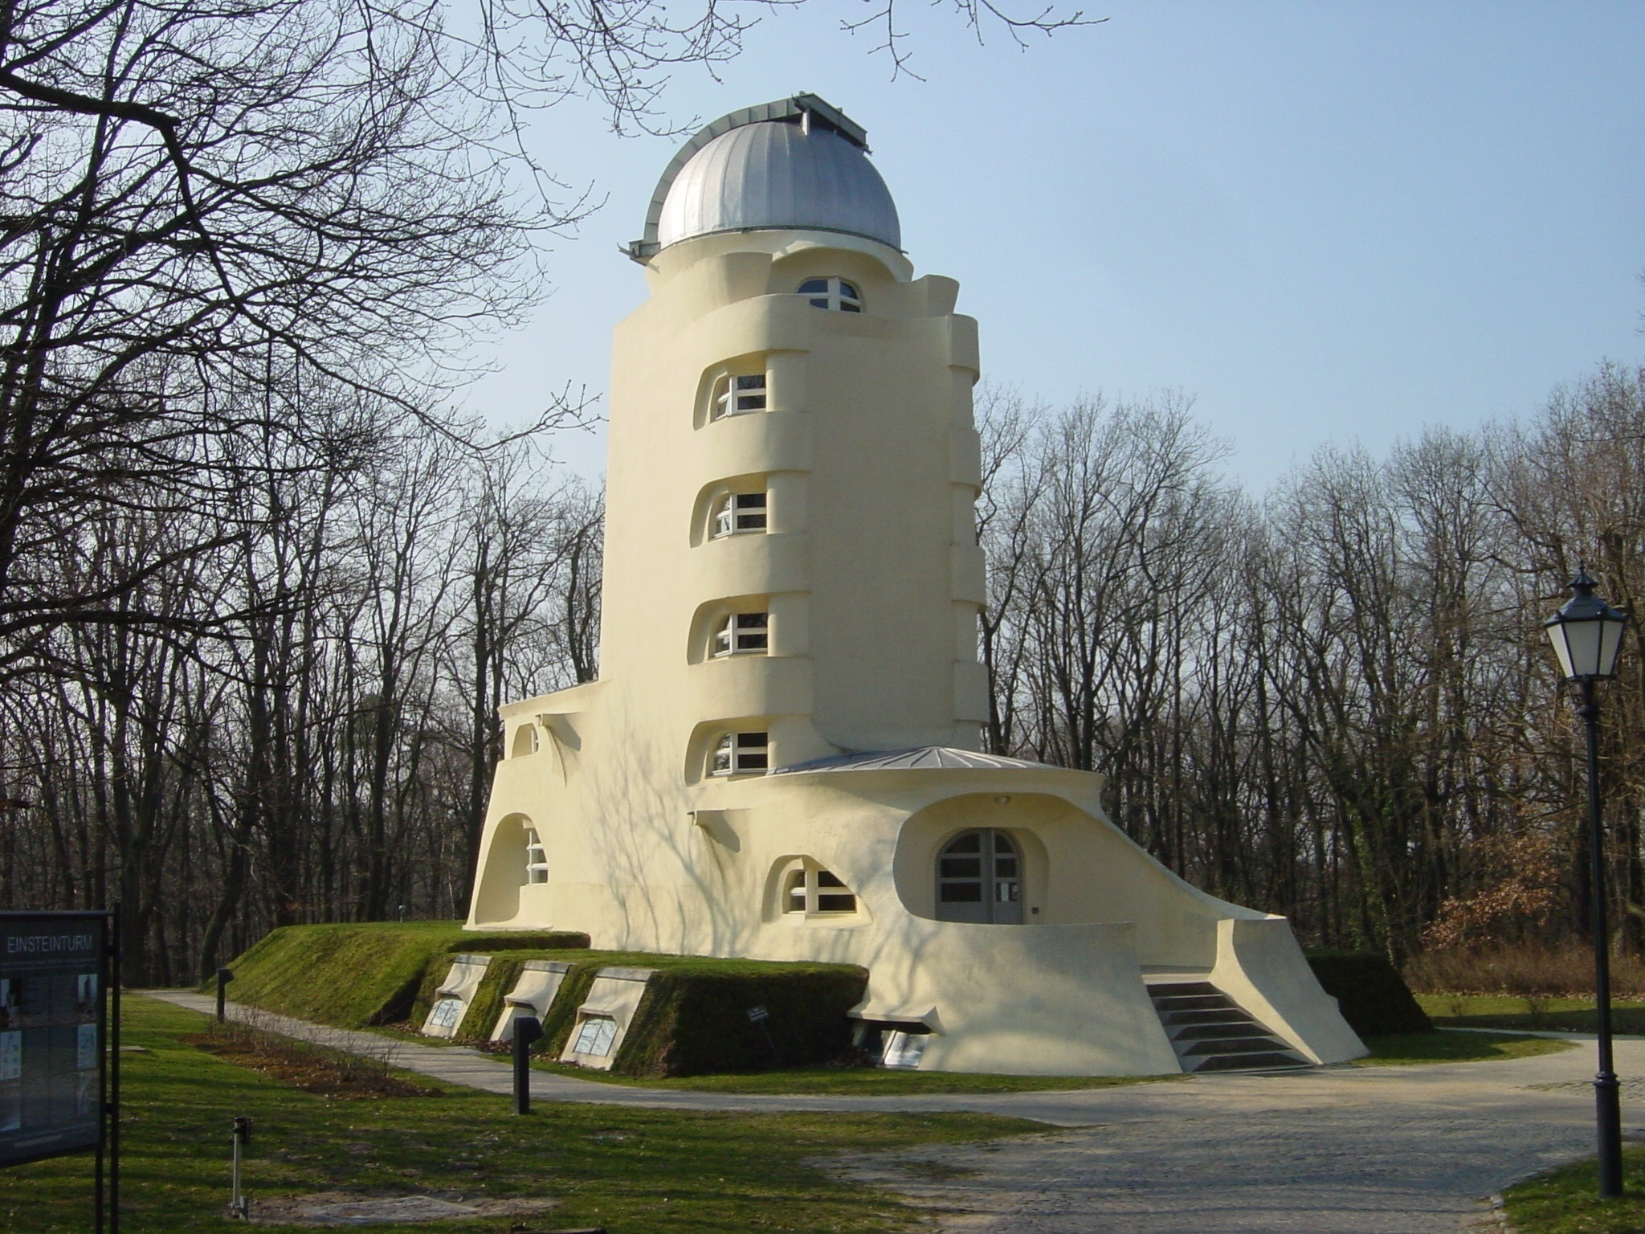
Can we trust the Web any longer?
- internet spying
- censorship
- manipulation
- erasing
- destruction
ありがとう ございました。しつもんが ありますか。
rit@gfz-potsdam.de
ritschel@kugi.kyoto-u.ac.jp
Thank you, Questions?
Notes:
物理学者 [ぶつりがくしゃ] physicist, 情報学者 [じょうほうがくしゃ] information scientist
研究所 [けんきゅうじょ] research institute

Slide 50
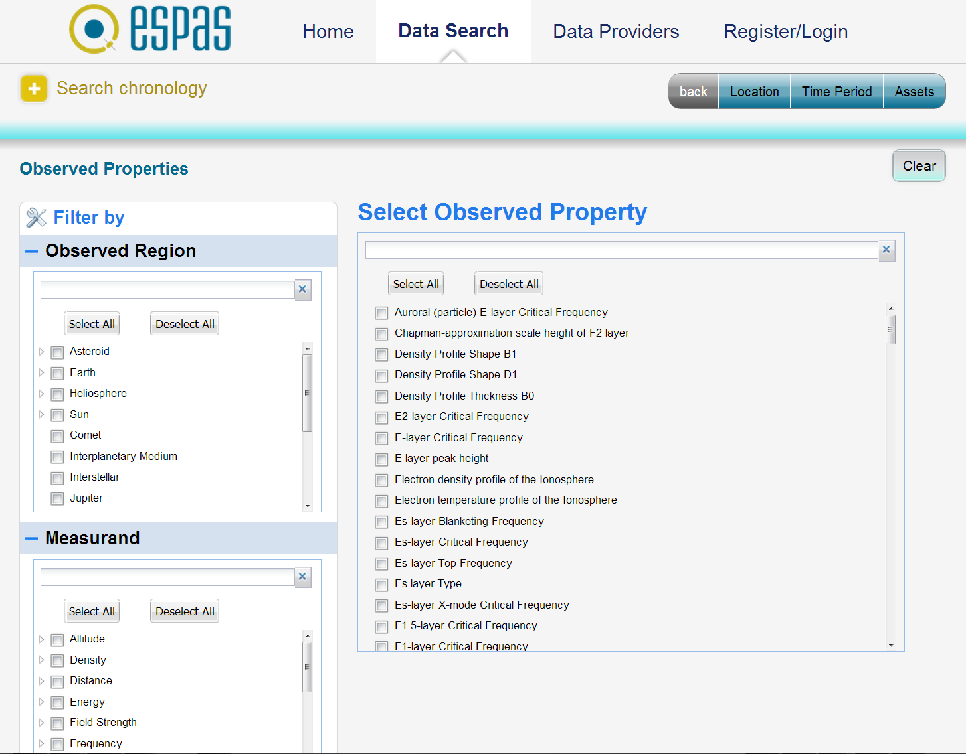


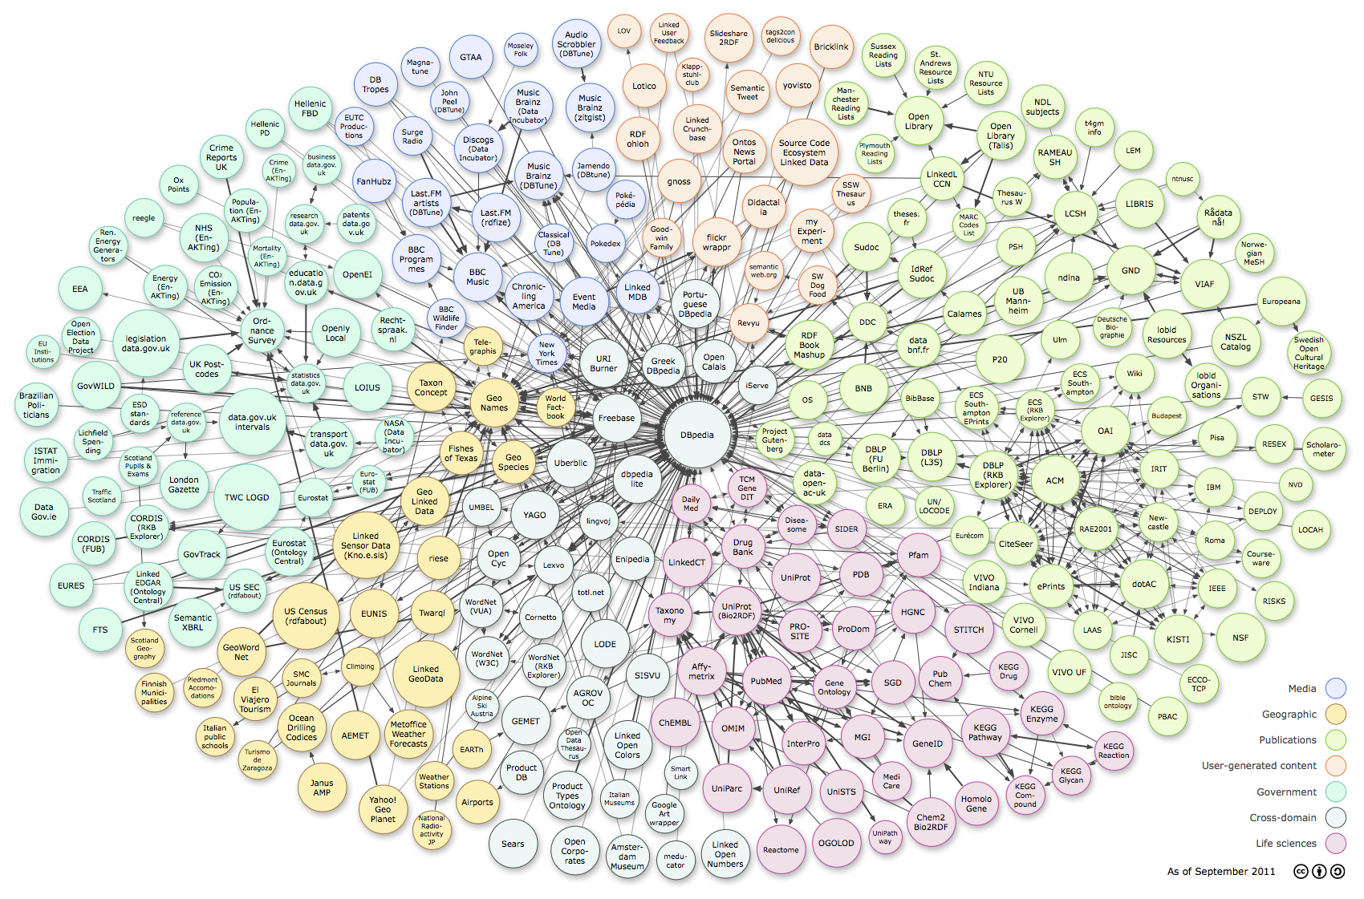

Japanese e-science project
EU 7th framework project
IUGONET Metadata DB Portal
Objectives
Platform to integrate data from
thermosphere, ionosphere,
plasmasphere & magnetosphere
Provide unique access to
scientific near-earth space data
Offer Web-based applications
and services
Project
Inter-university Upper atmosphere
Global Observation NETwork*
Objectives
creation of a Metadata DataBase of
ground-based observations of the
upper atmosphere
www.iugonet.org
LOD*
www.espas-fp7.eu
Domain
Ontology
Merging
FOAF
BIBO
GeoNames
dbPedia
SPASE
Terminological
Ontology
Merging
GFZ ISDC Drupal 7 proof of concept
GCMD Keywords
GEMET
SPASE
PDS
IVOA
Information model & resources
ISDC ontology network
Keyword vocabularies
GFZ RDF+RDB data, LOD data
Technical implementation
Drupal CMS, Virtuoso Triple Store
Open Semantic Framework OSF
Resources
Geodetic data
Magnetic field data
Atmosphere data
*Linked open Data
http://lod-cloud.net/
Notes:
Near-earth space data of ESPAS and IUGONET
measure and use the same type of data and information
share the common use of observatories and instruments
ISDC provides data form the same domain (atmosphere and ionosphere)

Slide 51
Challenges of [Open] Science
Scientifical
Technical
Social (Cultural)
Financial
Sociatal (Political)
Philosophical

Slide 52
Scientific Challenges
Complex sciences and research of complex systems (e.g. climate or space weather)
Cross domain and cross-border (transnational or global)
Big data (also technical aspect)
„Big“ and multidomain instruments (e.g. CERN) (also technical aspect)
Data science as new research topic (bridging the gapes between domain sciences and eScience and has integrating effect on domain sciences)

Slide 53
Technical Challenges
Adopting to scientific and technological progress and cultural changes
Wetware (WI) <-> Software
Social networks as collaboration platforms
Scientific collaboration <-> competition => Return of investment (publications)

Slide 54
Social Challenges
Adopting to scientific and technological progress and cultural changes
Wetware (WI) <-> Software
Social networks as collaboration platforms
Scientific collaboration <-> competition => Return of investment (publications)

Slide 55
Science: Complex Sciences (research of complex systems)
Cross domain and cross-border (transnational or global)
Big data (also technical aspect)
„Big“ and multidomain instruments (CERN) (also technical aspect)
Data science as new research topic bridging the gapes between domain sciences and eScience and more
Social:
Wetware (WI) <-> Software
Social networks as Collaboration platforms
Scientific Collaboration <-> Return of Investment (publications)
Technical: eScience and Research infrastructure
Cloud computing and cloud storage <-> loose of control of data and knowledge
AI (neuronal networks) and Deep learning = Branche of machine learing ()
Virtual Reality and interacting with avatars
Google Large Scale Deep Learning Jeff Dean
Apple Making Big Hiring Push in Artificial Intelligence and Machine Learning
Instrumentation
Financial
Hardware (very expensive, Satellites/vessels/drilling/CERN)
Not enough money for software (design/engineering) and wetware
Not enough funds for independent/public eScience infrastructure
Funding policy: big projects (big money) <=> small projects (small money)
Sociatal (Political)

Slide 56
Sociatal (Political)
Particular interests <-> majority stake interests (e.g. Climate change or fracking)
2 sides of a medal (e.g. nucleaer physics research)
Employment conditions (short and ultra short time contracts) no future
Abuse of data
Permanent and ubiquity controll of life
AI + WI or AI <-> WI
„Transhumanism“ for everybody <-> minority, do we really want this?
3 laws of western society (capitalism) keep rich people rich
Particular interests <-> majority stake interests (e.g. Climate change or fracking)
2 sides of a medal (e.g. nucleaer physics research)
Employment conditions (short and ultra short time contracts) no future
Permanent and ubiquity controll of life
AI + WI or AI <-> WI
„Transhumanism“ for everybody <-> minority, do we really want this?
3 fundamental principles of western society (capitalism)
Keep rich people rich (do not change the class society)
Make rich people more rich (maximization of profit)
Do all for keeping the first 2 principles (rule the legislature, executive, judiciary + mass media, Internet/WWW)
Goethe Faust/Zauberlehrling
Private <=> public interests
Interest controlled <=> freedom of science
Education <=> Research

Slide 57
Machine Learning -> Deep Learning
Deep Learning (DL) takes the AI a step further:
DL trains machines
to recognize patterns in the data, then classify and categorize them, all on their very own (so with less engineering labor). And second, it enables the process to unfold huge reams of previously unmanageable data.
enables the process to unfold huge reams of previously unmanageable data.
Google
Brain team => 100 different teams use that technology
http://recode.net/2015/07/15/deep-learning-ai-is-taking-over-tech-what-is-it/

Slide 58
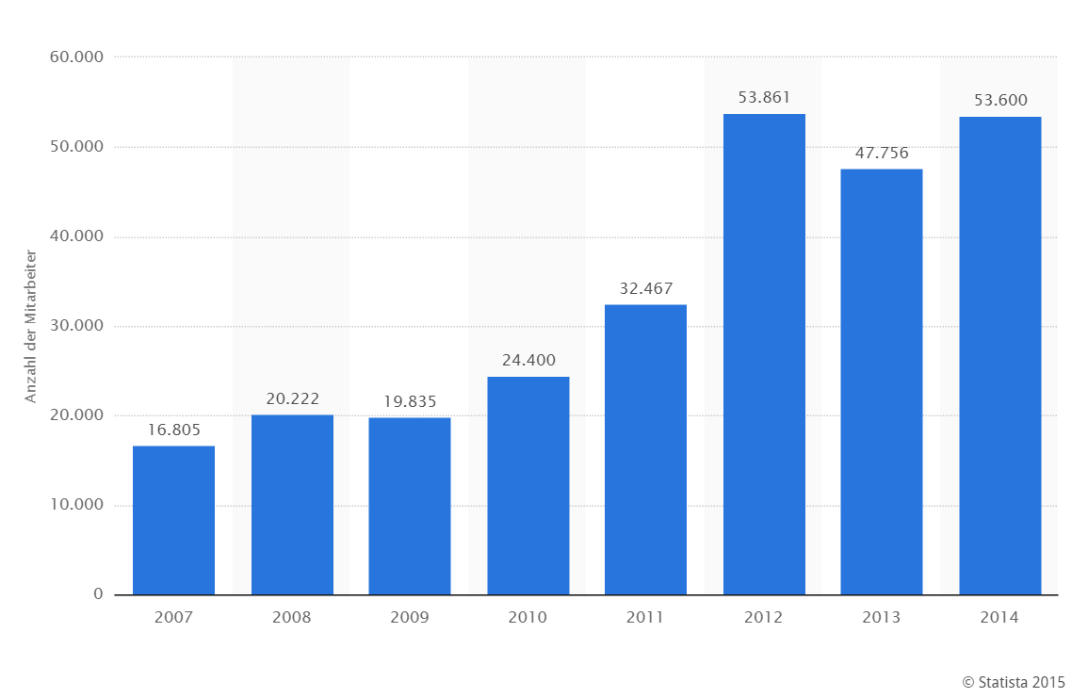
Google

Slide 59
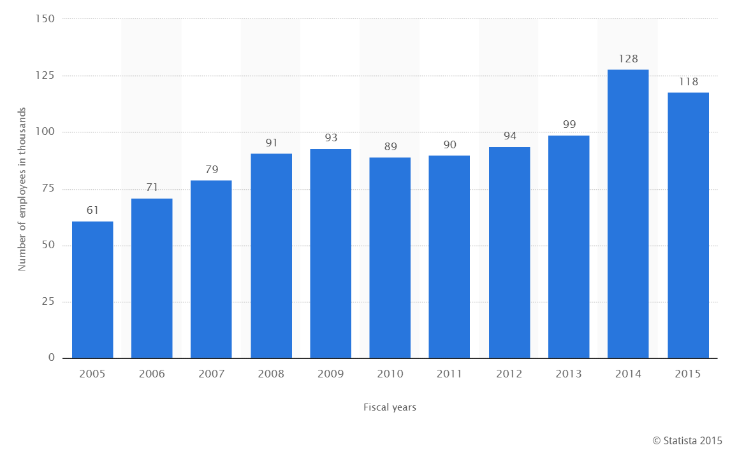
Microsoft

Slide 60
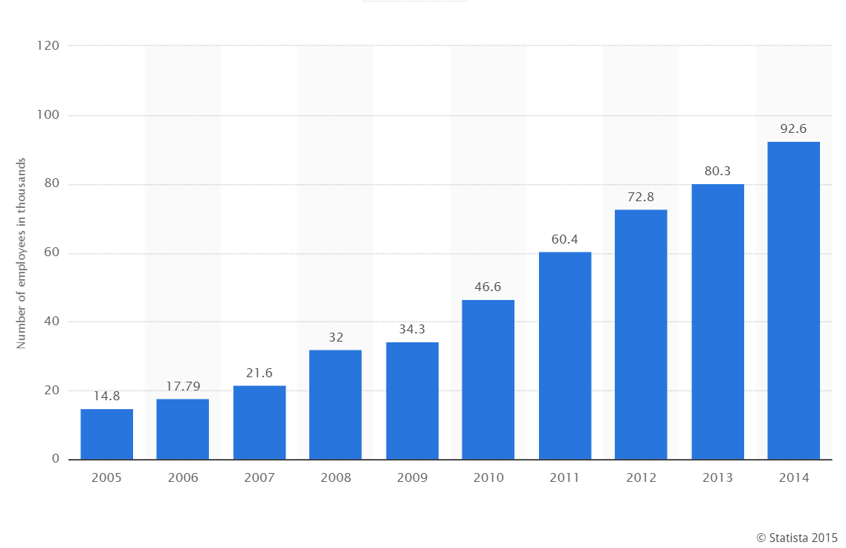
Apple

Slide 61
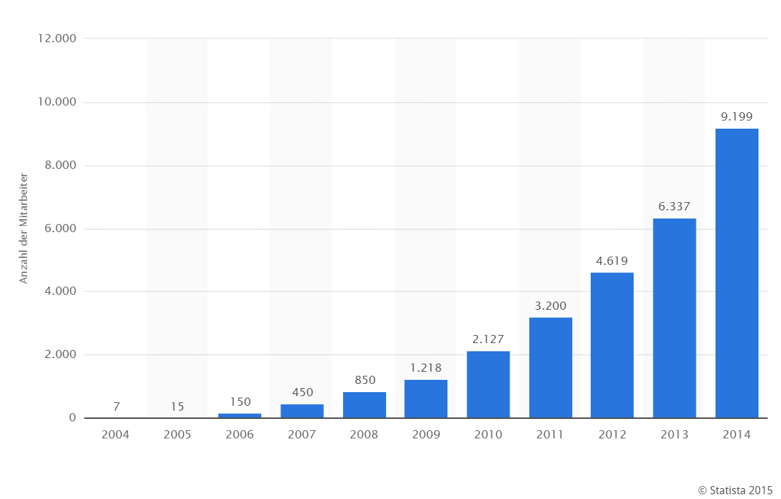
Facebook

Slide 62
IBM, Amazon, Twitter, Uber, Baidu

Slide 63
Google: Drain for the brain
Money is at play. An engineer proficient in deep learning can earn upward of $250,000 a year at places like Google and Facebook, according to several sources; exceptional or more experienced ones can net seven-figure salaries.
“There’s been a huge brain drain from academia,” said Naveen Rao, the CEO of Nervana Systems, a heavily funded deep learning startup. (Bengio is an adviser.) Valley firms are taking up the mantle. That tends to push research in their preferred direction, advancing models that, for instance, work best for smartphones or search, Rao argued. DeepMind is working directly with Google’s search or Knowledge unit. “It’s always a little bit biased,” Rao said. “It always has a slant.”
http://recode.net/2015/07/15/ai-conspiracy-the-scientists-behind-deep-learning/

Slide 64
Brain Projects
EU Human Brain Project
large 10-year scientific research project, established in 2013
Its total costs are estimated at €1.19 billion
Mission
Understanding the human brain is one of the greatest challenges facing 21st century science. If we can rise to the challenge, we can gain profound insights into what makes us human, develop new treatments for brain disease and build revolutionary new computing technologies. Today, for the first time, modern ICT has brought these goals within sight.
White House BRAIN Initiative Project (Brain Research through Advancing Innovative Neurotechnologies)
public-private research initiative, April 2, 2013
10 year, $4.5 billon (also DARPA)
Goal
supporting the development and application of innovative technologies that can create a dynamic understanding of brain function
https://www.humanbrainproject.eu/
http://www.braininitiative.nih.gov/index.htm

Slide 65
Which way does the Web take?
Image and speach recognition
Natural language processing
Autonomous cars

Slide 66
Streit über Umwelt-PR: So irreführend sind die Wissenslücken der Klimaforscher
http://www.spiegel.de/wissenschaft/natur/klima-wie-forscher-und-medien-ergebnisse-verzerren-a-1050336.html

Slide 67
Five companies control more than half of academic publishing
MERCREDI, 10 JUIN 2015 14:00 NEWS
http://www.nouvelles.umontreal.ca/udem-news/news/20150610-five-companies-control-more-than-half-of-academic-publishing.html

Slide 68
The Oligopoly of Academic Publishers in the Digital Era
http://journals.plos.org/plosone/article?id=10.1371/journal.pone.0127502

Slide 69
Zauberlehrling
Zerstörte Grenzen findet man überall, selbst auf Gebieten, wo man sie gar nicht vermutet hätte. Ein überraschendes Beispiel: Die Nutzung der Erdwärme (Geothermie). In politisch korrekter Raserei werden dabei – um »umweltfreundliche Energie« zu gewinnen – tiefe Erdschichten angebohrt und auf diese Weise geologische Grenzen verletzt. So kann zum Beispiel plötzlich freigesetztes unterirdisches Wasser Gesteinsschichten »schmieren« und Erdbeben verursachen. In Staufen im Breisgau wurden 2008 etwa 200 Häuser beschädigt, nachdem sich nach Tiefenbohrungen der Erdboden im Stadtgebiet bis zu 20 Zentimeter gehoben hatte.

Slide 70
Wahrscheinlich hatten sich unterirdisch Dinge gemischt, die nicht zusammengehören, nämlich Anhydrit und Wasser. Der dabei entstehende Gips dehnt sich aus und hebt den Boden an. In Kamen-Wasserkurl gab es 2009 einen regelrechten Erdrutsch, als nach Geothermie-Bohrungen plötzlich 48 Kubikmeter Boden »in einem Loch verschwanden« (Der Westen, online, 24.09.2009): »Erdwärmebohrungen vergrößerten bereits vorhandene Risse im Felsgestein«. Während allerorten über die Risiken von Kernenergie gesprochen wird, hat die Geothermie hierzulande bereits konkrete und massive Schäden angerichtet und führt uns anschaulich vor Augen, wie destruktiv die Verletzung von Grenzen ist.

