Slide 1
Publishing Data – WDS Building Blocks
Mustapha Mokrane
WDS-IPO Executive Director
2nd Open Science Data Workshop, Kyoto University

Slide 2
Part I: World Data System
Part II: Publishing Data

Slide 3
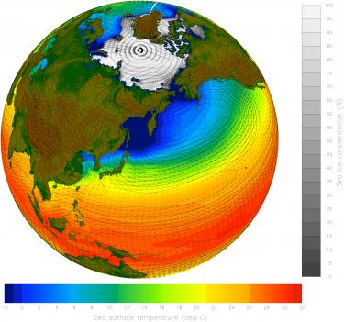
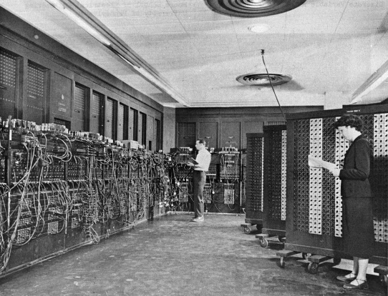
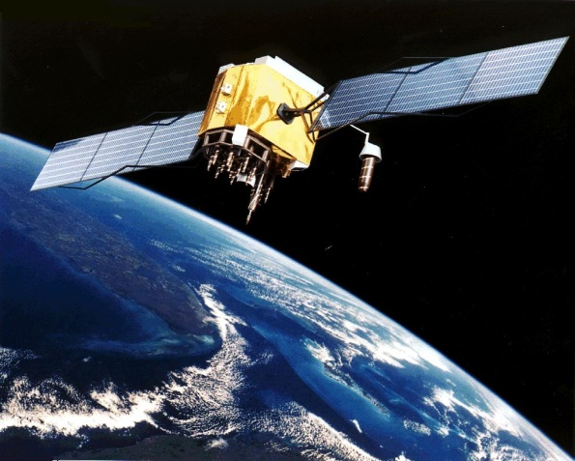
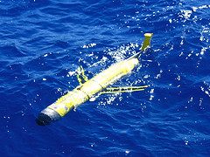
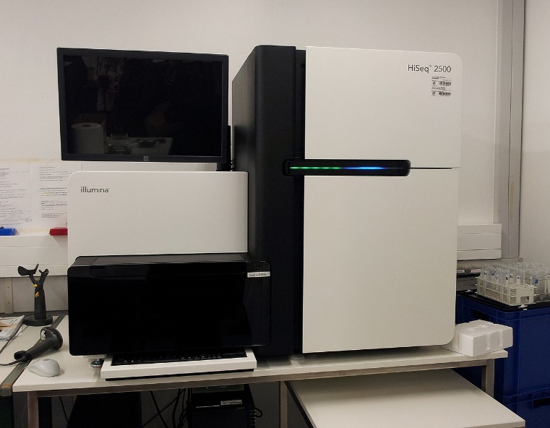
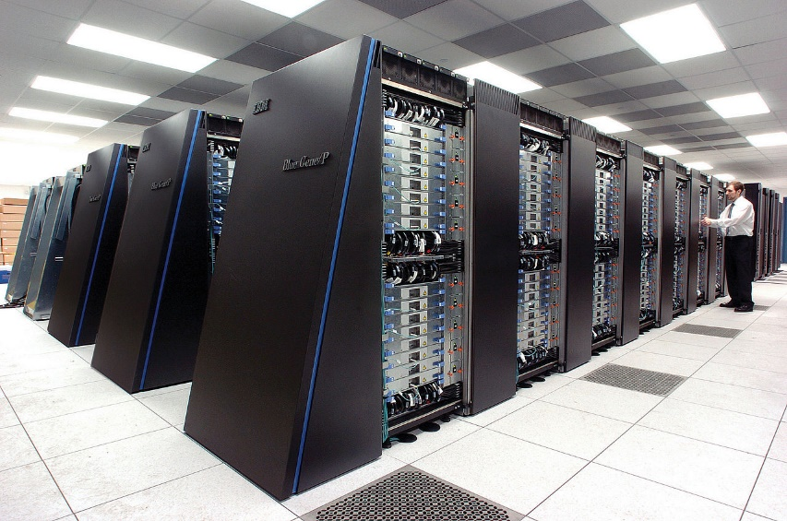

Data Intensive Science

Slide 4

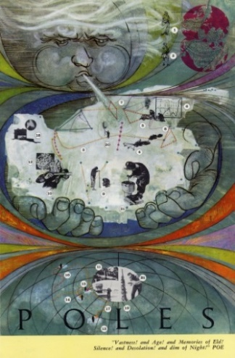








Open Data for Science
‘All observational data shall be available to scientists and scientific institutions in all countries.’ IGY 1957–58

Slide 5
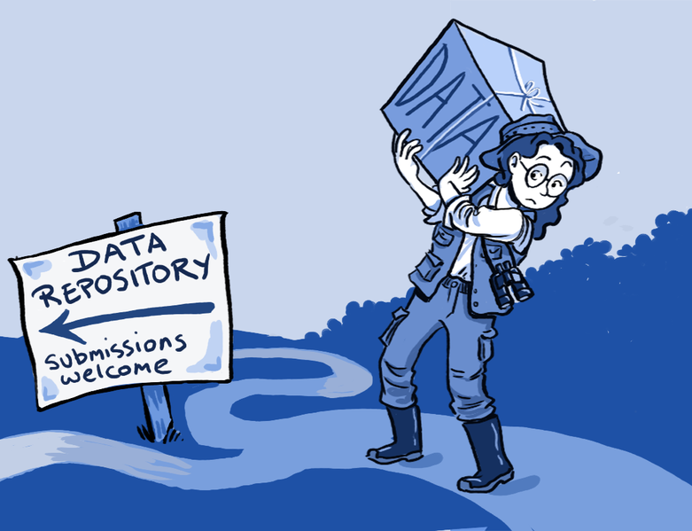
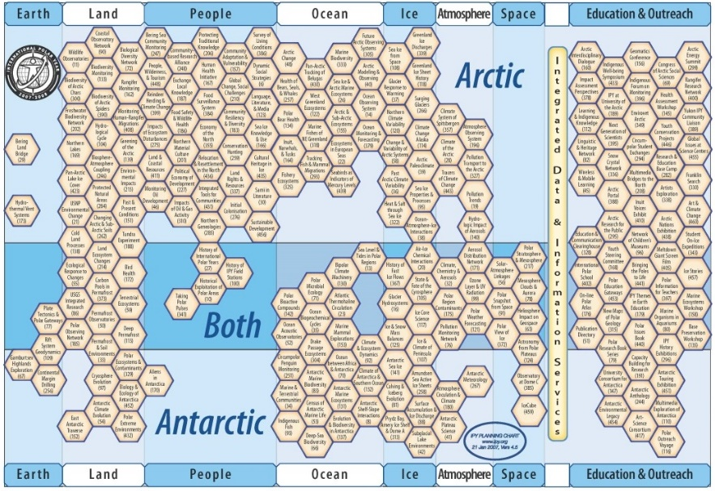
IPY 2007–08
‘IPY data, including operational data delivered in real time, are made available fully, freely, openly, and on the shortest feasible timescale… It is essential to ensure long-term preservation and sustained access.…’

Slide 6

ICSU World Data System
IPY influenced the WDS concept:
Operates as a network
Better geographic balance
Better disciplinary coverage
WDS created in 2008
First Scientific Committee 2009
First accredited members 2011
IPO hosted by NICT in 2012

Slide 7
WDS Membership
Scientific Data Services: Assist organizations in the capture, storage, curation, long-term preservation, discovery, access, retrieval, aggregation, analysis, and/or visualization of scientific data, as well as in the associated legal frameworks...

Slide 8
WDS Goals
Enable universal and equitable (full and open) access to quality-assured scientific data, data services, products and information
Ensure long-term data stewardship
Foster compliance to agreed-upon data standards and conventions
Provide mechanisms to facilitate and improve access to data and data products

Slide 9
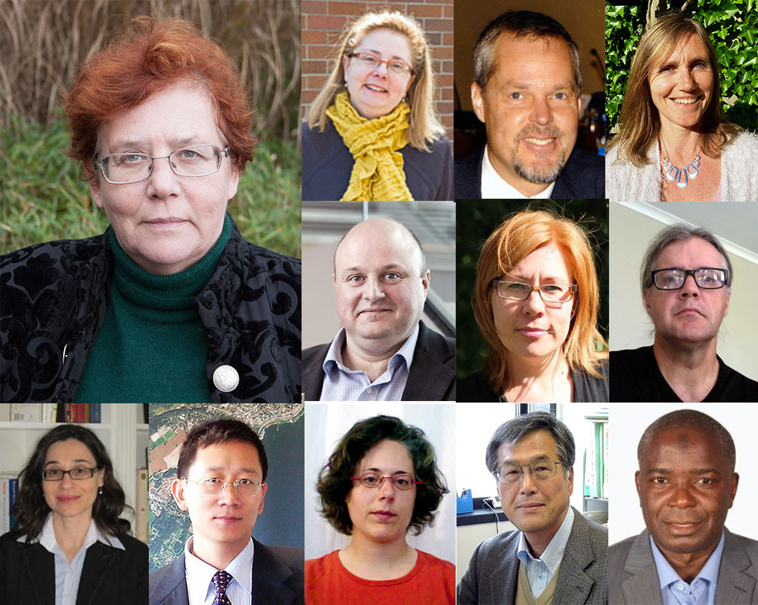
Scientific Committee 2015–18
Sandra Harrison (Chair, UK)
Aude Chambodut (France)
Arona Diedhiou (Senegal/France)
Ingrid Dillo (The Netherlands)
Claudia Emerson (Canada)
Elaine Faustman (USA)
Wim Hugo (South Africa)
Toshihiko Iyemori (Japan)
Guoqing Li (China)
Alexander de Sherbinin (USA)
Sanna Sorvari (Finland)
Seat for Latin America (TbC)
Ex Officios:
Heide Hackmann (ICSU)
Yasuhiro Murayama (NICT)

Slide 10

Strategic Targets
Make trusted data services an integral part of international collaborative scientific research
Nurture active disciplinary and multidisciplinary scientific data services communities
Improve the funding environment for data services
Improve the trust in and quality of open scientific data services
Position WDS as the premium global multidisciplinary network for quality-assessed scientific research data

Slide 11
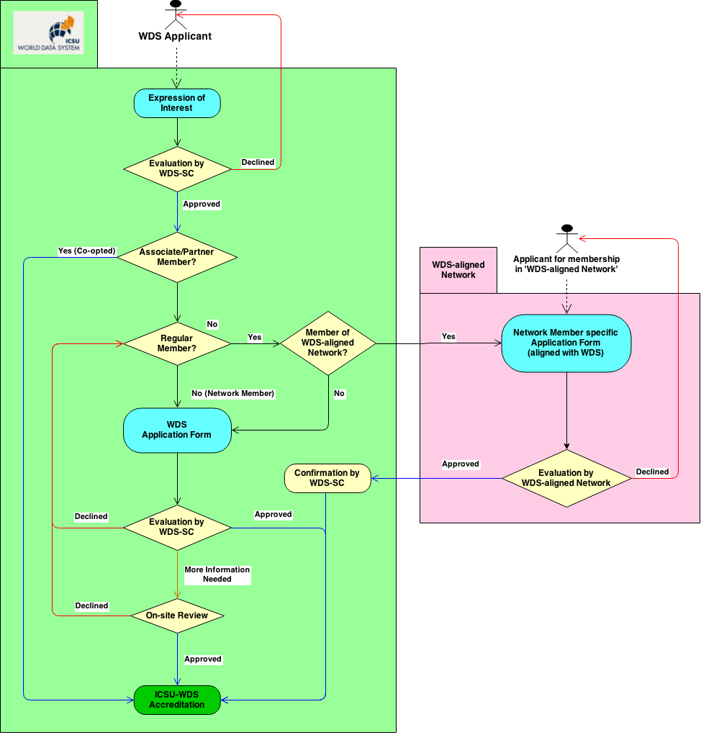
WDS Certification
Certification and periodic review of data services
Evaluation criteria based on international standards and best practices
Review board and certification authority

Slide 12
WDS Evaluation Criteria
General requirements & Policies
Letter of Agreement with ICSU
External experts to provide advice and guidance
WDS bi-annual meetings
Active communication with research community/users
Full, open, timely, unrestricted access to metadata, data…
Organizational framework
Defined scope, responsibility for long-term preservation, target user community and needs, rights of users to access data, processes to respond to change
Adequate in terms of funding, staff, long-term planning
Scientific expertise: local oversight of international repute
Continuity plan
Committed to formal periodic review and assessment
Management of data, products and services
Ensures integrity and authenticity during ingest, archival storage, data quality assessment and analysis, product generation and access and delivery
Defined criteria for collection, selection and evaluation
Defined specifications for archival storage
Efficient usage: defined criteria, preferably open standards (searchable, accessible, and usable objects and services)
Technical infrastructure
Well-supported OS and software
Hardware and software technologies appropriate to the services it provides to its designated community(ies)
Security: facility, its users, data, products and services

Slide 13
WDS Membership (Decenber 2015)
60 Regular | Organizations that are data stewards and/or data analysis services
10 Networks | umbrella bodies representing groups of data stewardship organizations and/or data analysis services (ESDIS, IODE, IVOA...)
5 Partners | Contribute to and support WDS Membership
18 Associates | Interested in the WDS endeavour

Slide 14
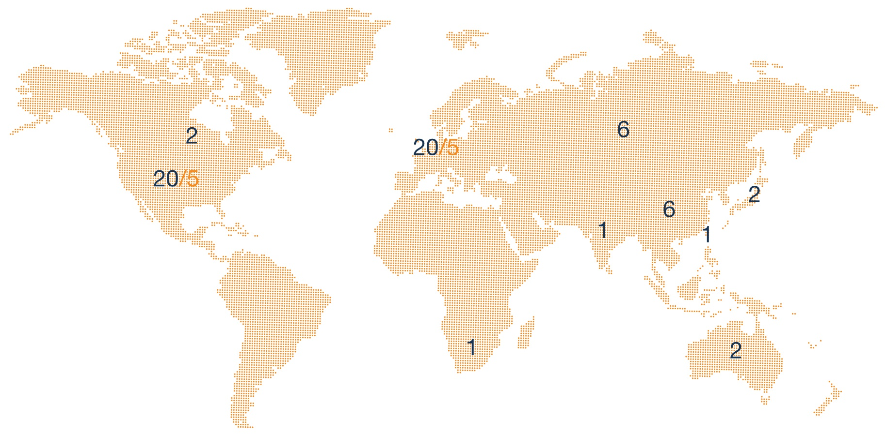
WDS Membership
Regular Members
Network Members

Slide 15
Part I: World Data System
Part II: Publishing Data

Slide 16
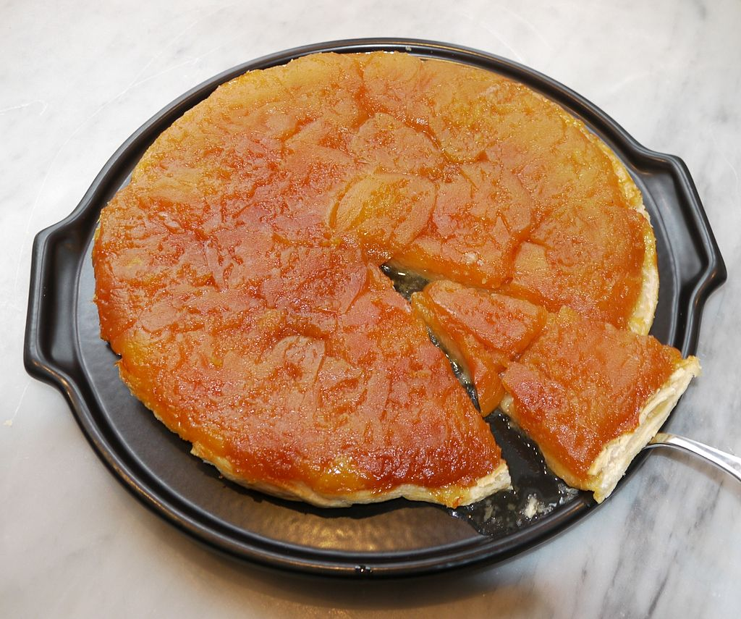

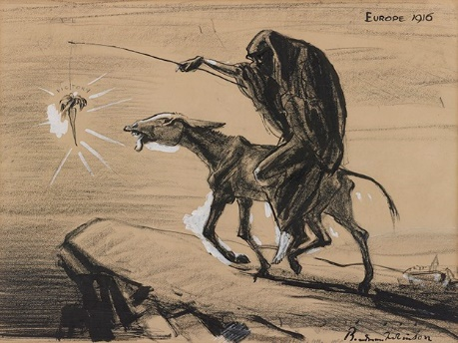

From Data Sharing Principles to Implementation
Data Sharing Principles are easy to proclaim and profess.
Implementation is more complicated:
Frictions and risks!

Slide 17
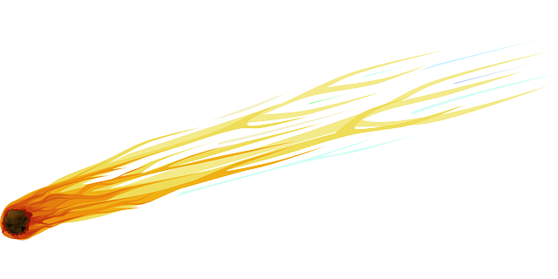
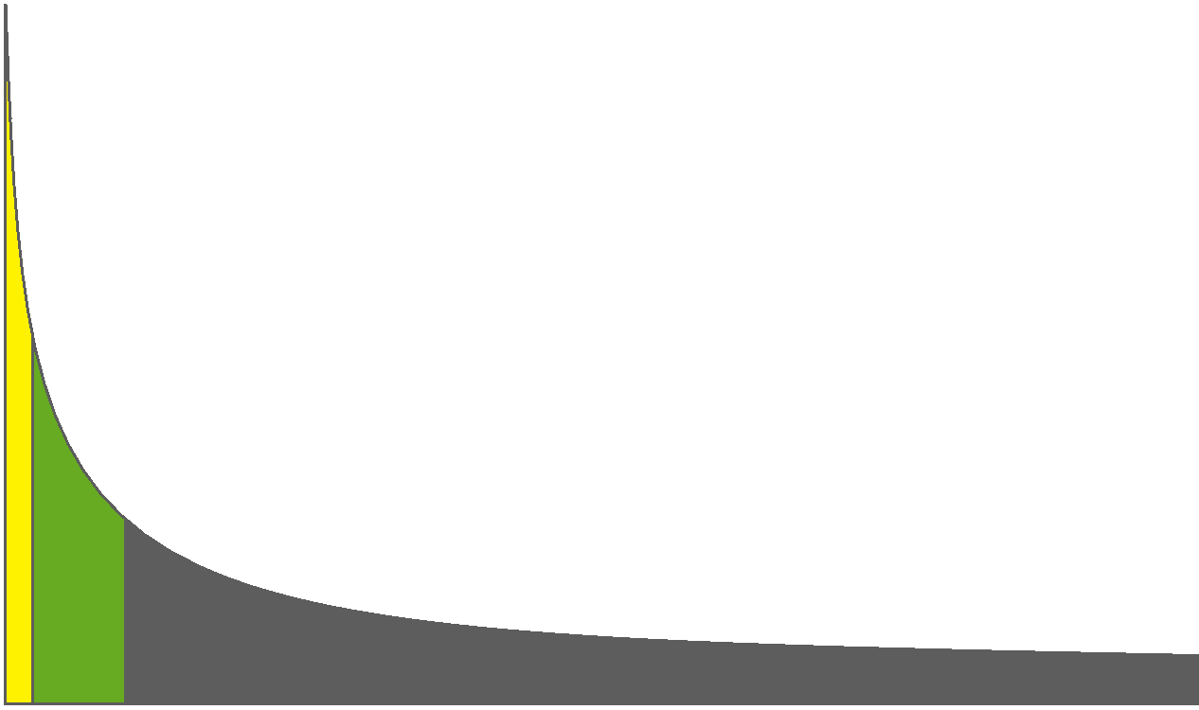

The dirty long tail!
e-Infrastructures
Publishing Data
Fitness for use
Managed open
Unmanaged open
Scientific research projects
Unmanaged closed
Total volume of scientific data

Slide 18
Bridging domains
e-Infrastructures
Fitness for use
Managed open
Publishing Data
Unmanaged open
Scientific research projects
Unmanaged closed
Total volume of scientific data

Slide 19
Publishing Data?
Facilitating
Access to, and Use or reuse of datasets.

Slide 20
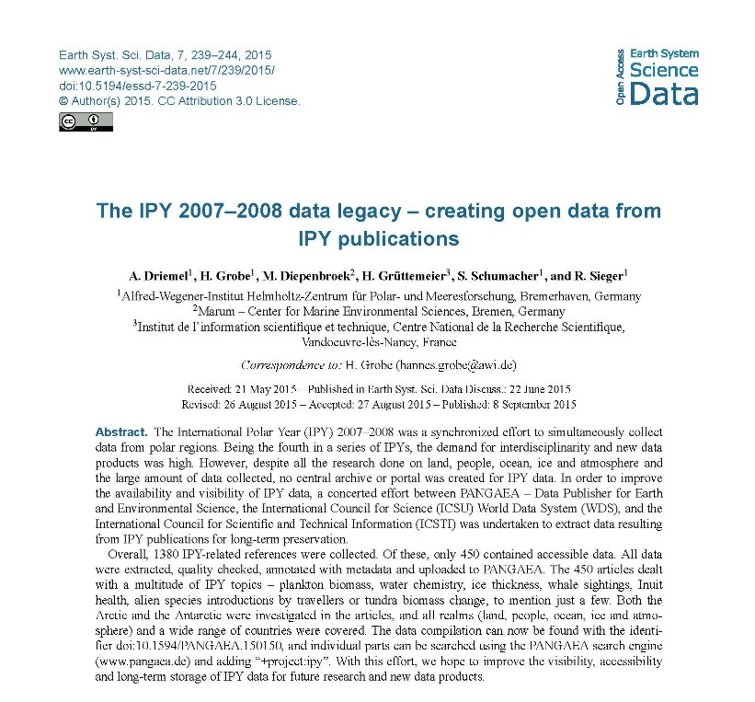




Data Access?
DOI:10.5194/essd-7-239-2015
Bibilography
1380 IPY-related publications
Selection
450 articles with valuable datasets
Digitization and curation
1270 extractable datasets

Slide 21
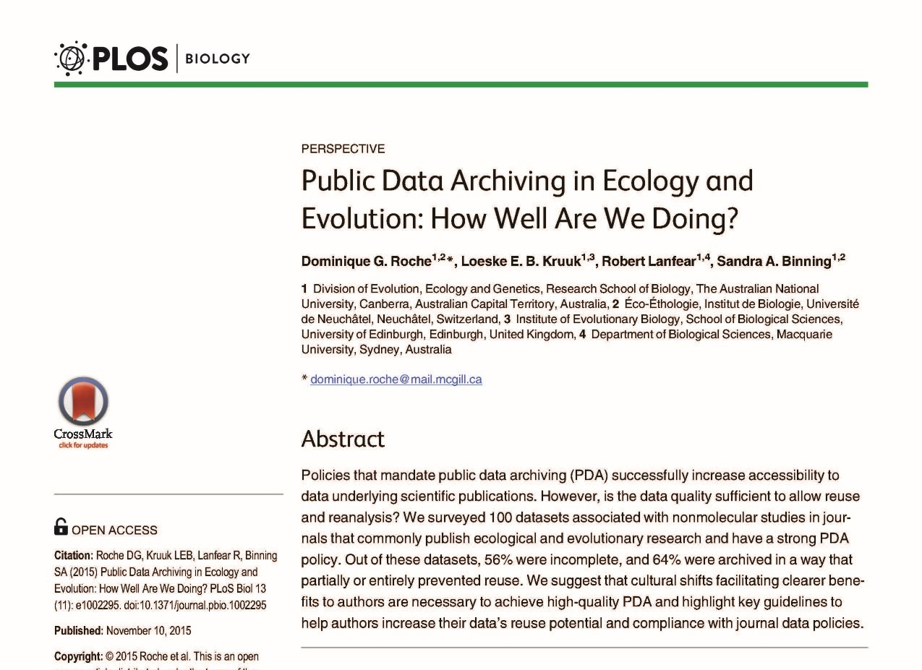
Use and re-use?
DOI: 10.1371/journal.pbio.1002295

Slide 22
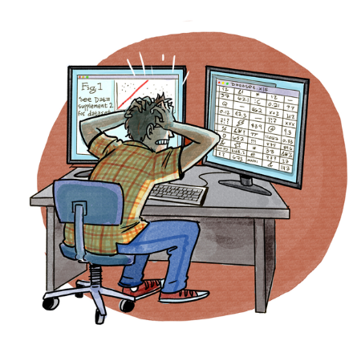

Slide 23
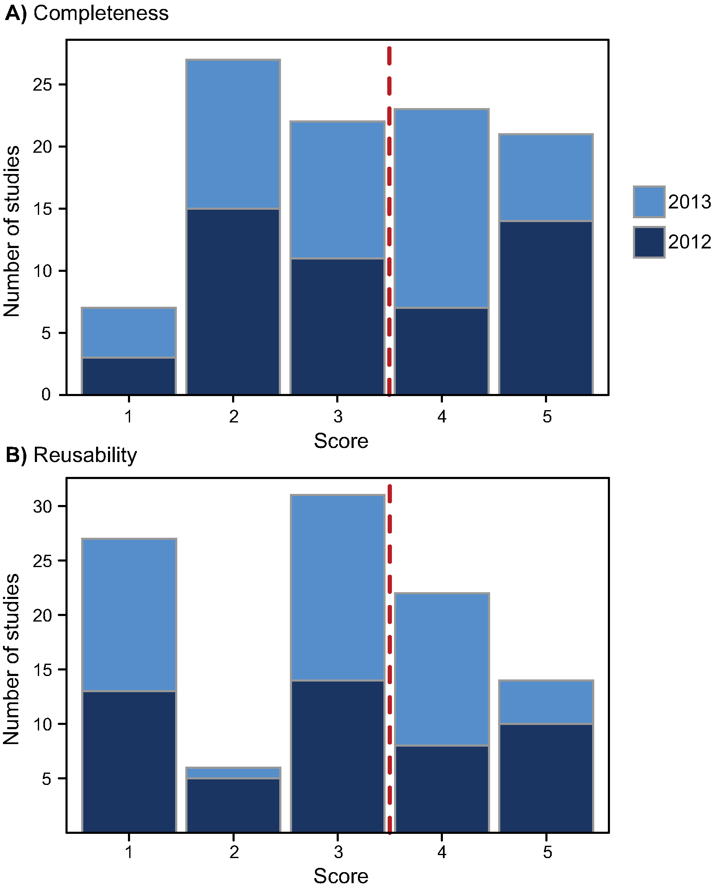
How well are we doing?
100 studies in Ecology and Evolution
Published in 2012/13 with 7 leading journals
Data openly accessible and published in Dryad
56% incomplete
64% were non reusable
Poor Good

Slide 24


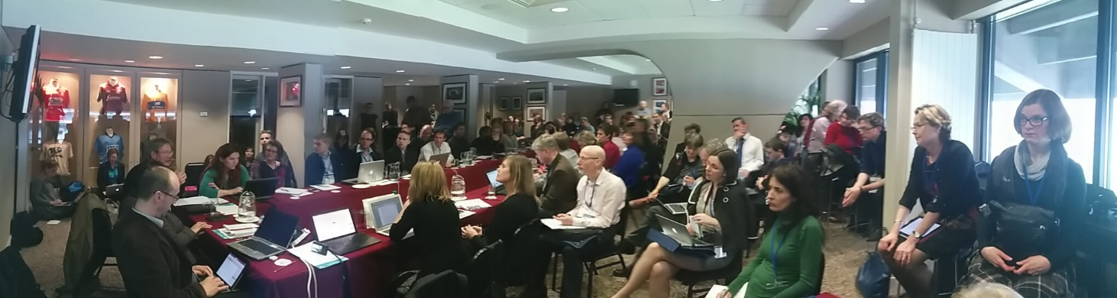
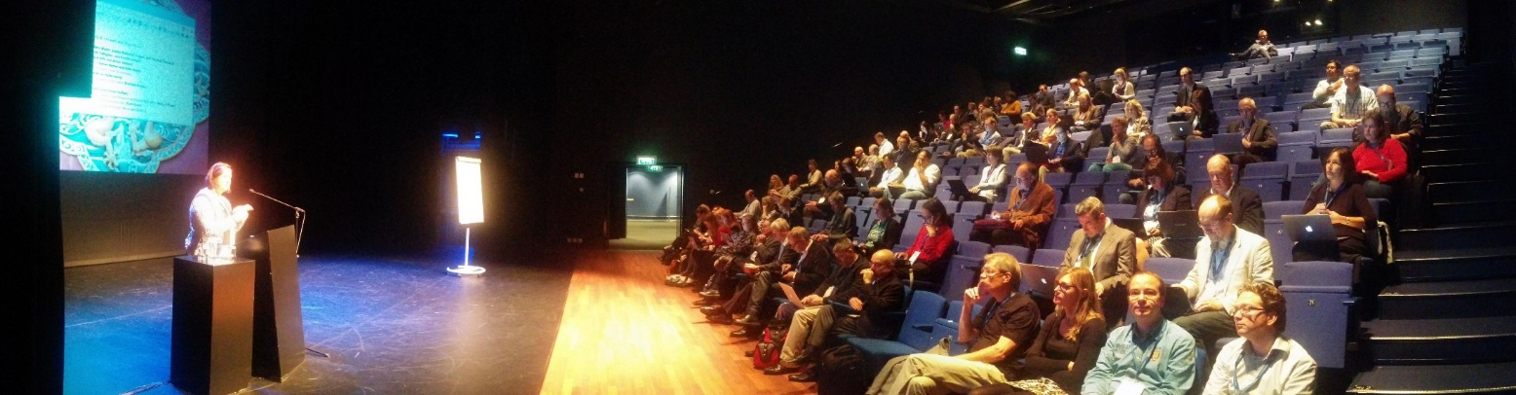
Publishing Data
RDA–WDS Publishing Data Interest Group
RDA 3rd Plenary, Dublin, March 2014
RDA 4th Plenary, Amsterdam, Sep 2014

Slide 25
































Interest Group
Research facilities
Data repositories
Universities
Libraries
Industry

Slide 26
Publishing Data IG
Workflows WG: Provide generic workflow models for data publication
Bibliometrics WG: Approaches & solutions that allow analysis of content & proper citations
Cost recovery for data repositories WG
Services WG: Universal Article–Data cross-referencing service

Slide 27
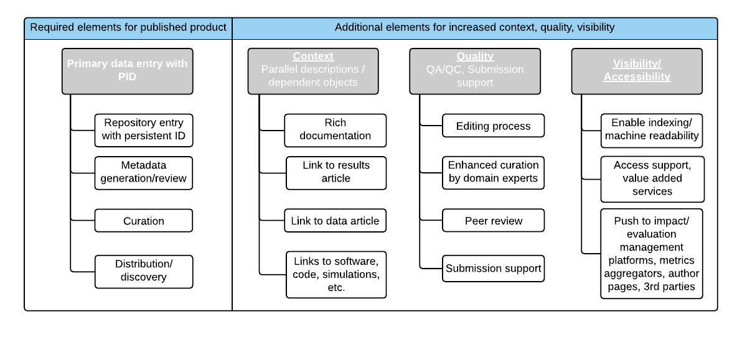
Workflows WG
Data publishing key components

Slide 28
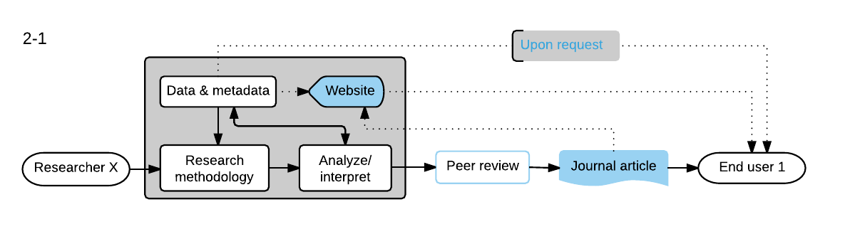

Workflows WG
Traditional article publication workflow

Slide 29
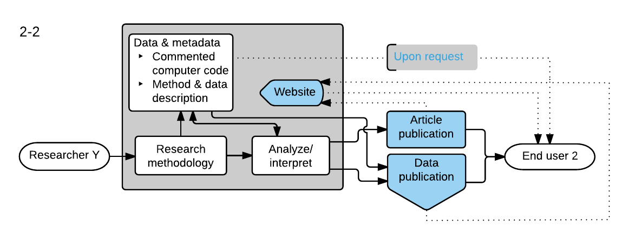
Workflows WG
‘Reproducible’ research workflow

Slide 30
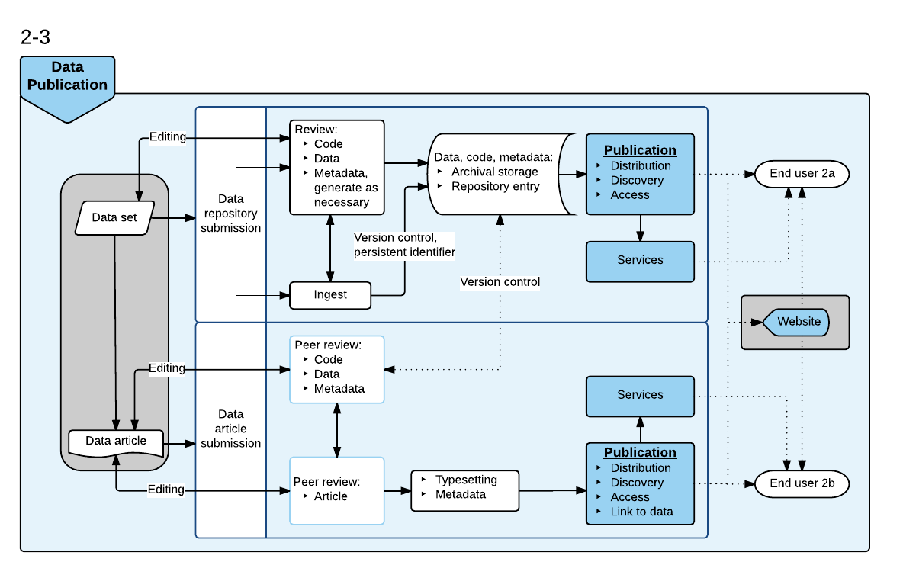
Workflows WG
Data Publication research workflow

Slide 31
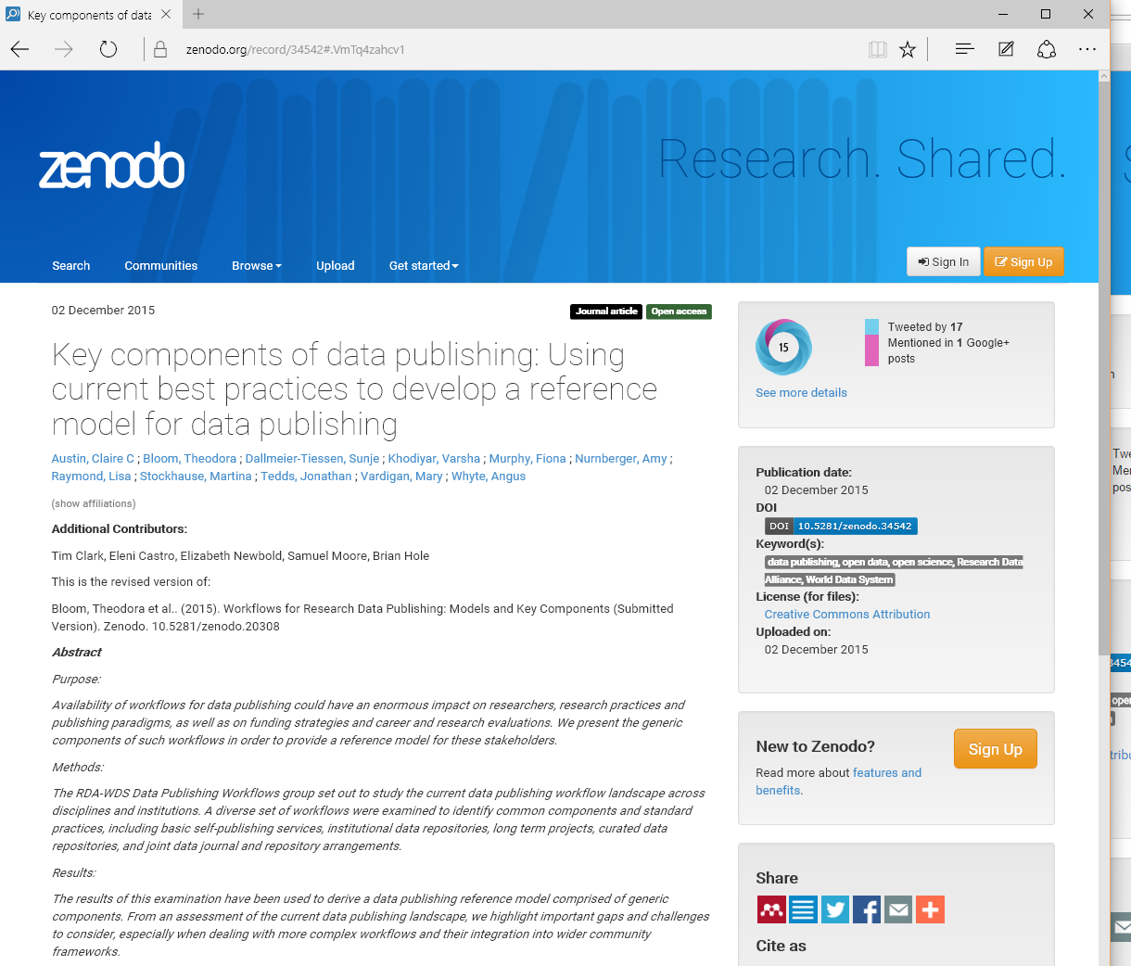
Workflows WG
http://dx.doi.org/10.5281/zenodo.34542

Slide 32
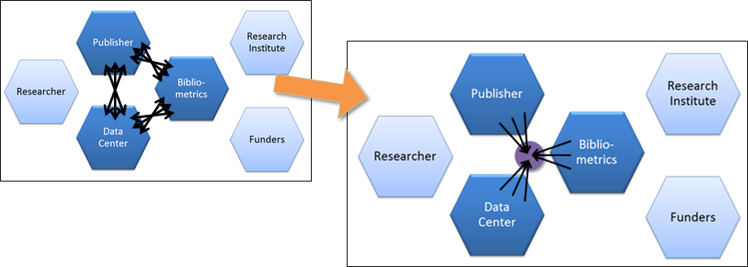
Services WG
How to move from a plethora of (mostly) bilateral arrangements to a universal service model infrastructure for the research data publication landscape?
Increase interoperability
Decrease systemic inefficiencies
Power new tools and functionalities to the benefit of researchers

Slide 33
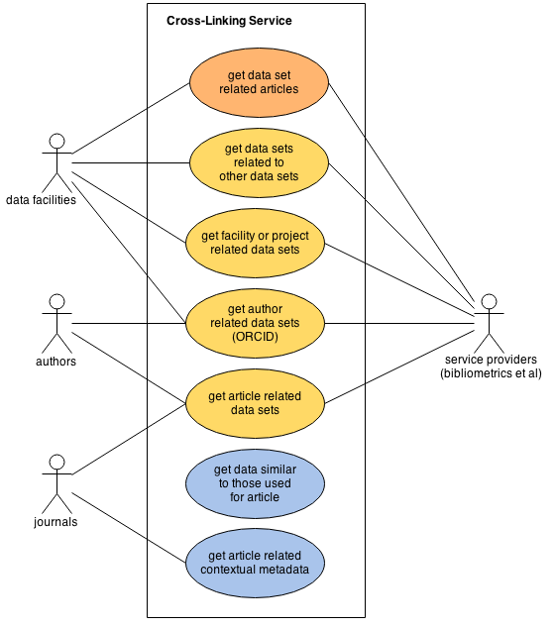
Services WG: User Scenarios

Slide 34
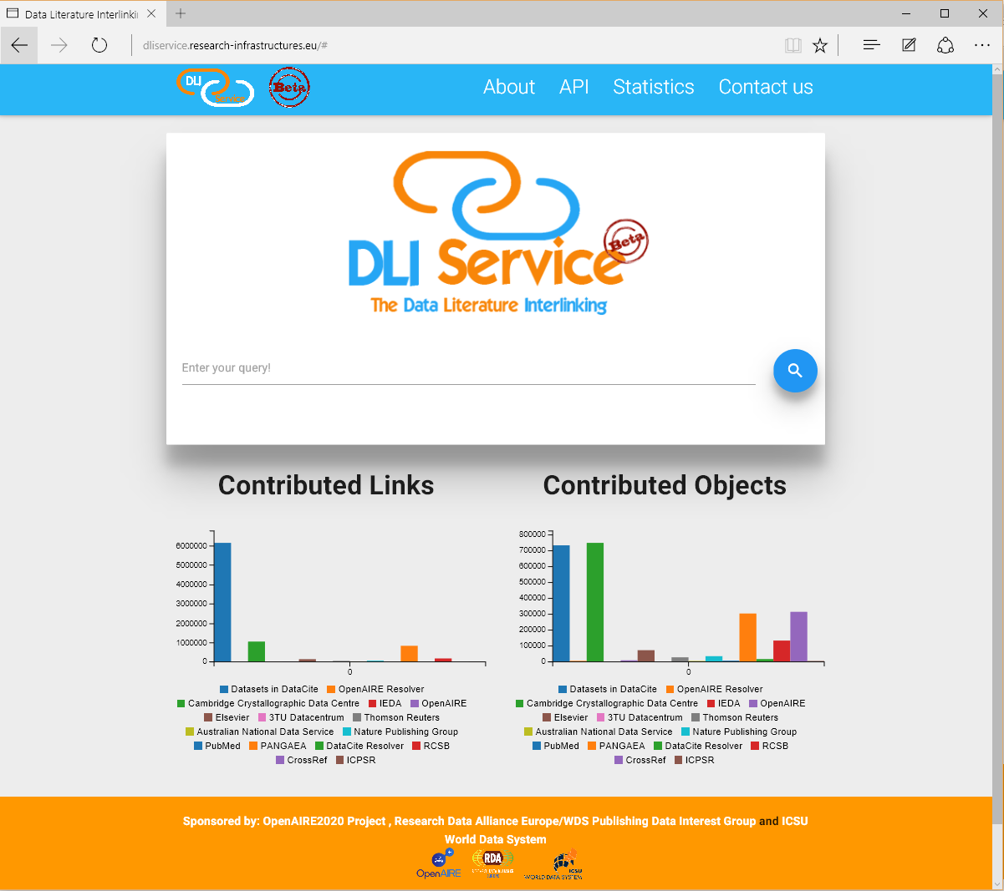
Services WG: DLI Prototype
http://dliservice.research-infrastructures.eu/#/

Slide 35
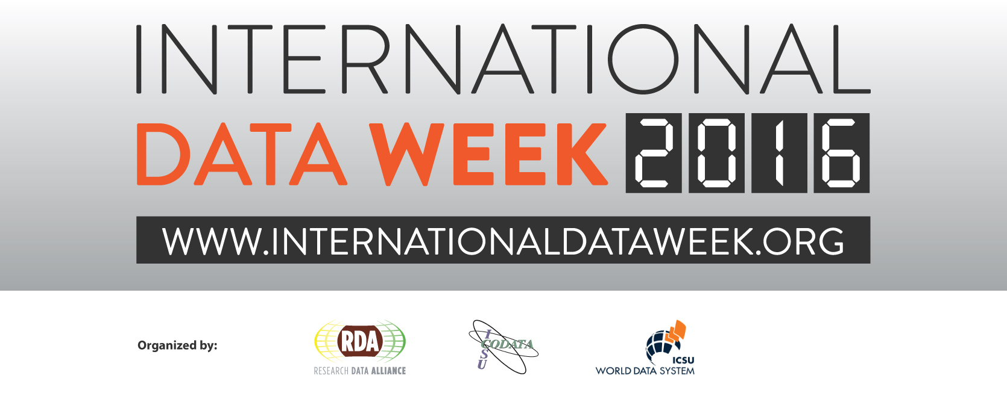
12–16 September 2016, Denver, Colorado, USA
SciDataCon 2016
International Data Forum
RDA 8th Plenary
info@internationaldataweek.org

Slide 36
Thank you!
Photo credits:
ENIAC U.S. Army photo: CC 0 via Wikimedia Commons
GPS Block II-F satellite: CC 0 via Wikimedia Commons
DNA Sequencer by Konrad Förstner: CC 0 via Wikimedia Commons
IBM's Blue Gene/P supercomputer by Argonne National Laboratory : CC BY Flickr
Lenovo Ideapad U8 MID by Corymgrenier: CC BY
Climate model UCAR, image courtesy Gary Strand, NCAR
To deposit or not to deposit by Ainsley Seago: CC BY via PLoS Biol
Tarte Tatin by Wmeinhart: CC BY via Wikimedia Commons
Carrot and stick motivation by Nevit Dilmen CC BY via Wikimedia Commons
WWI Cartoon by Boardman Robinson: CC 0 via Wikimedia Commons
How complete and reusable are PAD in ecology and evolution? By PLOS Biology, CC BY 2015 Roche et al.

