Slide 1
2nd Workshop for Promoting Open Science Data
Data management of earthquake and crustal movement at RCEP, DPRI, Kyoto University
防災研究所附属地震予知研究センターの
地震・地殻変動観測データ
Research Center for Earthquake Prediction,
Disaster Prevention Research Institute,
Kyoto University
Yasuyuki KANO
理学部セミナーハウス
2015年12月8日（火）

Slide 2
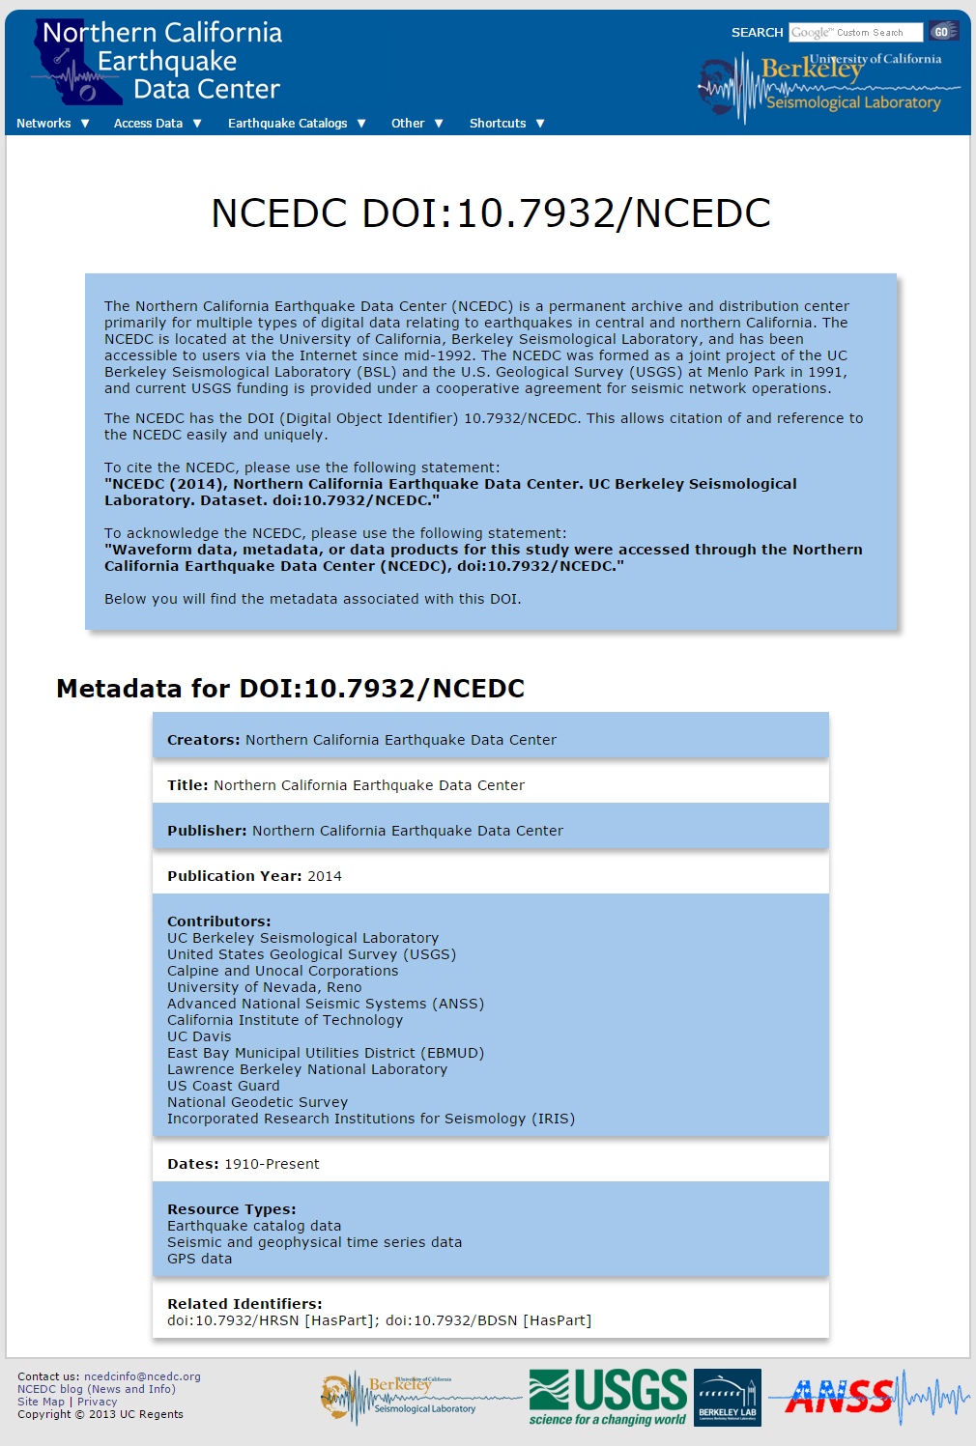
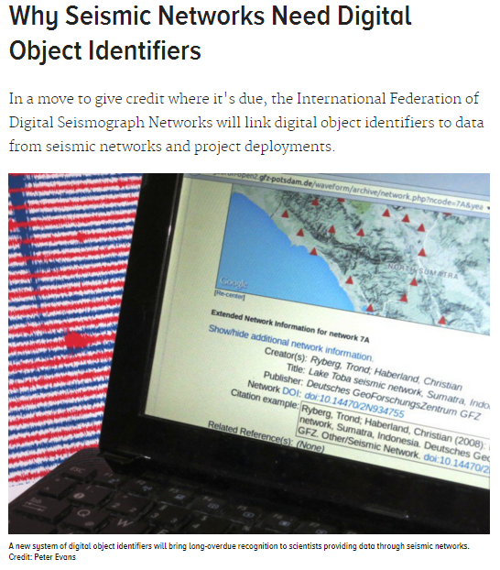
Good and leading examples
Evans, et al. (2015) EOS
doi:10.1029/2015EO036971. P

Slide 3
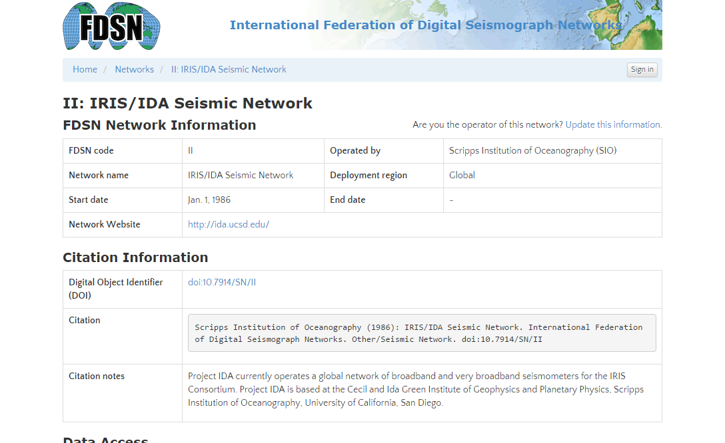
doi:10.7914/SN/II

Slide 4
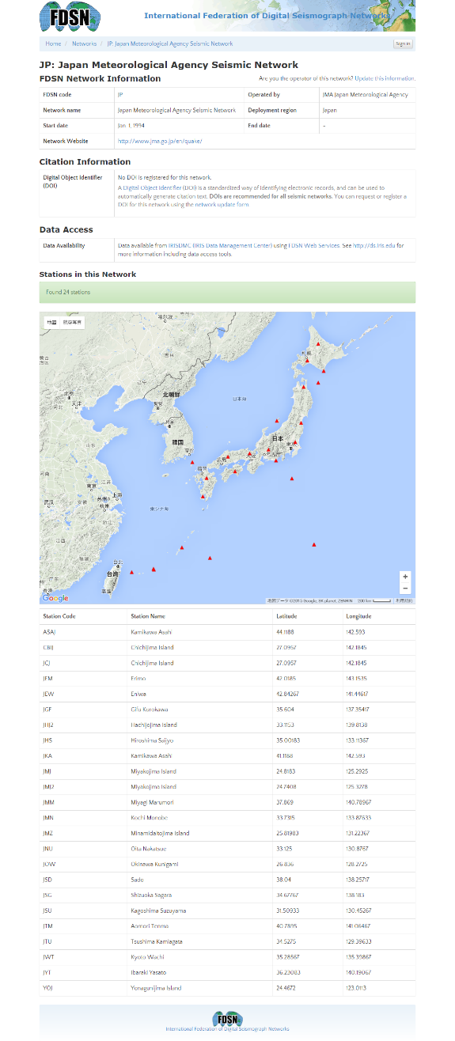
http://www.fdsn.org/networks/detail/JP/
No DOI is registered for this network.

Slide 5
Motivation to attend this WS
Provide data to community and public with less cost and in standard way. Is uploading the data on website enough?
Fit data policy for publication and policy of university
Share research activity with public through open data

Slide 6
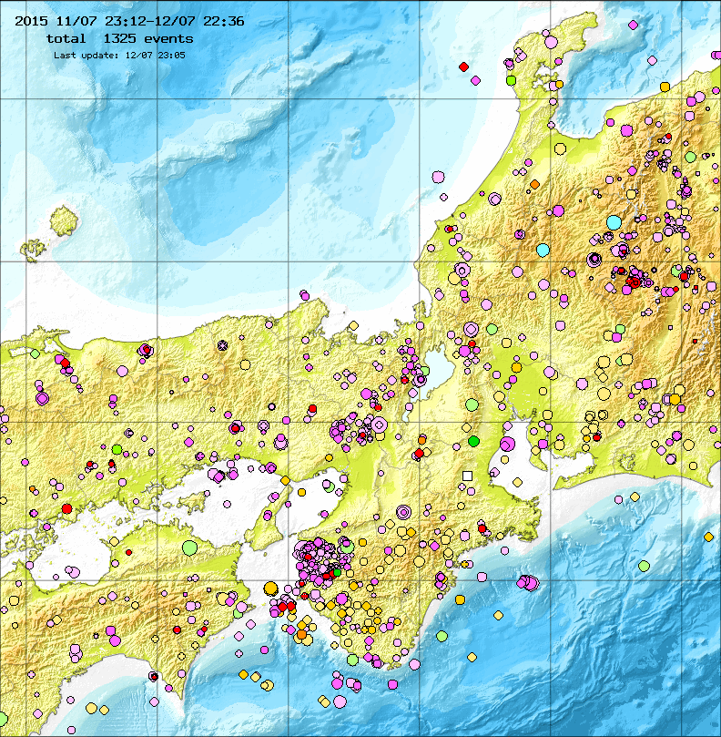
Most popular contents in RCEP is:
http://www.rcep.dpri.kyoto-u.ac.jp/recent/

Slide 7
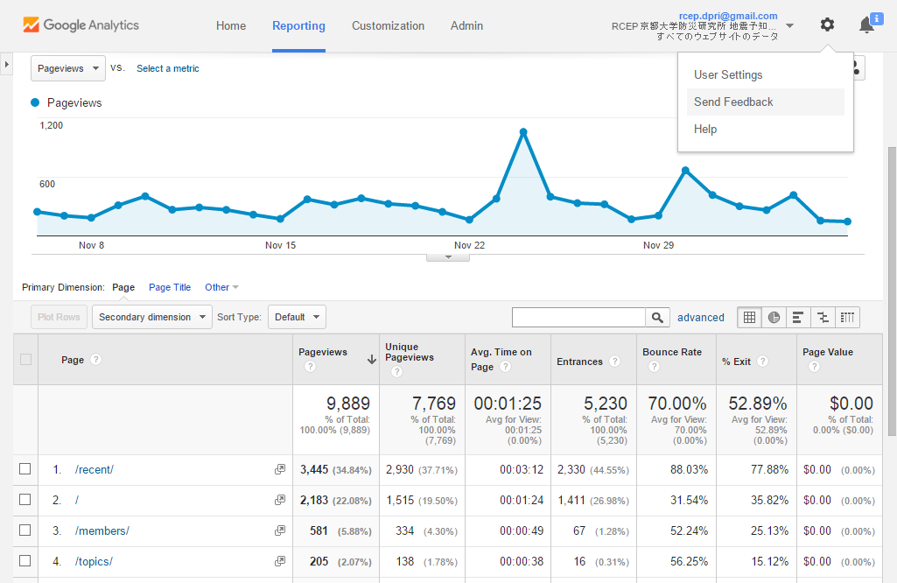
After M3.5 event at S. of Kyoto Pref.
The figure is not updated!
The number of earthquake decreased. Is this a precursor for large events?
Recent
epicenter map

Slide 8
Our Data
Raw data
  Seismic waveform data
  Crustal deformation, etc
Processed data
  Hypocenter catalog, etc
Nation-wide data is already hosted by agencies (JMA, NIED, GSI, etc.)
Old data
Data for historical earthquake

Slide 9
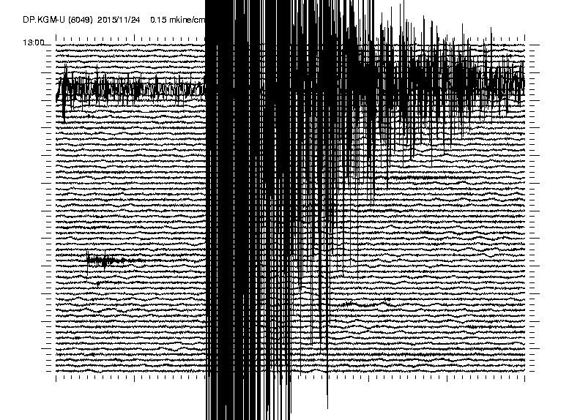
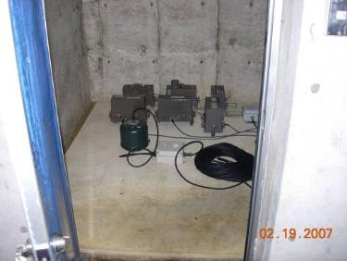
Seismic waveform

Slide 10
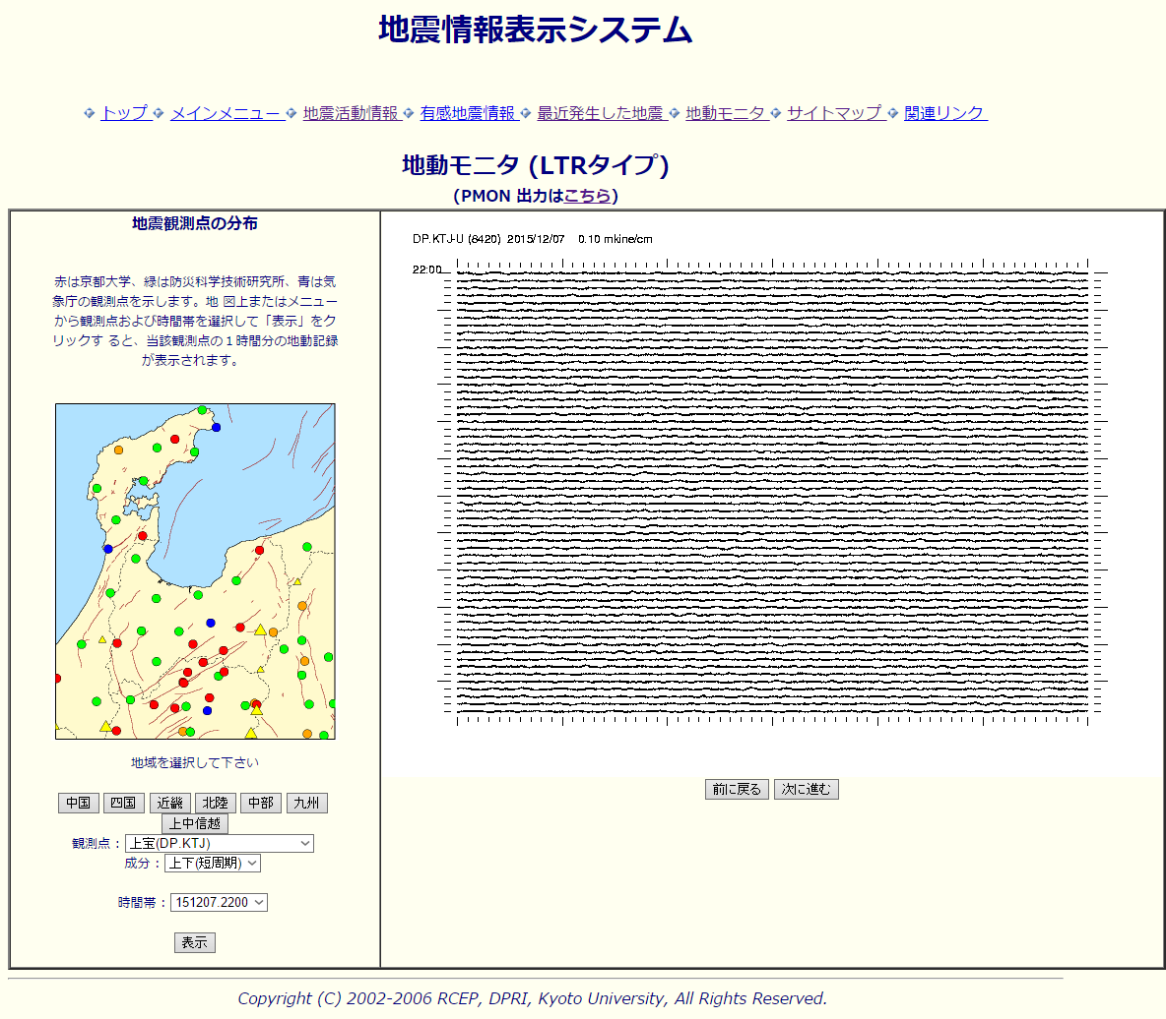
Seismic waveform – Kyoto Univ
RCEP is managing data from 50+ stations
Waveform images may be not so useful

Slide 11
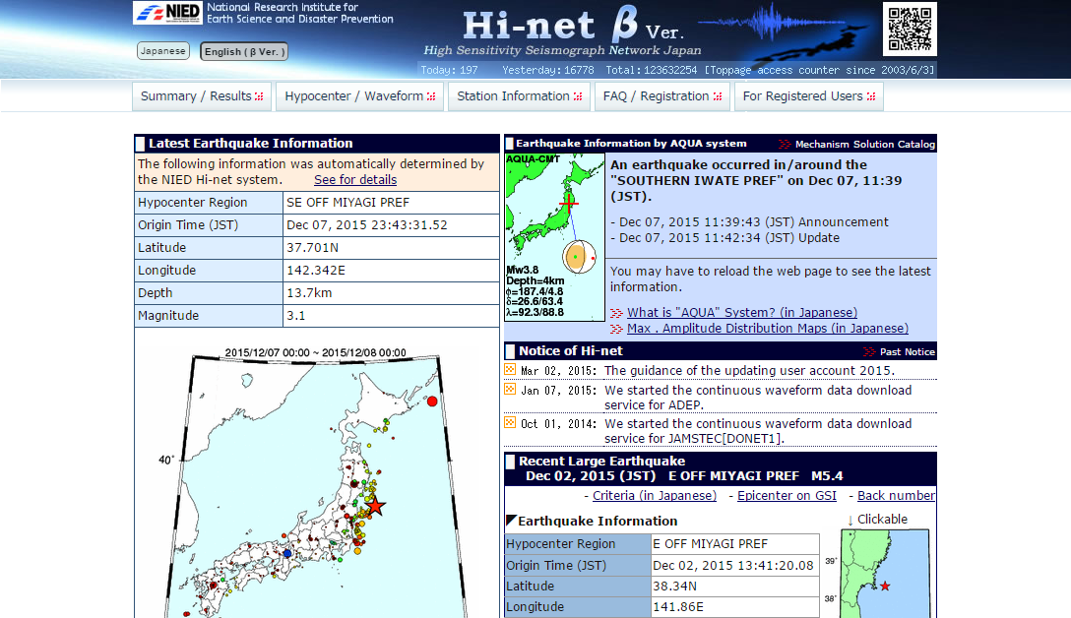
Seismic waveform – NIED
“Phase-D” (Saito-san) drived by the Kobe earthquake.
Hi-net DMC is a data management center defined by law.
http://www.hinet.bosai.go.jp/

Slide 12
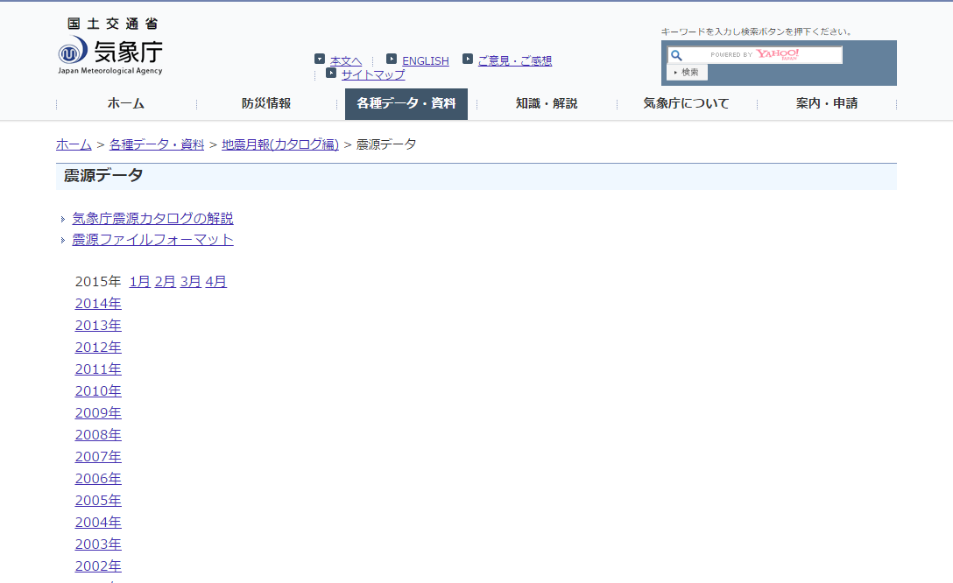
Hypocenter catalogue – JMA
JMA unified hypocenter catalog
http://www.data.jma.go.jp/svd/eqev/data/bulletin/hypo.html

Slide 13
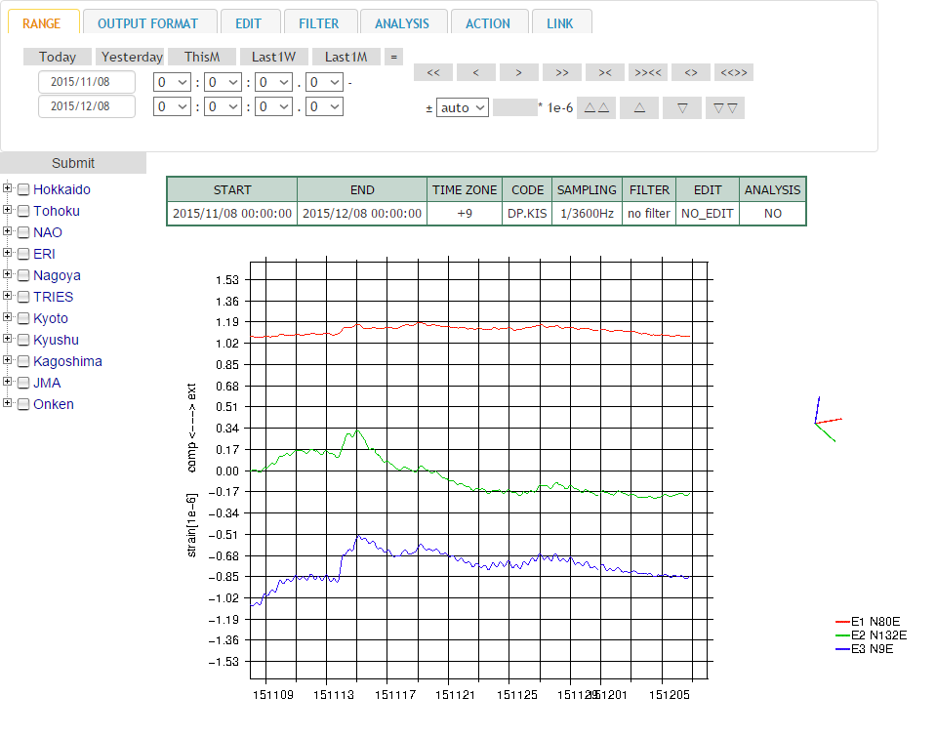
Crustal deformation – Univerities
Data center is launched by
Japanese University Consortium for crustal deformation

Slide 14
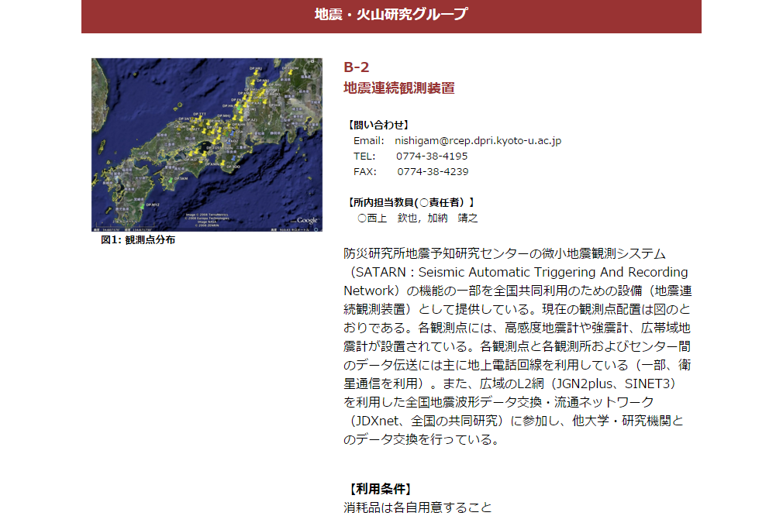
Joint Usage / Collaborative Research
The web cite should be reconstructed to get more proposals ..
Anyway, deadline is January 15, 2015.
http://www.dpri.kyoto-u.ac.jp/collaborative/

Slide 15
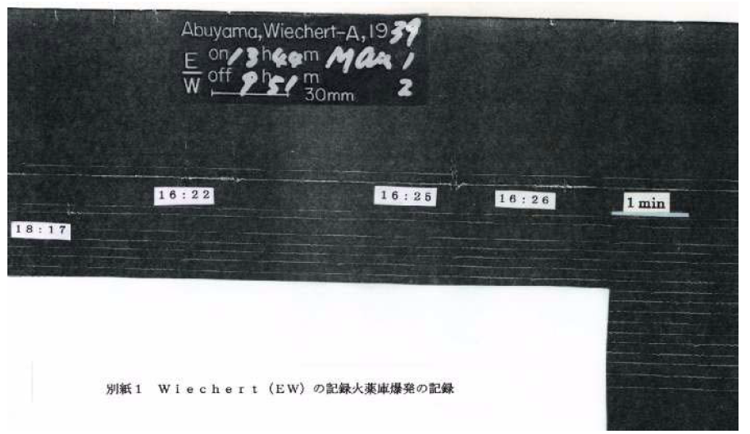
Old data - papers or films
Seismic signals caused by blow up of explosives warehouse observed at Abuyama in March, 1939.
http://dptech.dpri.kyoto-u.ac.jp/tusin/99/no91/info91.html
Almost all the data is digital scanned. How to publish?

Slide 16
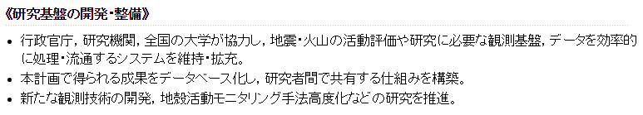
Observation and Research Program for Prediction of Earthquakes (1965-)
Infrastructure development
Produced massive data
(Poor) Data publication
construct database and share between researchers
災害の軽減に貢献するための地震火山観測研究計画の推進について（建議）の概要
http://www.mext.go.jp/b_menu/shingi/gijyutu/gijyutu6/toushin/attach/1341661.htm

Slide 17
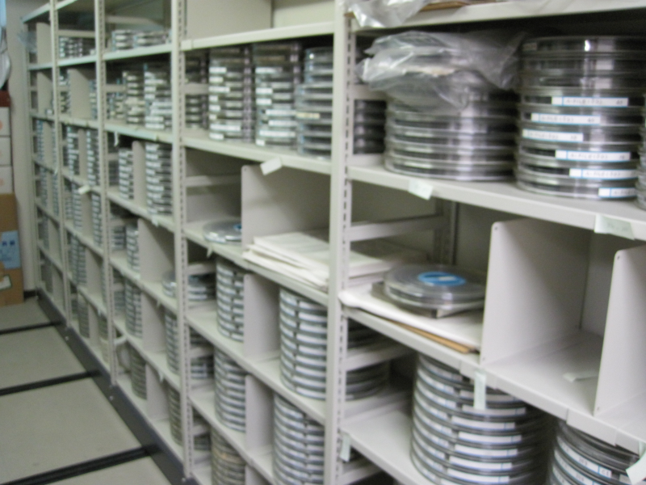
How to make old data open?
“Ultimately, the new practice will give data providers long-overdue credit for their scientific contributions. Such change can only encourage the generation of more high-quality data.” ー Evans et al., 2015, EOS

Slide 18
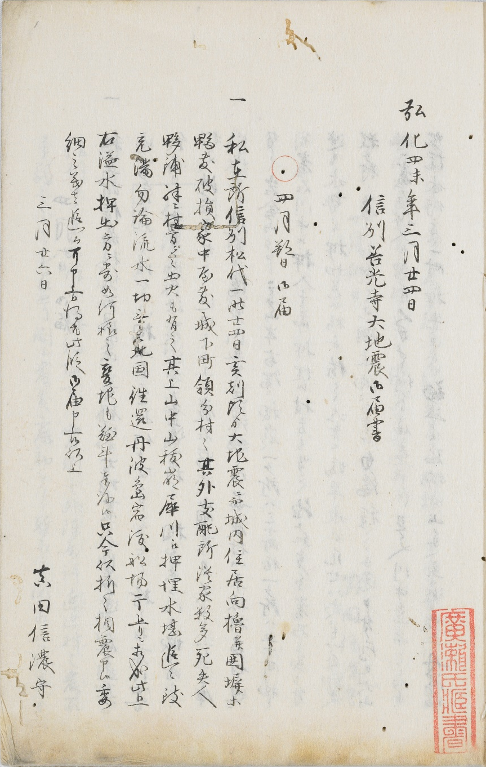
Data for Historical earthquake
弘化四未三月廿四日
信州善光寺大地震御届書
◯四月朔日御届
一 私在所信州松代一昨日廿四日亥刻頃より大地震ニ而・・・
信越震漲録（京都大学大学院理学研究科所蔵）

Slide 19
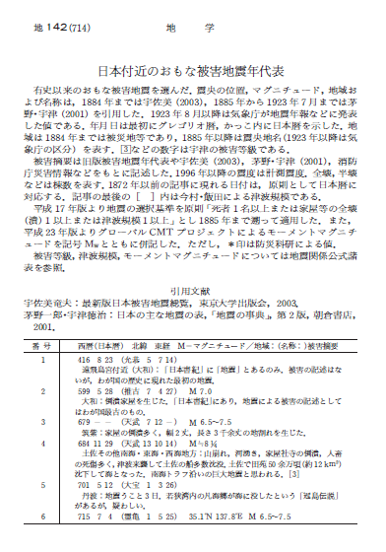
Data for Historical earthquake
Long-term effort to make database
Online database is now developping
Rika Nenpyo

Slide 20
Data for Historical earthquake
Digital archives are developing
  Can be used for research / training for reading
  Way to attract interested people
transcription
  Existing + new “raw data”
  Collaboration with Digital Humanities lab started from transcription party
Possibility to collaborate with citizens
  enormous (1-2M+) historical docs are existing in Japan
  Research + social education
  Easy access to data and good tools are necessary
「みんなで翻刻」

Slide 21
Data management → publication
Nation-wide data
  RCEP is one of data provider
  Need discussion with other data providers
Project-based data
Small, lab-based data
  Let’s start now. Learn how to realize data publication.

Slide 23
http://www.fdsn.org/networks/detail/JP/

Slide 24
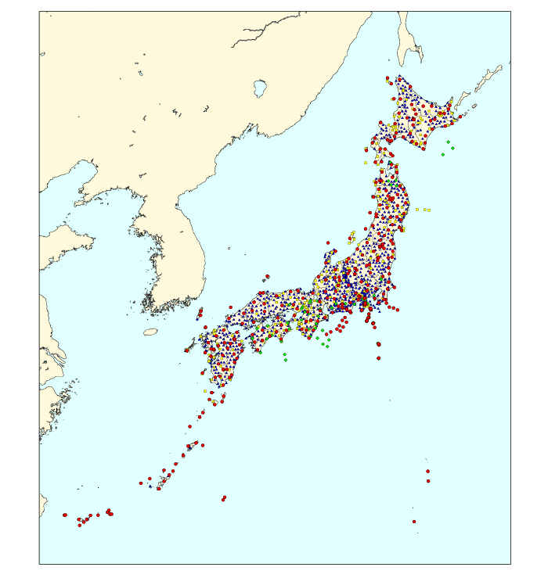
Short-period stations
[JMA]

Slide 25
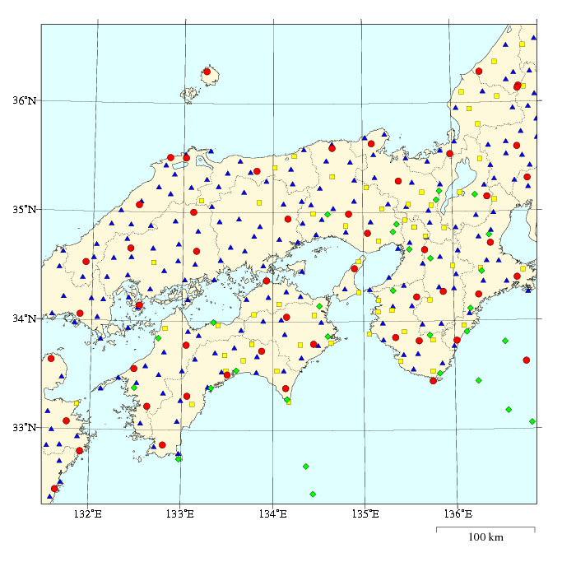
Short-period stations
[JMA]

